Slide 1

values chain initiatives in the new economy

Slide 2
Characteristics of “new economy” value-chain initiatives
They are place based – grounded in and dedicated to having impact on the communities and regions in which they are located
They are building on local assets, resources, knowledge, technical expertise and culture
They create and are part of strategic networks for learning and collaboration, to share strategies and resources because they understand shared prosperity occurs in collaboration, not in competition
The values of their collaborations are environmental and community sustainability, equity, and an expansive understanding of shared prosperity and wealth creation not confined to individual wages or shareholder value or the monetized value of conventional supply chains

Slide 3
Characteristics of “new economy” value-chain initiatives (cont’d)
They are exploring and implementing inclusive structures of membership, ownership, participation and governance
They engage workers/employees, managers/owners and stakeholders who are none of these (community leaders, local governments, educational institutions, policy makers)
They are developing alternatives to conventional community and economic development and recruitment
In place of the assertion that There Is No Alternative (TINA) to the race-to-the-bottom of 21st century capitalism, they are demonstrating that there must be and is an alternative (TMBA)

Slide 4
What kind of community and region and future do we want?
What kind of economy do we have to create in order to have the kind of community and future we want?

Slide 5
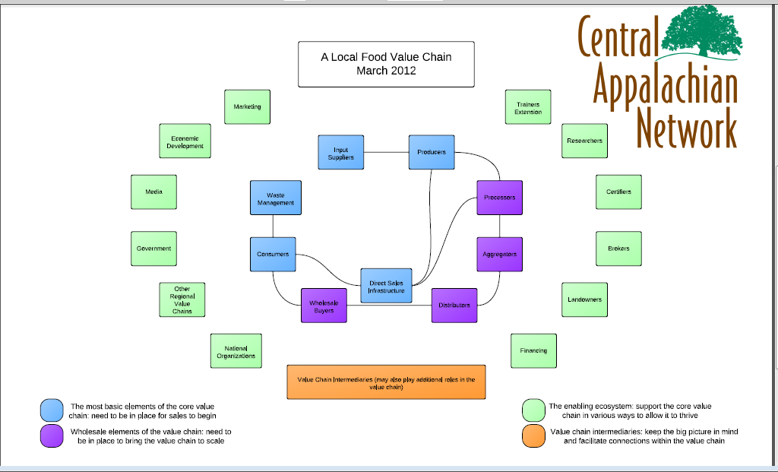

Slide 6
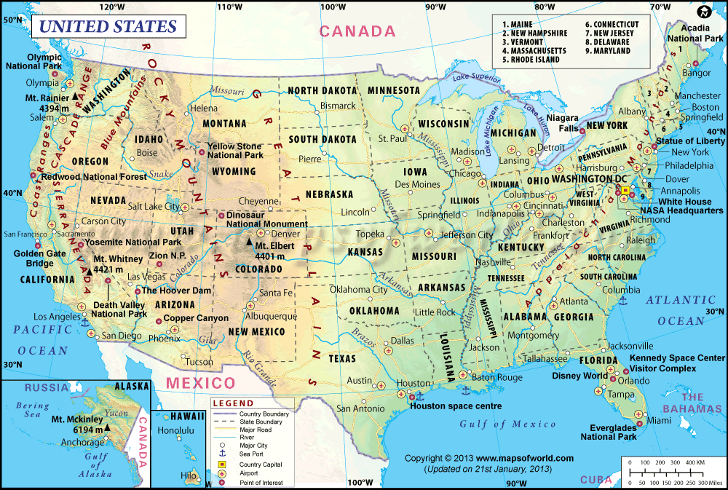

Slide 7
Wealth creation is designed to be
“a systems approach to rural development that can restore, create and maintain wealth in low-wealth rural areas by improving economies, the environment, and social conditions at the same time.”
(from Wealth Creation in Rural Communities: A New Approach by Yellow Wood Associates.)

Slide 8
There are seven forms of wealth included in the wealth creation framework:
Intellectual capital: knowledge, creativity, and innovation
Social capital: trust, relationships, and networks
Individual capital: skills, physical health, and mental health
Natural capital: environmental assets and natural resources
Built capital: infrastructure, like roads, equipment, and tools
Political capital: power or influence that can be used to achieve goals
Financial capital: money and investment

Slide 9
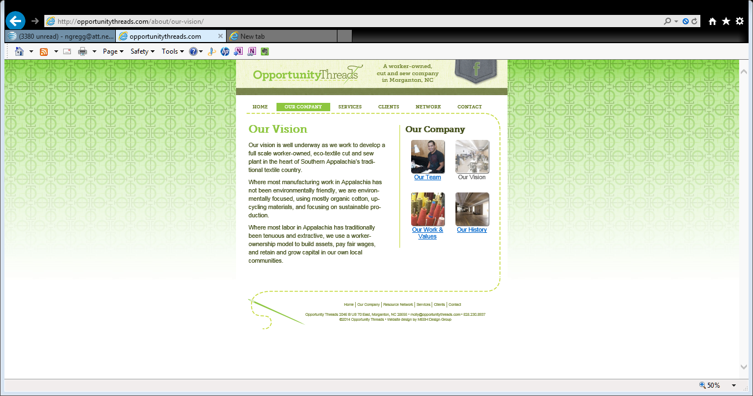

Slide 10
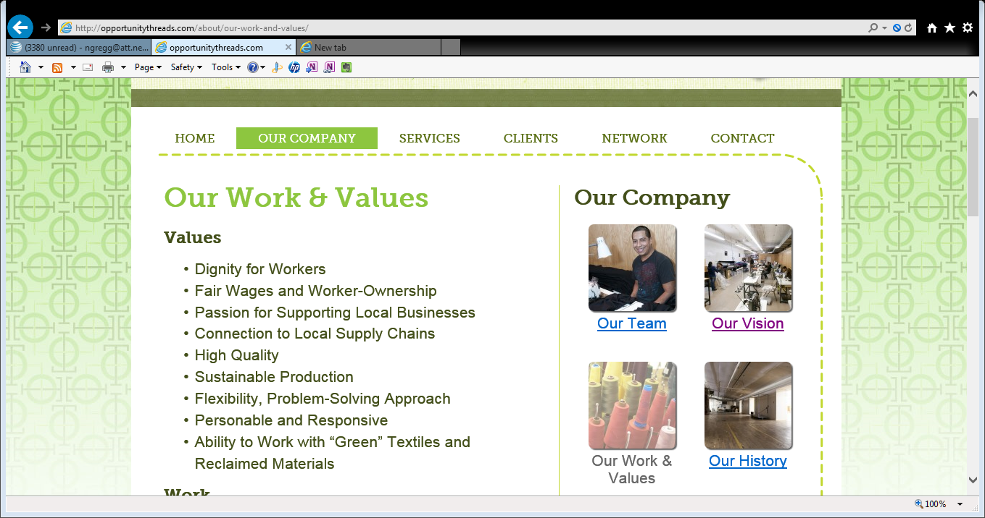

Slide 11
This model of worker-ownership has the poten­tial to change the lives of many work­ers, both native and immi­grant, in our region as they build assets and hone skills.
The empha­sis on “green prod­ucts and pro­duc­tion” looks to reverse the trend of anti-environmental man­u­fac­tur­ing and worker mar­gin­al­iza­tion that has plagued Appalachia.
http://opportunitythreads.com/about/our-work-and-values/
accessed Sept 13 2014

Slide 12
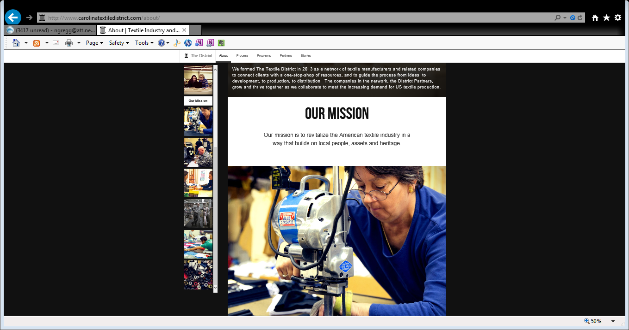

Slide 13
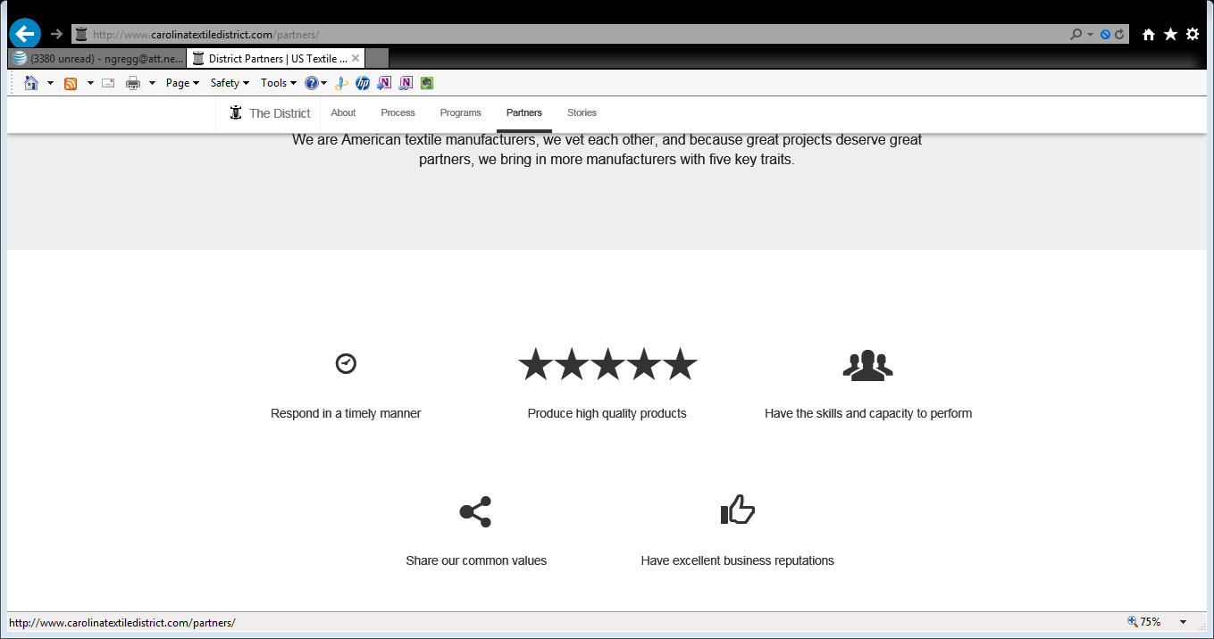

Slide 14
Folks are starting to see that it doesn’t make sense to compete with the people in your community anymore. Rather, for the Carolina Textile District, what makes sense is finding a way to band together, lift up one another’s work and grow the region as an investment in local livelihood.
http://www.carolinatextiledistrict.com/stories/rebuilding-textiles-through-cooperation/ accessed Sept 13 2014

Slide 15
Ensuring sustainable communities is the origin of these collaborations.
The economic initiatives were designed as a means to fulfill that larger purpose.
The means – the process of achieving the shared purpose – is as important as the ends – the outcome of the collaborations.

Slide 16
Lessons to bring forward for STS inter-organization design
1. POLICY CONSTRAINTS
a. Need legitimation of different and innovative organizational structures. Existing structures may not be appropriate for the social system you are trying to create:
  CTD is currently LLC, but wants to be organized more like a co-op – there is no legally recognized structure for this so exploring different leadership models. This is one of the tasks for the collaboration – determine together how to govern and design a structure consistent with values.
b. Workers compensation rate system is based on employees, not owners.
2. ACCESS TO CAPITAL AND WHAT CAPITAL IS USED FOR
a. How is the work of the collaboration resourced?
  Often these initiatives can’t get conventional loans. “We don’t have bad credit, we have no credit.” Models are unfamiliar, lenders don’t understand them. [Resources available in credit unions and other financial institutions but currently not being directed to this kind of enterprise.]
b. What gets resourced?
  Resources not sufficient for maintaining the social system – to be robust, Rural Action’s governance needs staff person to mobilize member engagement
VALUES AS DRIVER OF COLLABORATION
  Who maintains the collaboration’s alignment with core values, and is this role respected?
  All these collaborations have leaders for whom social and economic justice is a core value.

