Slide 1
Toward a Global Manufacturing Renaissance Alliance

Slide 2
CMRC Structure and Programs
Business
Labor
Government
Communities
Top leaders: business, labor, government, communities
Programs in:
Secondary and post-secondary education
Public sector initiatives in business services—Manufacturing Works
Innovation—the Austin Manufacturing Innovation Park

Slide 3
The Chicago MRC’s Four Guiding Principles
Chicago must be the global leader in advanced manufacturing.
Our competitive advantage is a strategic partnership of business, labor, government, education, and community.
A world-class educational system is a fundamental requirement for a strong advanced manufacturing sector.
A strong advanced manufacturing sector builds communities and a broad middle class, and can drastically reduce poverty.

Slide 4
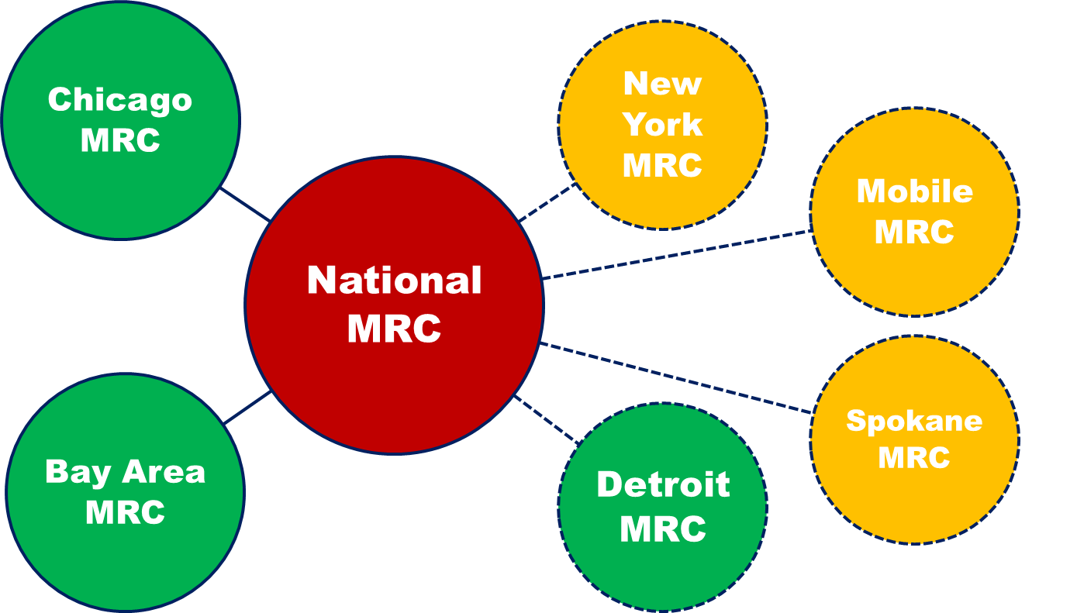
National Manufacturing Renaissance Council
American Federation of Labor (AFL-CIO)
National Urban League
Manufacturing Institute
Society for Manufacturing Engineers
National Institute for Metalworking Skills
California Teachers’ Association
Pittsburgh MRC

Slide 5
CMRC Structure and Programs
Business
Labor
Government
Communities
Top leaders: business, labor, government, communities
Programs in:
Secondary and post-secondary education
Public sector initiatives in business services—Manufacturing Works
Innovation—the Austin Manufacturing Innovation Park

Slide 6
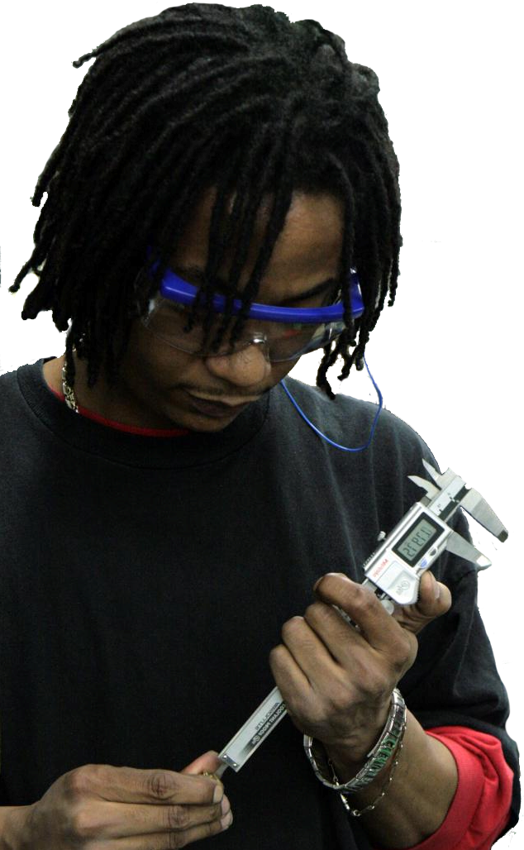
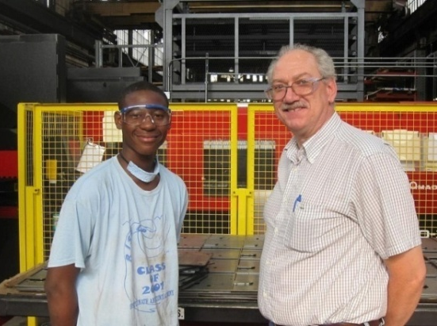
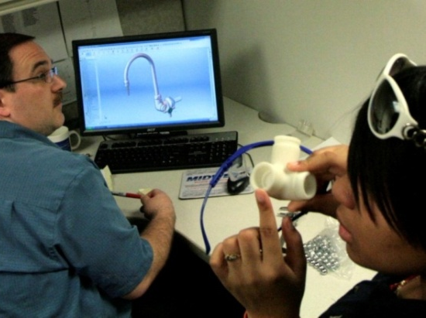
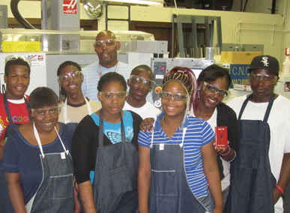
Advanced Manufacturing, Innovative Partnerships, Advanced Communities
Manufacturing Renaissance Model
Oct. 2013

Slide 7
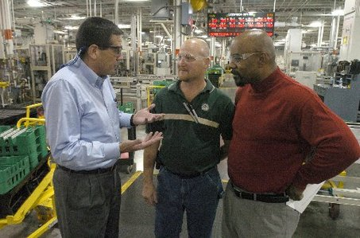
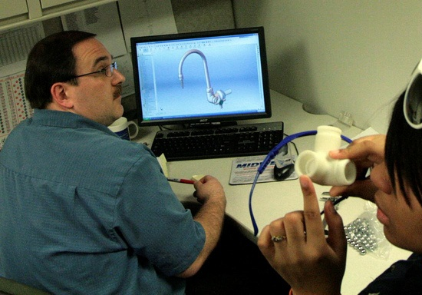
Manufacturing Career Paths
Chief Executive
$167,280/year
College
Management
$93,650/year
Skilled Production
$38,940/year
Engineering
$80,580/year
Source: U.S. Bureau of Labor Statistics
Notes:
Another key distinction we make in our program is that our students are not only aspiring to become machinists and engineers, but that career paths in manufacturing also include management and ownership positions. Our career program is designed so that students have exposure to the full breadth careers in all aspects of manufacturing.

Slide 8
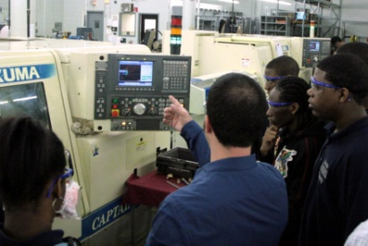
APA Career Program
Over 60 manufacturing company
partners
Work experience opportunities
Plant tours
Industry credentials
Job shadowing
Internships and summer jobs
Career-track jobs
Alumni Association/connections

Slide 9
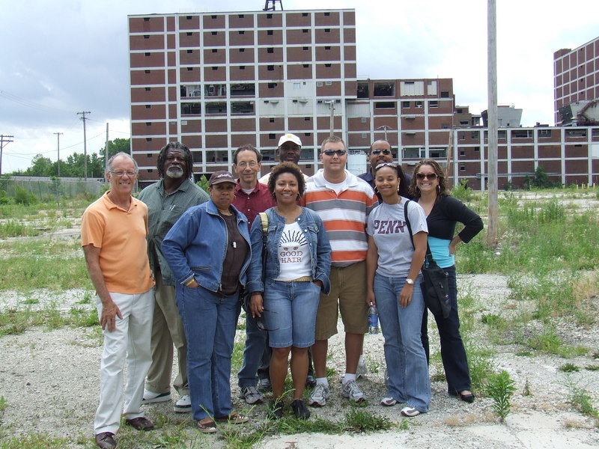

Slide 10
The Chicago MRC’s Four Guiding Principles
Chicago must be the global leader in advanced manufacturing.
Our competitive advantage is a strategic partnership of business, labor, government, education, and community.
A world-class educational system is a fundamental requirement for a strong advanced manufacturing sector.
A strong advanced manufacturing sector builds communities and a broad middle class, and can drastically reduce poverty.

Slide 11
In Conclusion
What We Know
Moving Forward
Demise of U.S. Manufacturing was Avoidable
Manufacturing Renaissance is a Practical Model
Shared realities
Social exclusion
Unemployment
Political polarization
Advanced Manufacturing fused with Social Inclusion is Key
Timing is Critical
Joint creation of the Global Manufacturing Renaissance Alliance

