Slide 1
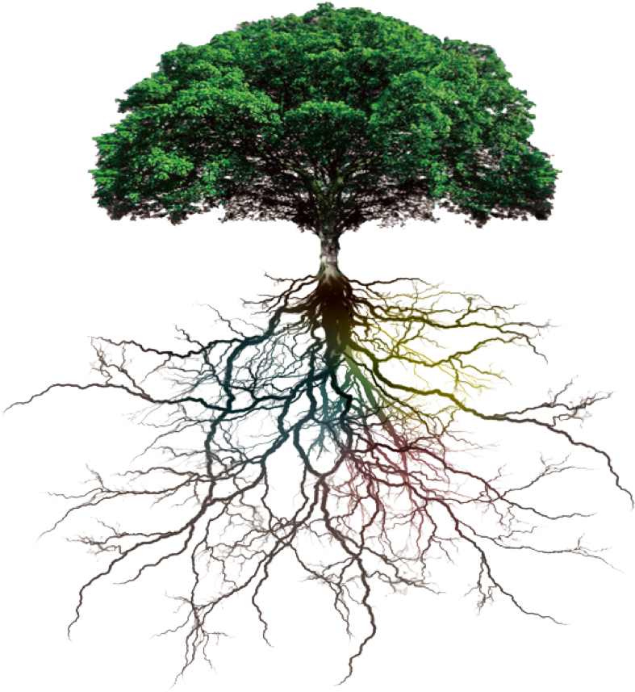
Renewal of A Conceptual Foundation for SmarT Organization Design
Carolyn Ordowich & Bert Painter
Los Angeles, 10-13 September 2019

Slide 2
To enrich our Socio-Technical Systems Design heritage, with new ideas, frameworks, or practices for SmarT Organization Design in a digital world…
To grow our Global Network by connecting with a wider ‘universe’ of others who believe “humanism and effectiveness can and must be linked together in the design of work and work systems”

Slide 3
May ‘19: ‘crowdsourcing’ process webinar was held.
Sept.’19: during our conference, we apply our learning from innovative cases to further renewal our STSD heritage.
In 2020: we will lead an asynchronous journey within a social media platform (such as SLACK) to exchange ideas with others outside of our immediate community who can help us continue the development of SmarT Organization Design for a digital world.
www.smartorganizationdesign.com
Notes:
Make a mention:
Where are you from?
What is your occupation
Years of experience
Numbers of time at RT (global event): 1, 2-5, 6-10, 10-15, more then 15
What do you hope to get from this meeting?

Slide 4
Recalling The Development of our “Heritage”
1949-1971 Tavistock theory and practice focused on a "basic shift in organizational paradigm" that was contrary to the emphasis in previous paradigms (Scientific Management: Taylor, 1911; Human Relations: Mayo, 1933) which focused on either the technical or the social aspects of an organization. In the Tavistock approach, both factors were “integrated as…components of one single socio-technical entity” (Van Eijnatten, 1993).
Recalling the Development of our STS “Heritage”
Post 1971 “Modern” Socio-Technical Systems Design (STSD) evolved with “amendments” and different development trajectories (in Australia, the Netherlands, Sweden, and North America). Languages and concepts differ in these various “schools” of STS Design. Yet, all of these approaches are still “rooted in the Tavistock tradition” with a focus on achieving organizational excellence in both technical performance and the quality of people’s lives

Slide 5
STS
Conceptual
Foundation
Socio-
Ecological
Perspective
Socio-Psychological
Perspective
Integral System
Participative Design Process
Socio- Technical Systems Perspective
Our Heritage of
‘Whole/Integral System’
Organization Design
Notes:
The methodology of the Tavistock origins of the STS Conceptual Foundation was ACTION RESEARCH… As well as tacitly embedding direct participation as a key feature of the Socio-Technical Systems Design (STSD) paradigm, Tavistock’s action research evolved through three distinct “perspectives” or ways of knowing and “engaging” with the world. These 3 perspectives—socio-psychological perspective, socio-technical systems perspective, and socio-ecological perspective—were elaborated continuously thru the ‘classical’ and up to and during the ‘modern’ period of STSD. AND they are all linked and related to comprehensive organization design

Slide 6
(1 of 2)
Perspective as lenses in film-making: 3 different lenses offer 3 different images of the same scene
Different lenses communicate on depth, positioning and space differently
Notes:
These Perspectives are like the different LENSES of filmmaking…Each LENS (or each Perspective) captures different images (or Information) of the same scene. In very basic filmmaking terms, for example, there is a NORMAL Lens (with a focal length of 50mm or so) that is similar to what the human eye sees. Then, there are SHORTER, WIDE-ANGLE Lenses that communicate more of the surrounding environment and accentuate the depth and distance between objects. At the same time, a filmmaker has access to LONGER, TELEPHOTO Lenses that make objects appear closer together and heighten awareness of the relationships between objects while excluding much of the surrounding environment.

Slide 7
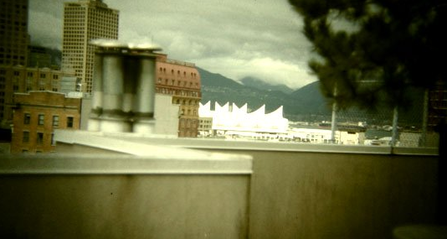
NORMAL LENS (50mm)
Notes:
These Perspectives are like the different LENSES of filmmaking…Each LENS (or each Perspective) captures different images (or Information) of the same scene. In very basic filmmaking terms, for example, there is a NORMAL Lens (with a focal length of 50mm or so) that is similar to what the human eye sees. Then, there are SHORTER, WIDE-ANGLE Lenses that communicate more of the surrounding environment and accentuate the depth and distance between objects. At the same time, a filmmaker has access to LONGER, TELEPHOTO Lenses that make objects appear closer together and heighten awareness of the relationships between objects while excluding much of the surrounding environment.

Slide 8
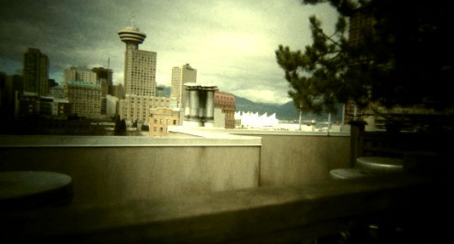
WIDE-ANGLE LENS (24mm)
Notes:
These Perspectives are like the different LENSES of filmmaking…Each LENS (or each Perspective) captures different images (or Information) of the same scene. In very basic filmmaking terms, for example, there is a NORMAL Lens (with a focal length of 50mm or so) that is similar to what the human eye sees. Then, there are SHORTER, WIDE-ANGLE Lenses that communicate more of the surrounding environment and accentuate the depth and distance between objects. At the same time, a filmmaker has access to LONGER, TELEPHOTO Lenses that make objects appear closer together and heighten awareness of the relationships between objects while excluding much of the surrounding environment.

Slide 9
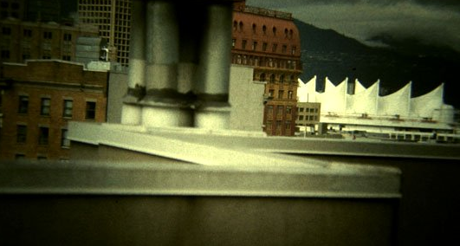
TELE-PHOTO LENS (100mm)
Notes:
These Perspectives are like the different LENSES of filmmaking…Each LENS (or each Perspective) captures different images (or Information) of the same scene. In very basic filmmaking terms, for example, there is a NORMAL Lens (with a focal length of 50mm or so) that is similar to what the human eye sees. Then, there are SHORTER, WIDE-ANGLE Lenses that communicate more of the surrounding environment and accentuate the depth and distance between objects. At the same time, a filmmaker has access to LONGER, TELEPHOTO Lenses that make objects appear closer together and heighten awareness of the relationships between objects while excluding much of the surrounding environment.

Slide 10
WIDE-ANGLE LENS
(24mm)
TELE-PHOTO LENS
(100mm)
NORMAL LENS (50mm)
Notes:
These Perspectives are like the different LENSES of filmmaking…Each LENS (or each Perspective) captures different images (or Information) of the same scene. In very basic filmmaking terms, for example, there is a NORMAL Lens (with a focal length of 50mm or so) that is similar to what the human eye sees. Then, there are SHORTER, WIDE-ANGLE Lenses that communicate more of the surrounding environment and accentuate the depth and distance between objects. At the same time, a filmmaker has access to LONGER, TELEPHOTO Lenses that make objects appear closer together and heighten awareness of the relationships between objects while excluding much of the surrounding environment.

Slide 11
(2 of 2)
Making movies – the ‘narrative’ lens plot – by Sidney Lumet:
How to make sure that your images all serve your story as a whole?
Example:
‘12 angry men’— entire story (of entrapment) takes place in a jury room
Notes:
These Perspectives are like the different LENSES of filmmaking…Each LENS (or each Perspective) captures different images (or Information) of the same scene. In very basic filmmaking terms, for example, there is a NORMAL Lens (with a focal length of 50mm or so) that is similar to what the human eye sees. Then, there are SHORTER, WIDE-ANGLE Lenses that communicate more of the surrounding environment and accentuate the depth and distance between objects. At the same time, a filmmaker has access to LONGER, TELEPHOTO Lenses that make objects appear closer together and heighten awareness of the relationships between objects while excluding much of the surrounding environment.

Slide 12
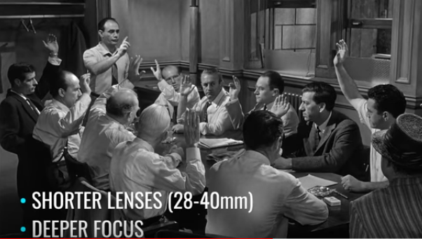
Notes:
Most creative filmmaking requires a MIX of different Lenses to tell a coherent STORY. This is what the great film director, Sidney Lumet called “The Narrative Lens Plot”—How to make sure that your Images All SERVE your STORY as an integral WHOLE. We can illustrate this effect with 3 scenes from Lumet’s film, 12 ANGRY MEN—a film story that takes place entirely in a jury room, and where Lumet wanted to create a growing sense of ENTRAPMENT. Thus, in the early scenes of the film, Lumet used a NORMAL Lens, but as the story progresses, he used LONGER Lenses—the background appears to come closer, until in the closing scenes, the walls close in on each person and the room seems to get smaller and smaller. Lumet used this mix of Lenses VERY ARTFULLY to tell his story of people becoming entrapped by the challenge of making a decision about the life or death of another human being.

Slide 13
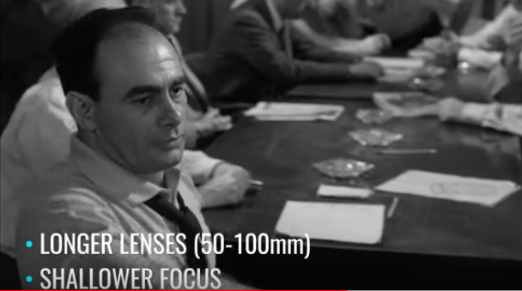
Notes:
Most creative filmmaking requires a MIX of different Lenses to tell a coherent STORY. This is what the great film director, Sidney Lumet called “The Narrative Lens Plot”—How to make sure that your Images All SERVE your STORY as an integral WHOLE. We can illustrate this effect with 3 scenes from Lumet’s film, 12 ANGRY MEN—a film story that takes place entirely in a jury room, and where Lumet wanted to create a growing sense of ENTRAPMENT. Thus, in the early scenes of the film, Lumet used a NORMAL Lens, but as the story progresses, he used LONGER Lenses—the background appears to come closer, until in the closing scenes, the walls close in on each person and the room seems to get smaller and smaller. Lumet used this mix of Lenses VERY ARTFULLY to tell his story of people becoming entrapped by the challenge of making a decision about the life or death of another human being.

Slide 14
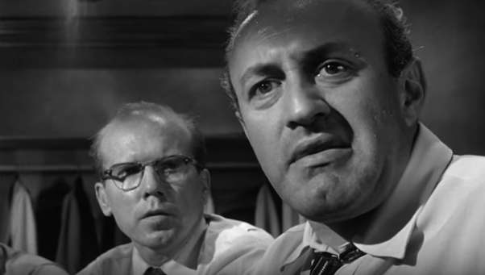
Notes:
Most creative filmmaking requires a MIX of different Lenses to tell a coherent STORY. This is what the great film director, Sidney Lumet called “The Narrative Lens Plot”—How to make sure that your Images All SERVE your STORY as an integral WHOLE. We can illustrate this effect with 3 scenes from Lumet’s film, 12 ANGRY MEN—a film story that takes place entirely in a jury room, and where Lumet wanted to create a growing sense of ENTRAPMENT. Thus, in the early scenes of the film, Lumet used a NORMAL Lens, but as the story progresses, he used LONGER Lenses—the background appears to come closer, until in the closing scenes, the walls close in on each person and the room seems to get smaller and smaller. Lumet used this mix of Lenses VERY ARTFULLY to tell his story of people becoming entrapped by the challenge of making a decision about the life or death of another human being.

Slide 15
STS
Conceptual
Foundation
Socio-
Ecological
Perspective
Socio-Psychological
Perspective
Integral System
Participative Design Process
Socio- Technical Systems Perspective
Our Heritage of
‘Whole/Integral System’
Organization Design
Notes:
The methodology of the Tavistock origins of the STS Conceptual Foundation was ACTION RESEARCH… As well as tacitly embedding direct participation as a key feature of the Socio-Technical Systems Design (STSD) paradigm, Tavistock’s action research evolved through three distinct “perspectives” or ways of knowing and “engaging” with the world. These 3 perspectives—socio-psychological perspective, socio-technical systems perspective, and socio-ecological perspective—were elaborated continuously thru the ‘classical’ and up to and during the ‘modern’ period of STSD. AND they are all linked and related to comprehensive organization design

Slide 16
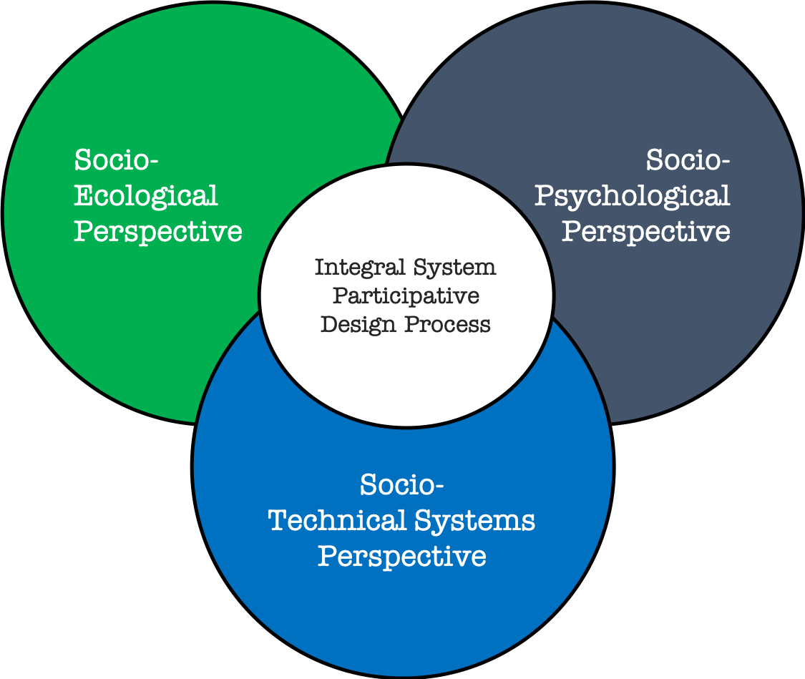
Whole/Integral System Organization Design thru 3 interrelated Perspectives in the digital era
STS Conceptual Foundation: Whole/Integral System Organization Design thru 3 interrelated Perspectives
Socio-Ecological Perspective
Understanding both the unity of the organization and its environment as well as their respective underlying dynamics, thereby enabling strategies, relationships, and processes for future opportunity.
Key Design Parameters:
Purpose
System boundary
Mutual benefit
Socio-Technical Systems Perspective
Organizing for work/value creation through structures and processes that jointly optimize both the social and technical features in an integral system.
Key Design Parameters:
Value creation
Work system
Jointly optimizing
Socio-Psychological Perspective
What individuals need for agency to thrive as a group, with culture as the ‘bridge’ in the dynamic relations between the individual and the social entity.
Key Design Parameters:
Group Dynamics
Culture
Leadership
Notes:
But to be skilful in this creative Design process, we need to understand the ESSENCE of what each LENS/PERSPECTIVE can provide us—THEN, design parameters can act as further ‘framing’ tools.
Individually, each of these lenses has been adopted by many disciplines. However, what is unique about the STS Design foundation is that all 3 lenses/perspectives are part of a holistic organization design process.
Nevertheless, historically, these perspectives were developed in a sequence beginning with the SOCIO-PSYCHOLOGICAL PERSPECTIVE… (Note: slides are animated according to the historical sequence of development.)

Slide 17
Digital Revolution
Notes:
Perspectives are used differently in a new context to achieve humanity

Slide 18
Digital Revolution
– 3 Stages
Communication
Computation
Fabrication
Notes:
Perspectives are used differently in a new context to achieve humanity

Slide 19
Digital Revolution
– 3 Stages
Communication
Computation
Fabrication
Internet
Digital Platforms
Ecosystem Innovation
Connectivity
Data & Analytics
Ethics
Notes:
Perspectives are used differently in a new context to achieve humanity

Slide 20
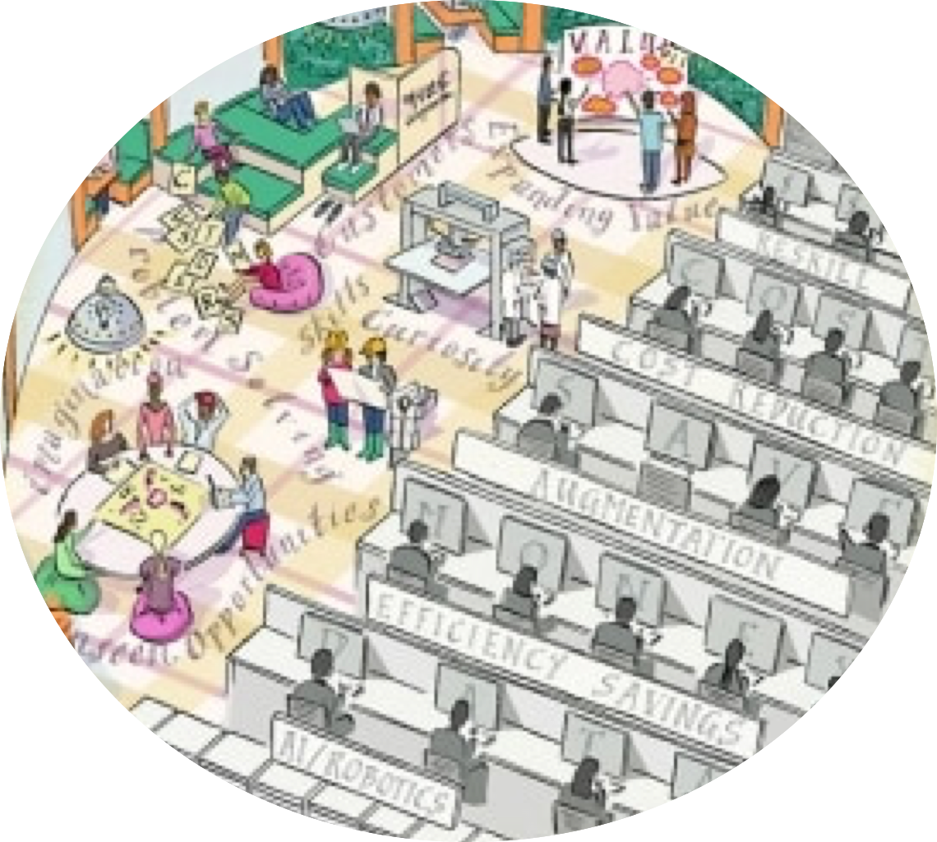
Humanity Choice
Collaborative Ecosystem Design
Ecosystem Design Default
THRIVING PATHWAY
EFFICIENCY PATHWAY
Notes:
Perspectives are used differently in a new context to achieve humanity

Slide 21
Digital World: new socio-economic-technical context
ecosystem for value creation with data and platforms
Scalable Efficiency World

Slide 22
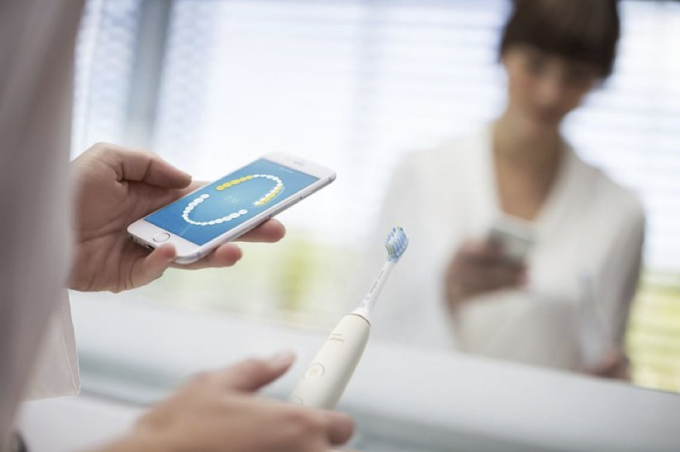
Digital World: new socio-economic-technical context
ecosystem for value creation with data and platforms
Scalable Efficiency World
Scalable Learning World
DIGITAL
PLATFORM

Slide 23
Digital World: new socio-economic-technical context
ecosystem for value creation with data and platforms
Scalable Efficiency World
Scalable Learning World
DIGITAL
PLATFORM
Ecosystem
Econiche
Value Proposition

Slide 24
Conceptual
Foundation
for SmarT
Organization
Design
Socio-
Ecological
Perspective
Socio-Psychological
Perspective
Integral System
Participative Design Process
Socio- Technical Systems Perspective
Hyper-connected,
Instantaneous,
Limitless and
Nonlinear-dynamic
World
Notes:
Perspectives are used differently in a new context to achieve humanity
MENSEN toevoegen!

Slide 25
3 interrelated Perspectives for SmarT Organization Design in the Digital Era of Paradox
Socio-Ecological Perspective
Key Features:
a negotiated order of system boundary and purpose
AND
diverse institutional actors’ pursuit of alternate futures
Socio-Technical Systems Perspective
Key Features:
self-organized work systems optimizing human + digital-technical
AND
a learning infrastructure for scaling to entire ecosystem
Socio-Psychological Perspective
Key Features:
culture enactment as a ‘stable bridge’ within organizations + their ecosystem
AND
culture as a ‘disruptive force’ for bridges to parties with different thinking for innovation

Slide 26
SmarT Organization Design Exercise
In your table group, using the perspective assigned to your group, discuss for 30 minutes & post your responses on the appropriate chart on the wall.
What are your reactions to the proposed what definitions of the three perspectives for organization design in our digital world?
What is most relevant (Blue Post-its) in the description of each perspective?
What might you add or alter (Pink Post-its)?

Slide 27
3 interrelated Perspectives for SmarT Organization Design in the Digital Era of Paradox
Socio-Ecological Perspective
Key Features:
a negotiated order of system boundary and purpose
AND
diverse institutional actors’ pursuit of alternate futures
Socio-Technical Systems Perspective
Key Features:
self-organized work systems optimizing human + digital-technical
AND
a learning infrastructure for scaling to entire ecosystem
Socio-Psychological Perspective
Key Features:
culture enactment as a ‘stable bridge’ within organizations + their ecosystem
AND
culture as a ‘disruptive force’ for bridges to parties with different thinking for innovation

Slide 28
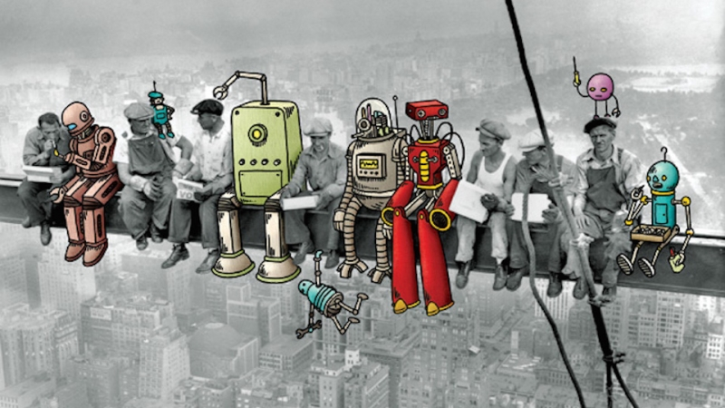
Break

Slide 30
Some
Comments
Closing

Slide 31
JOURNEY
3 days - 3 cases

Slide 32
After the break…
Socio-
Ecological
Perspective
Socio-Psychological
Perspective
Day 2: 2nd case
Day 1: 1st case
SMART City LA
Day 3: 3rd case
Notes:
Perspectives are used differently in a new context to achieve humanity
MENSEN toevoegen!

Slide 33
After the break…
Socio-Psychological
Perspective
Day 1: 1st case
Notes:
Perspectives are used differently in a new context to achieve humanity
MENSEN toevoegen!

Slide 34
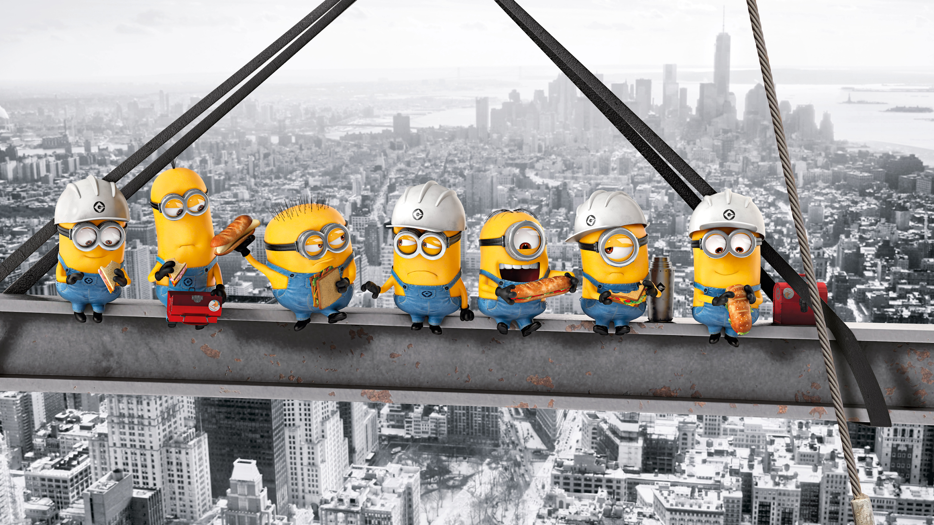
Break

Slide 35
to STARlab presentation

Slide 36
(shifting back to main deck - CLICK)

