Slide 1
Co-Designing the Design Space
A New Value Proposition for STS Designing
Carolyn Ordowich, Douglas Austrom, Bert Painter
Austin September 2022
Notes:
On behalf of Bert, Doug and myself , we are very pleased to be sharing the fundamental theory created by the Tavistock Institute scientists 70 years ago that underlies what is known to designers as Socio-technical Systems Theory. This is a deeper level of understanding about social systems that informs design.
This conceptual renewal began as a project of the STS Roundtable in North America, and it has evolved over the past 2 years, as the concepts have been shared and shaped with colleagues from Europe, Scandinavia, and Australia in our Global Network for Smart Organization Design.
The explanatory power of a coherent fundamental theory helps make the design knowable to all participants in the ecosystem so all can participate fully.
Once you fully understand and have deeply integrated the interplay of these dynamics in your day-to-day experience, you will no longer be at the whim and will of those forces and can instead channel them to create lasting impact in every area of your own life and in our world.
You’ll deeply understand the process of developmental evolution and its trajectory towards greater integration and wholeness. And you’ll gain a deeper insight into the underlying unity that pervades existence and the limitless potential that is latent within us all.

Slide 2
A New Value Proposition for STS Designing
The new value proposition for STS we are proposing is a Meta-Approach that …
Is based on explicitly articulated first principles of human-centered designing and organizing, and is otherwise agnostic about specific approaches and the structured deliberations on which they are based.
Is a prelude to detailed designing, helping diverse stakeholders build on a foundation of human-centered first principles and develop awareness of their frequently varied perceptions of reality and then, build a common understanding to create a pathway through ’design space’, determining together the elements of a meaningful comprehensive design.
Builds on the three systems perspectives originally expounded by the Tavistock Institute – socio-psychological, socio-technical, and socio-ecological – to achieve a ‘whole systems’ mindset.
Recognizes that we are not organization designers, but rather co-designers of the design space in which the system’s stakeholders deliberate and dynamically design the organization.
Identifies deliberations as the primary unit of analysis for work in an knowledge era.
Assumes that work, especially knowledge work, is continuously being (re-)designed by the people doing the work through a series of deliberations.

Slide 3
Simulation Purpose, Desired Outcomes and Agenda
PURPOSE
Practice using the meta-approach by co-designing the design space for post-peak pandemic work design
DESIRED OUTCOMES
Conduct two co-designing deliberations for developing …
Principles and parameters for designing post-peak pandemic work arrangements
Deep, shared understanding of respective experiences of the pandemic work situation and aspirations for working arrangements going forward
Learn how the role of designer and change practitioners is changing
Explore sampling of methods and tools consistent with this framework
AGENDA
15m Introduction to Workshop
60m Overview of the Meta-Approach and the Simulation
60m Deliberation 1: How might we generate principles and parameters for designing post-pandemic work arrangements?
15m Break
60m Deliberation 2: How might we generate a shared ‘whole system’ understanding of the situation?
30m Simulation Debrief

Slide 4
PULPCO Designing Our Future ‘Empowered’ Hybrid Work Arrangements
10,000 Employees in 15 Divisions in 3 diverse National Cultures
Each Division & Business Unit to Design The Best Solutions for their Own Business
With & By Their Own People
Within Our Shared Corporate Vision, Values & Purpose
“To be Exceptional People Creating BioProducts for a Sustainable World”
Notes:
Emery and Trist suggest that ideals (what we are calling 1st principles) generate a substitute symbolical field of coherence that allows us to cope with our emerging turbulent environment and allows every adult (not just professionals) the capability to make choices about organization design. [The Next thirty Years, pp 85-87]
First Principles Thinking
First principles thinking is the act of boiling a problem down to the fundamental parts that you know are true and building up from there.
For Elon Musk it means Boiling a problem down to its most fundamental truth

Slide 5
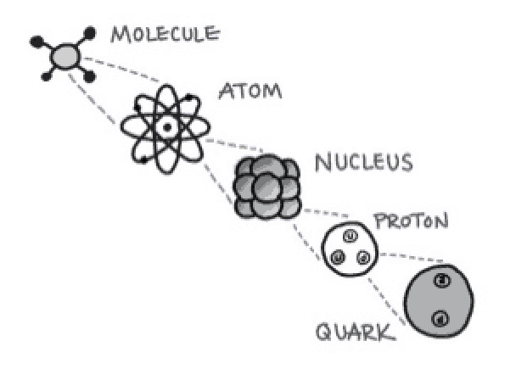
First Principles for Human-Centered Designing
The first basis from which a thing is known.
Aristotle
First Principles | In Practice
Respect for human dignity | Enhance human dignity Trust and believe in people (Theory Y) Capital and technology as tools in service of all people Human centered design of technology
Self-determination and Co-Determination | Choice and voice Responsible autonomy Negotiated order and consensus Connection and communion Dialogue and dialogic design
Mutual Flourishing | Reciprocity and symbiosis Mutual beneficial outcomes
Open systems | Whole systems thinking and wholeness Socio-psychological/technical/ecological systems Enterprises as organisms within the natural order
Notes:
Emery and Trist suggest that ideals (what we are calling 1st principles) generate a substitute symbolical field of coherence that allows us to cope with our emerging turbulent environment and allows every adult (not just professionals) the capability to make choices about organization design. [The Next thirty Years, pp 85-87]
First Principles Thinking
First principles thinking is the act of boiling a problem down to the fundamental parts that you know are true and building up from there.
For Elon Musk it means Boiling a problem down to its most fundamental truth

Slide 6
Socio-Ecological
Perspective
Socio-Psychological
Perspective
Our Heritage of ‘Whole System’ Integral Designing
Integral Whole System
Participative Design Process
Socio-Technical
Perspective
Trist et al., (1990-1997),
”The Social Engagement of
The Social Sciences: A Tavistock Anthology”, Volumes I, II, III.
Published by the University of Pennsylvania Press and
www.moderntimesworkplace.com
.
Notes:
The methodology of the Tavistock origins of the STS Conceptual Foundation was ACTION RESEARCH… As well as tacitly embedding direct participation as a key feature of the Socio-Technical Systems Design (STSD) paradigm, Tavistock’s action research evolved through three distinct “perspectives” or ways of knowing and “engaging” with the world. These 3 perspectives—socio-psychological perspective, socio-technical systems perspective, and socio-ecological perspective—were elaborated continuously thru the ‘classical’ and up to and during the ‘modern’ period of STSD. AND they are all linked and related to comprehensive organization design

Slide 7
WIDE-ANGLE VIEWPOINT = holistic and inclusive ‘Landscape’ for designing
STANDARD
VIEWPOINT =
how human eye sees ‘Action’ & ‘Structure’ in the world
CLOSE-UP VIEWPOINT = personal and interpersonal expression & dialogue
7
Notes:
Tavistock researchers 70 years ago, had the foresight to see that a truly holistic and inclusive worldview would have the highest chance for success at addressing the emerging “turbulent environment” that is VUCA:
Volatile: We live in a world of increasingly rapid change. Small changes in one system can have outsized, or non-linear, impacts in unexpected areas.
Uncertain: Complex systems demonstrate unpredictable behavior that makes it not always possible to quantify or assess the level of risk that will unfold.
Complex: Complex systems have many small parts that are both independent and connected to other parts. The actions in one part of the system ultimately contribute to the behavior of the whole but not in a predictable way.
Ambiguous: Relevant information is unavailable and unknown, or relevant information is available but the overall meaning is still unknown because events are not the product of a clear pattern.
The Tavistock contribution of fundamental theory in the form of 3 integral perspectives of social system ordering in turbulent environments provided:
a more holistic view, like a wide-angle lens, that allows one to fit more of the ‘scene’ of social interactions into the one’s perspective, giving the context more significance and relevance that allows for more impactful designing.
an understanding of how the machines we create begin to recreate us as well, to change the work we do, the lives we lead, and what we define as good. As technology evolves, so do we. Technology is a wholly human construction, yet they saw it developing to the point where it might expand beyond our human ability to either comprehend its inner workings or to completely control it. We have built the pieces without a master plan for how these pieces should eventually interact and evolve with humans – we must look at risk, opportunity, implementation, and ethics in the same framework such as the 3 perspectives provide.

Slide 8
Three Interrelated Perspectives for ‘Whole System’ Designing in the Digital Era
Socio-Ecological Perspective
Is both about a continuously evolving negotiated order of system boundary and purpose among diverse interacting institutional actors
and
their simultaneous pursuit of alternate futures
Socio-Technical Perspective
Is both about self-organized work systems with an optimal combination of human and digital-technical capability for value creation
and
a learning infrastructure for scaling learning to the entire ecosystem to maintain rapid innovation.
Socio-Psychological Perspective
Is both about culture enactment as a ’stable bridge’ for continuous development and growth of trust among diverse individuals and groups within bounded organizations and their ecosystem
and
culture enactment as a ’disruptive force’’ to build new bridges to people with different thinking for a rapid pace of innovation.
First Principles for Human-Centered Designing
8

Slide 9
Co-Designing the Deliberations for Co-Creation
Deliberations are patterns of reflection, exchange and communication in which people engage to reduce the uncertainty and ambiguity of problematic issues that are critical to advancing knowledge and moving this work forward.
The initiating step in designing a deliberation is to identify the Topic(s) or problematic issue(s) about which people must reflect and communicate.
Then, address these elements …
Sharpen definition of the Topic(s), i.e. challenge, opportunity to be addressed
Identify Participants – Critical stakeholders to the issue; those who should be involved in the reflections and conversations; representative diversity of roles and perspectives
Determine Data – the information that is needed to effectively address the topic and advance the reflections and communication; physical documents and stored information; data bases; analytics, algorithms and machine learning
Choose Forums – in which they occur which may be structured, semi-structured, unstructured or ad hoc; informal interactions; in person or online including Enabling Digital Technologies … email, Slack, Zoom, instant messaging, etc.
9
Notes:
WE BELIEVE COMPETENCE IN DELIBERATION DESIGN IS ESSENTIAL FOR ‘SMART’ ORGANIZATION DESIGN IN THIS DIGITAL ERA. SO, IT IS IMPORTANT TO UNDERSTAND WHAT WE MEAN BY DELIBERATIONS AND THE KEY STEPS IN DESIGNING A DELIBERATION….

Slide 10
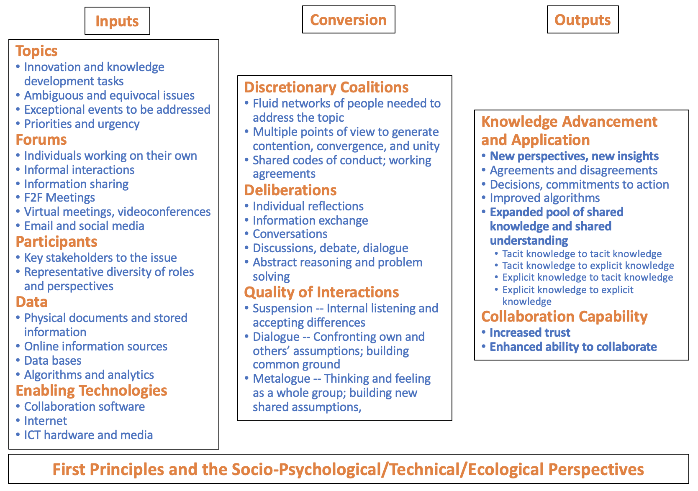
Deliberation Conversion Process

Slide 11
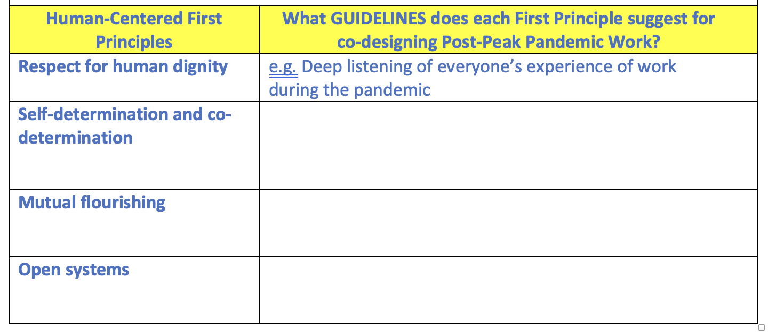
Deliberation 1: Worksheet 1

Slide 12
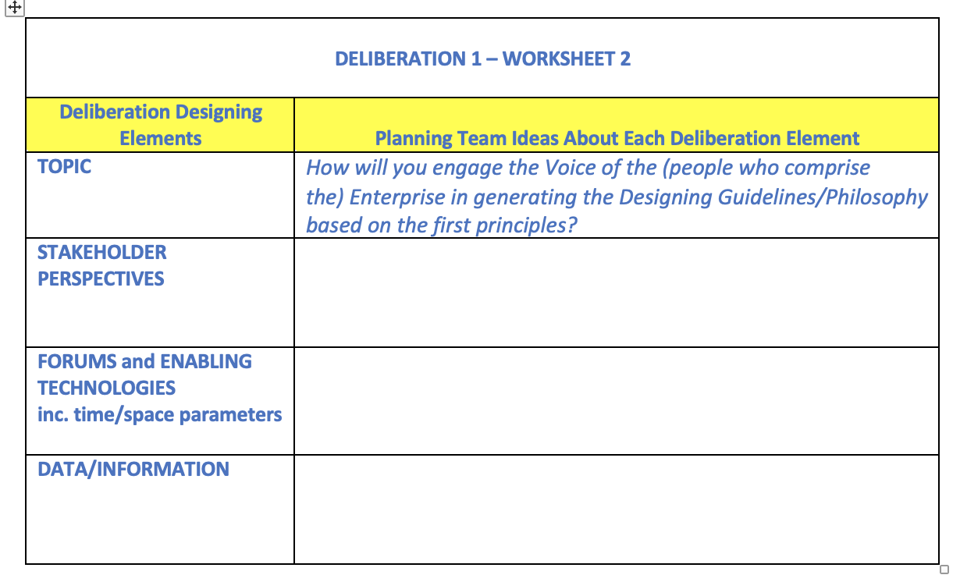
Deliberation 1: Worksheet 2

Slide 13
Deliberation 2 Worksheet

Slide 14
Designing Models and Tools as Structured Deliberations
Dialogic Organization Design and Development
Design Thinking
Agile
Digital STS Designing
Platform STS Designing
Humanocracy
Participative Design Workshops
Appreciative Inquiry
Sociocracy
Holacracy
Liberating Structures
Co-Creating Mutual Value
World Cafes
Search Conferences, Future Searches, Conference Model
Design Charettes
Meeting Canoe Model
Open Space Technology
Participatory Action Research
Relational Coordination
Notes:
include identifying participants with representatively diverse viewpoints, determining appropriate topics, and creating forums or “safe containers” for open dialogue.
A sample of these change methodologies includes search conferences (Emery, 1999; Emery and Purser, 1996), participative design workshops (Emery, 1993), future searches (Weisbord & Janoff, 2010), the conference model (Axelrod, 2010), the meeting canoe model (Axelrod & Axelrod, 2014), design charrettes (Lennertz & Lutzenhiser, 2006), open space technology (Owen, 2008), world cafés (Brown & Issacs, 2005), participatory action research (Gustavsen, 1992) and dialogic organization development (Busche & Marshak, 2015).

Slide 15
Simulation Debrief
What questions, thoughts, responses, do you have to this new value proposition for STS and this meta-approach to co-designing the design space?
What impact can you envision this meta-approach having on the role of designers?
What take-aways from this workshop do you have for your own practice as “designers”?

