Slide 1
(dummy slide, start day 3)

Slide 2
Organizing to Thrive in the Digital Era
33rd STS Roundtable & 6th Global Network Meeting
Los Angeles, 10-13 September 2019
Organizing to Thrive in the Digital Era
33rd STS Roundtable & 6th Global Network Meeting
Los Angeles, 10-13 September 2019
Day 3

Slide 3
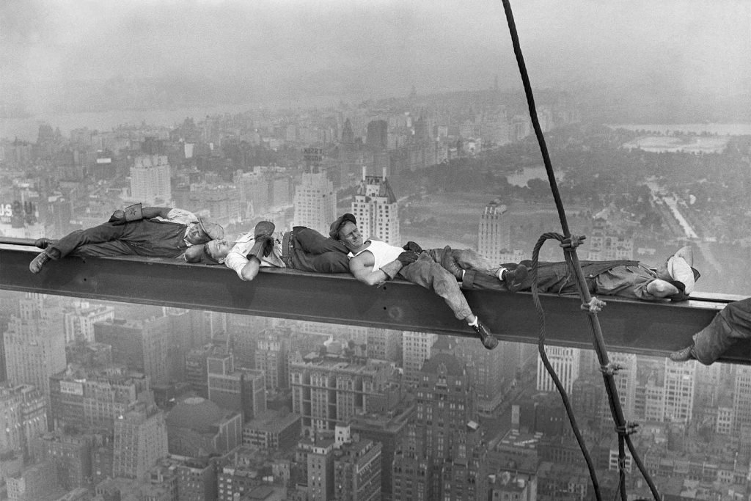
Slept well…

Slide 4
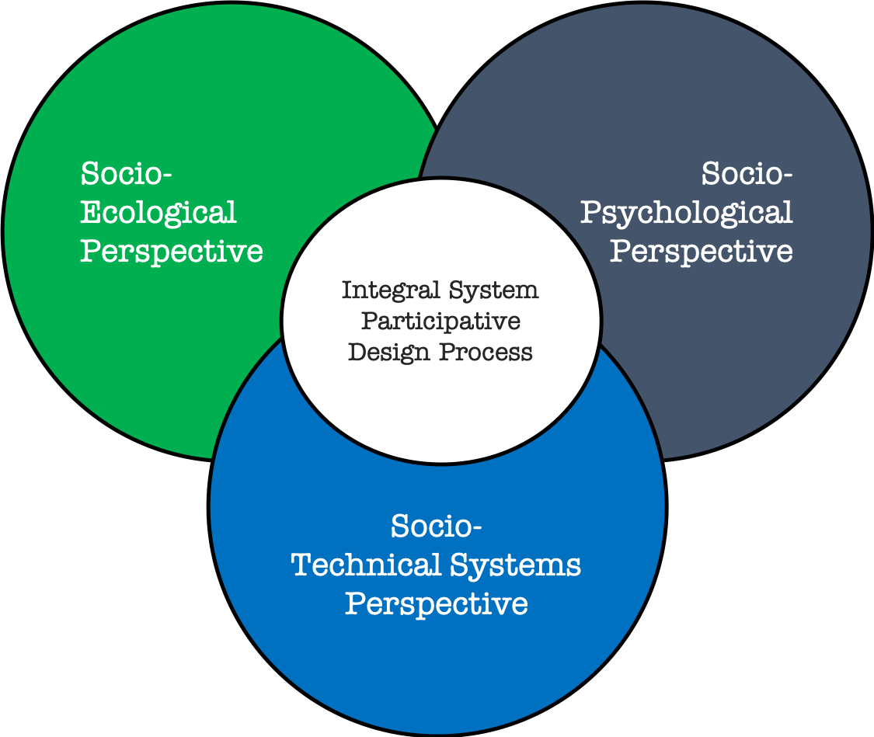
Today’s Journey
Socio-
Ecological
Perspective
Socio-Psychological
Perspective
Day 2: 2nd case
Day 1: 1st case
Socio- Technical Systems Perspective
SMART City LA
Day 3: 3rd case
Notes:
Perspectives are used differently in a new context to achieve humanity
MENSEN toevoegen!

Slide 5
program
Morning:
Welcome Back
Intro to Smart City LA & i3
Sprints on Smart City LA
Lunch: AGM (STS RT members only)
Afternoon:
Smart City LA (cont.)
Jim Spohrer - IBM
Trondheim & Close
(Informal deliberation: Value SmarT Design …)

Slide 6
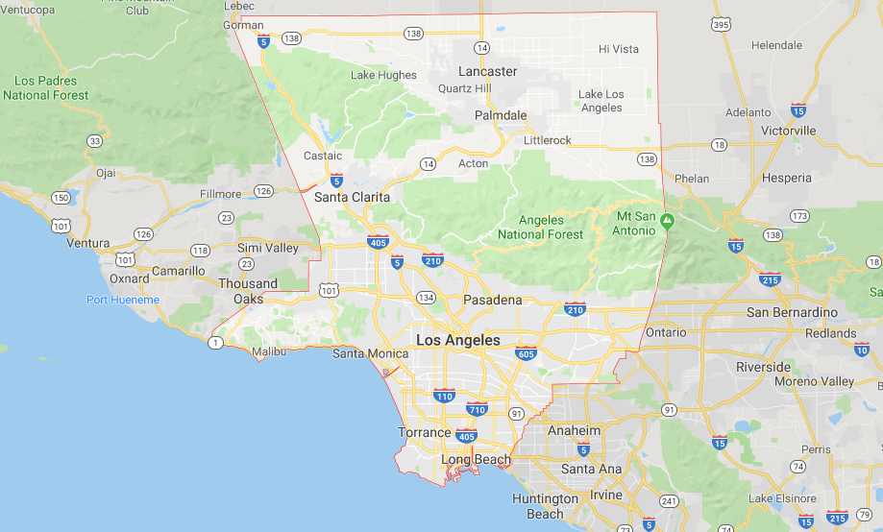
LOS ANGELES COUNTY, CA including LOS ANGELES CITY and LONG BEACH CITY

Slide 7
“A SMART CITY” uses ICT, IoT, and digital technologies to enhance the quality and performance of urban services such as energy, transportation and utilities AND to share information with the public and improve citizen welfare. Solutions include various aspects of a “City Ecosystem”, which represents a “community” of SMART SERVICE SYSTEMS.

Slide 8
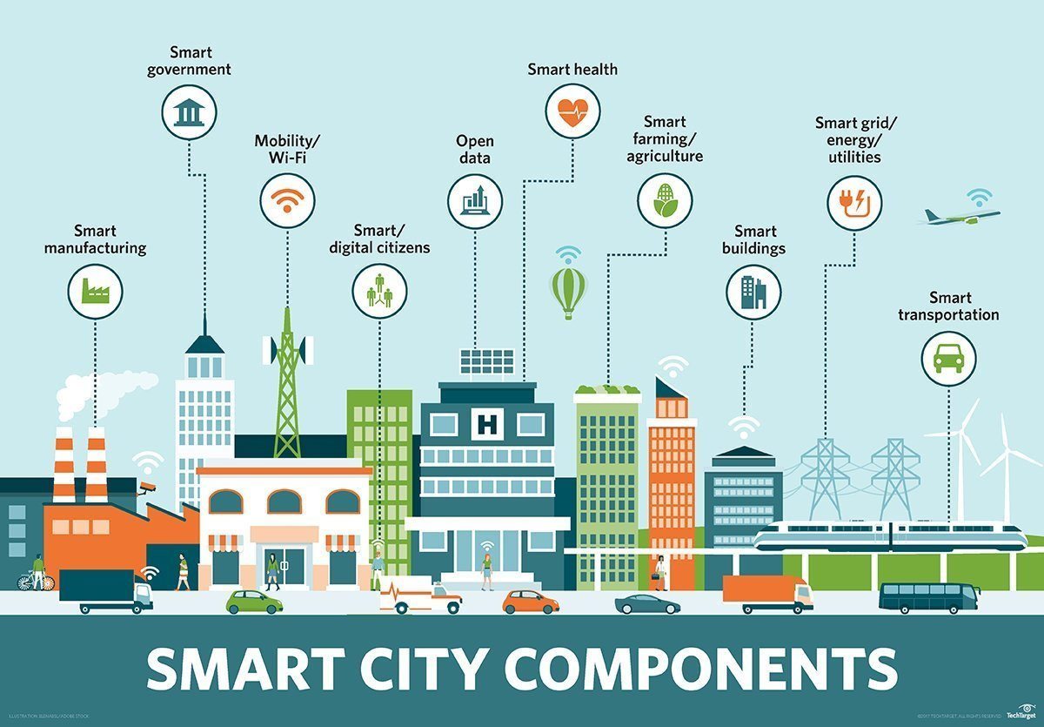

Slide 9
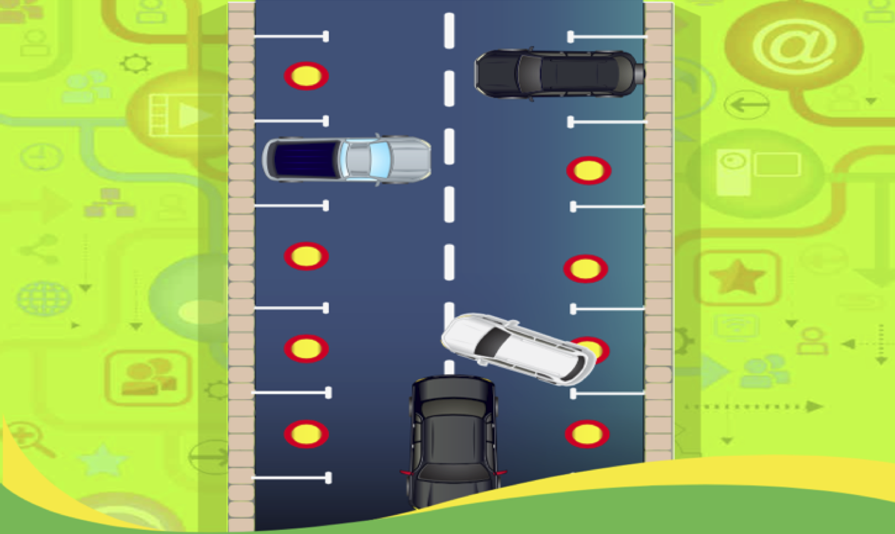
SMART PARKING

Slide 10
“SMART” Service System is a socio-economic-technical system that is a dynamic configuration of people, technology, information, and organization(s) connected by value propositions for mutual value co-creation, AUGMENTED WITH COGNITIVE SYSTEMS (e.g. AI)
Spohrer, J. et al., (2017) “Steps toward a science of service systems”. Computer. 40 (1). Spohrer, J., et al., (2017) What Makes a System Smart?; in “The Human Side of Service Engineering”.

Slide 11
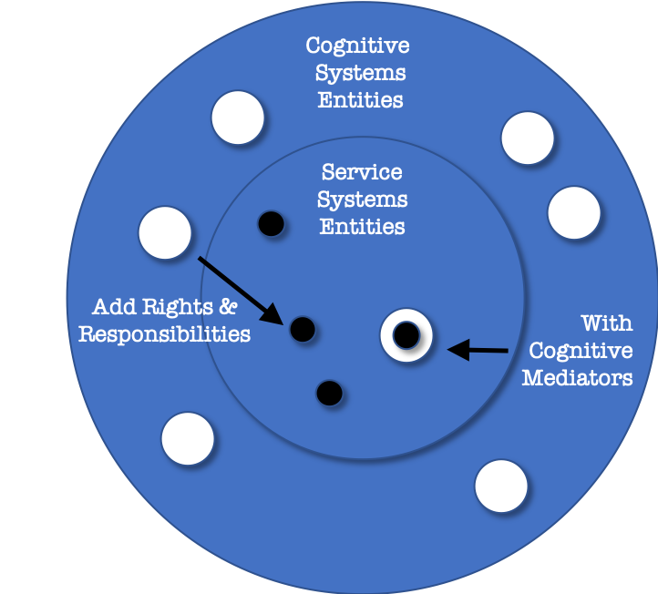
Smart Service Systems
MISSING STABLE MEMBRANE
For Co-operation between Naturally Intelligent & Artificially Intelligent Systems
Cognitive Systems
Entities
Service
Systems
Entities
Add Rights & Responsibilities
With
Cognitive
Mediators
Notes:
However, as identified by Jim Spohrer et al., “the current state of the art in smart service systems is MISSING a key component. All of the service system entities like ‘people and organizations’ have rights and responsibilities attached to them. However, not so for AI systems.
Why is this important? Because Rights and responsibilities are key to the development of TRUST, and trust is key to the development of collaborative interactions within a service system.
So, what’s missing in most smart service systems is a STABLE MEMBRANE that would encapsulate technology in a way favorable for co-operation of naturally intelligent and artificially intelligent systems.
However, here in the metropolis of LA, a public-private consortium led by USC Marshall School of Business & Viterbi School of Engineering has developed an innovative platform called the Intelligent IoT Integrator (I3) that addresses many of these issues and has thereby been a catalyst for SMART CITY development in LA.

Slide 13
Welcome: University of Southern California
A Joint Project: Led by Marshall and Viterbi
For more information, please visit http://i3.usc.edu/

Slide 14
(SMART City LA & i3 by Jerry)

Slide 15
Let’s continue …

Slide 16
Panel Discussion (as context)
Setup of Design Sprint
90-minute Sprint in Groups (after the break)
Plenary Sprint Debrief

Slide 17
Panel Discussion – Context
3 CIOs Talk
Smart City Vision & Opportunities
Organizational Challenges of Smart Parking
Ted Ross – City of Los Angeles
Cason Lee – City of Long Beach
Jagjit Dhalwal – LA County
15 minutes Q&A
Note: Jerry Power and 3 CIOs are available as resources during the Participative Exercise on Smart Parking

Slide 18
Organization Design Challenges
SMART PARKING

Slide 19
Sprint Brief
(90-minute, 3 groups)
After break, go to the group and location you have been assigned to.
We will work for 90 minutes on 3 Distinct + Inter-related, In-Parallel Organizational Design Challenges:
GROUP 1 (Socio-Ecological Perspective): Assemble LA Smart City constituents to coalesce on Smart Parking purpose, system boundaries and mutual benefits?
GROUP 2 (Socio-Technical Systems Perspective): Define the workflow and measures that are required for an effective work system that results in Smart Parking Value Creation with mutual benefit for all?
GROUP 3 (Socio Psychological Perspective): Enable the shift in IT to a larger strategic role regarding SmarT Transportation within the LA ecosystem?
The design challenges are in the early development phase for prototyping now. We do not expect a complete rollout of all phases during this exercise.

Slide 20
Challenge Process
(suggested 90-minute format)
20 minutes: develop understanding of LA Smart Parking context
(We have suggested questions related to each specific design challenge)
70 minutes (design task): develop prototype solutions for a specific LA challenge
(We have proposed specific design task questions to focus on for each challenge)
After approx. 30 minutes: each group designates 2 persons to ‘scout’ work of other design challenge groups (15 minutes)
Final 25 minutes: each group converges its design ideas for presentation after lunch in a plenary session
Notes:
Reference DESIGN BRIEF HANDOUT…

Slide 21
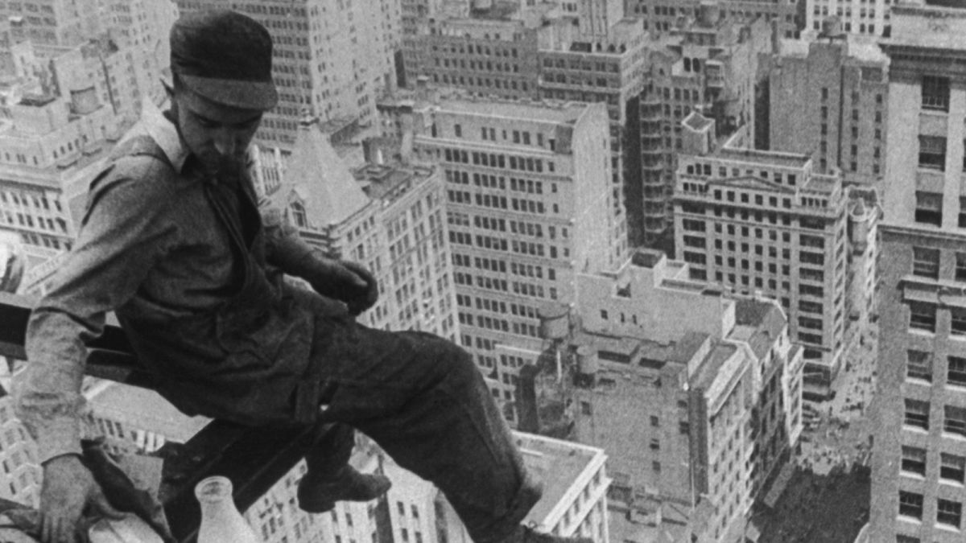
Break
After break, go to the group and location you have been assigned to.

Slide 22
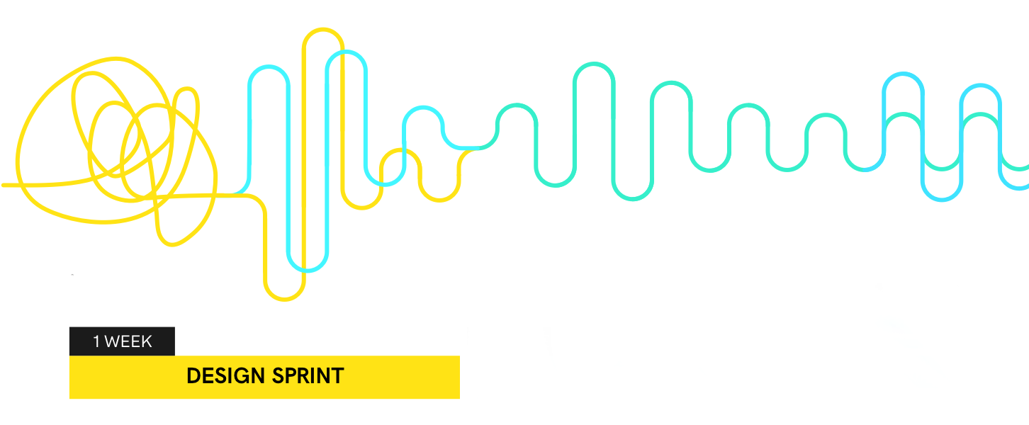
90 – Minute
Participative Sprint Exercise
Working on design challenge in your assigned group using the design sprint brief

Slide 23
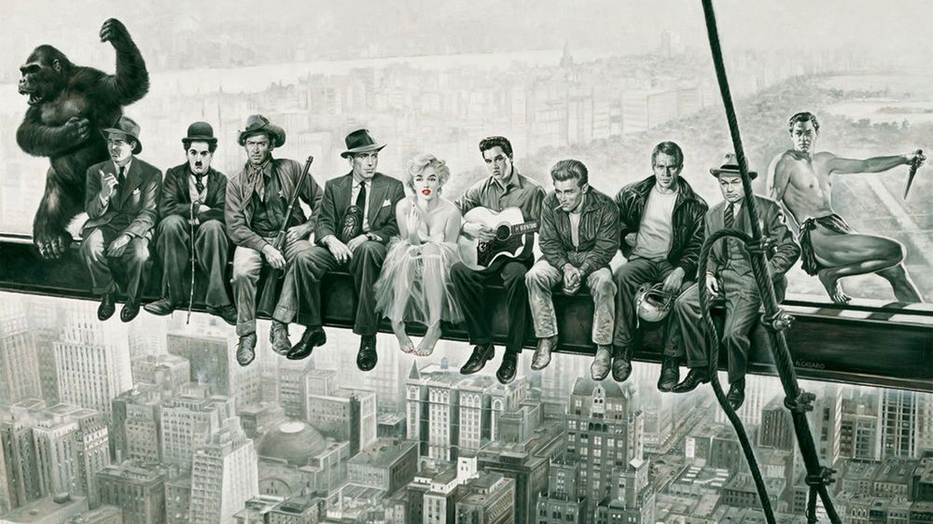
Lunch & AGM (AGM: only for STS RT members)

Slide 24
Plenary Participative Sprint Exercise

Slide 25
Let’s continue …

Slide 26
(to Jim Sphorer’s presentation)

Slide 27
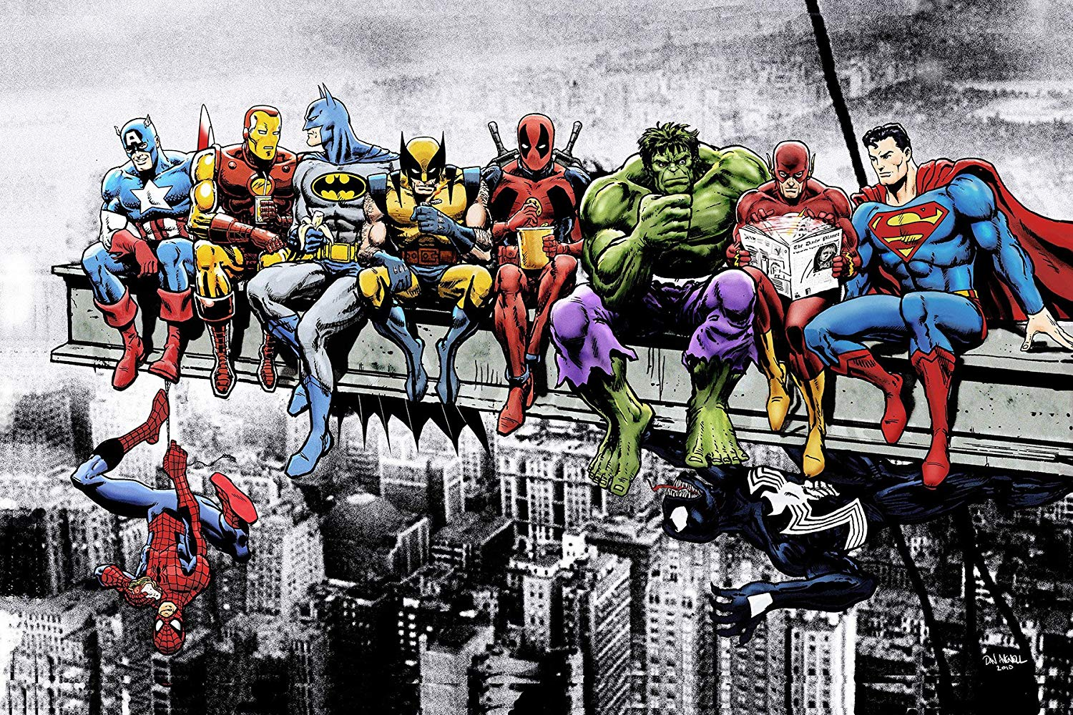
Let’s continue…

Slide 28
Trondheim – September 2020
(The Journey Will Continue)

Slide 29
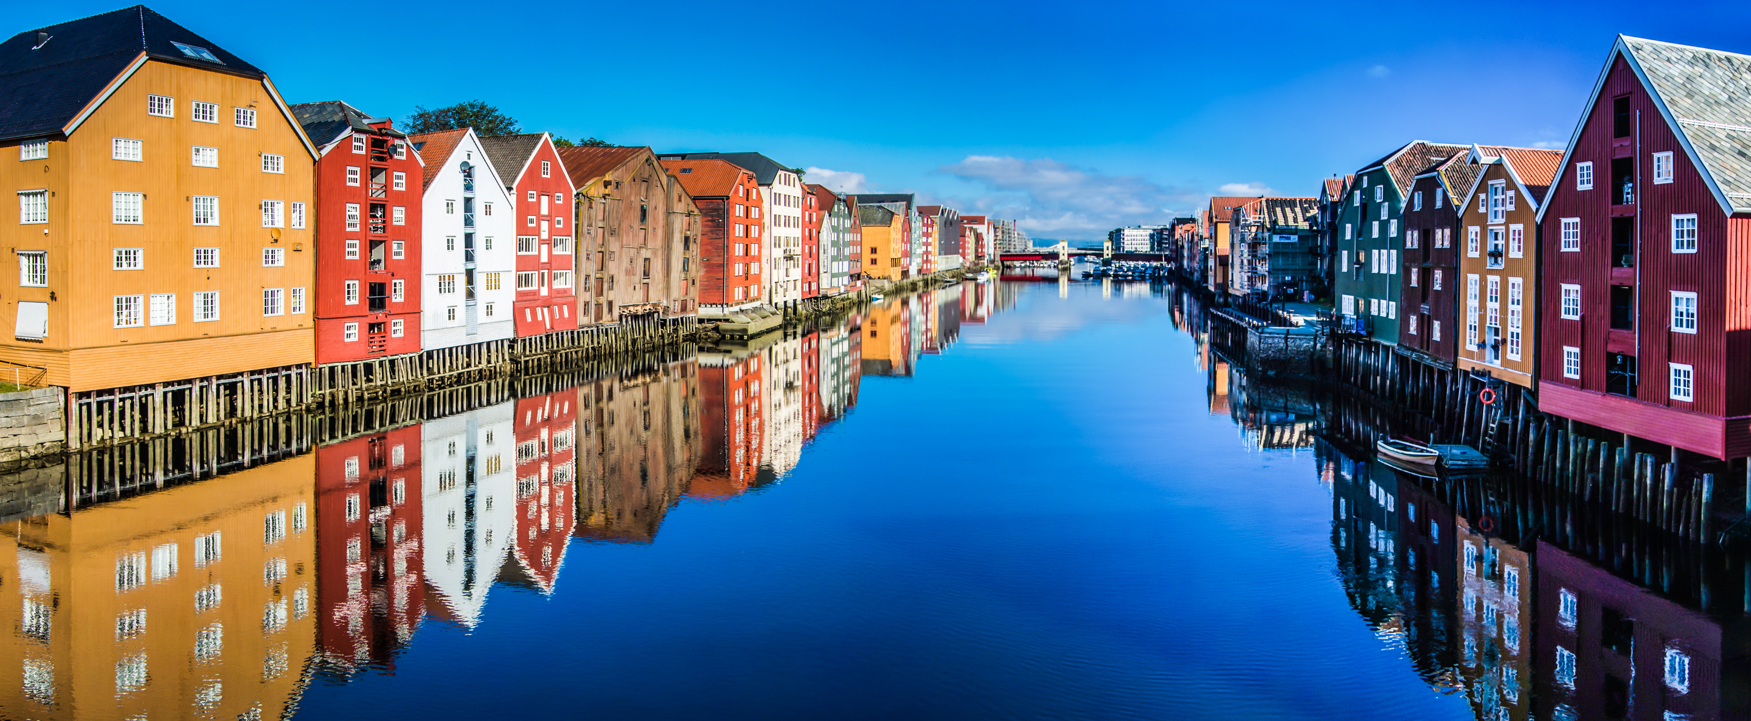
Trondheim – September 2020
(The Journey Will Continue)

Slide 30
Let’s bring it to an end…

Slide 31
MAIN FOCUS of our JOURNEY:
To explore new thinking and innovative approaches for organizing to thrive in the digital era.
Notes:
Perspectives are used differently in a new context to achieve humanity
MENSEN toevoegen!

Slide 33
n
t
a
a
i
r
r
n
g
n
e
t
t
l
e
a
a
n
i
r
i
t
e
e
l
r
t
l
n
t
g
g
e
i
g
l
l
t
l
i
a
g
r
n
i
l
r
g
n
g
a
e
i
r
a
e

Slide 34
n
t
a
a
i
r
r
n
g
n
e
t
t
l
e
a
a
n
i
r
i
t
e
e
l
r
t
l
Integral
n
t
g
g
e
i
g
l
l
t
l
i
a
g
r
n
i
l
r
g
n
g
a
e
i
r
a
e

Slide 35
Integral
≠ integrated

Slide 36
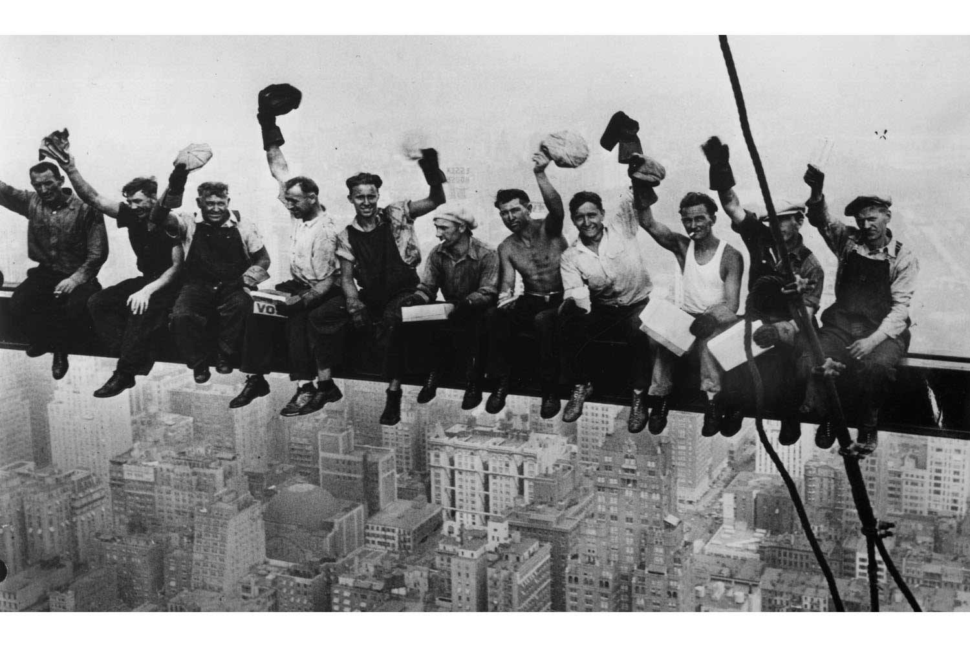
So long
So long

Slide 37
Informational Deliberation on the Value of the Smart Design Conceptual Foundation (3:30 – 5:00 PM)
Notes:
Perspectives are used differently in a new context to achieve humanity
MENSEN toevoegen!

