Slide 1
(dummy slide, start day 2)

Slide 2
Organizing to Thrive in the Digital Era
33rd STS Roundtable & 6th Global Network Meeting
Los Angeles, 10-13 September 2019
Organizing to Thrive in the Digital Era
33rd STS Roundtable & 6th Global Network Meeting
Los Angeles, 10-13 September 2019
Day 2

Slide 3
Conceptual
Foundation
for SmarT
Organization
Design
Socio-
Ecological
Perspective
Socio-Psychological
Perspective
Integral System
Participative Design Process
Socio- Technical Systems Perspective
In a Digital – Instantaneous, Limitless & Nonlinear-dynamic – World
Notes:
Perspectives are used differently in a new context to achieve humanity
MENSEN toevoegen!

Slide 4
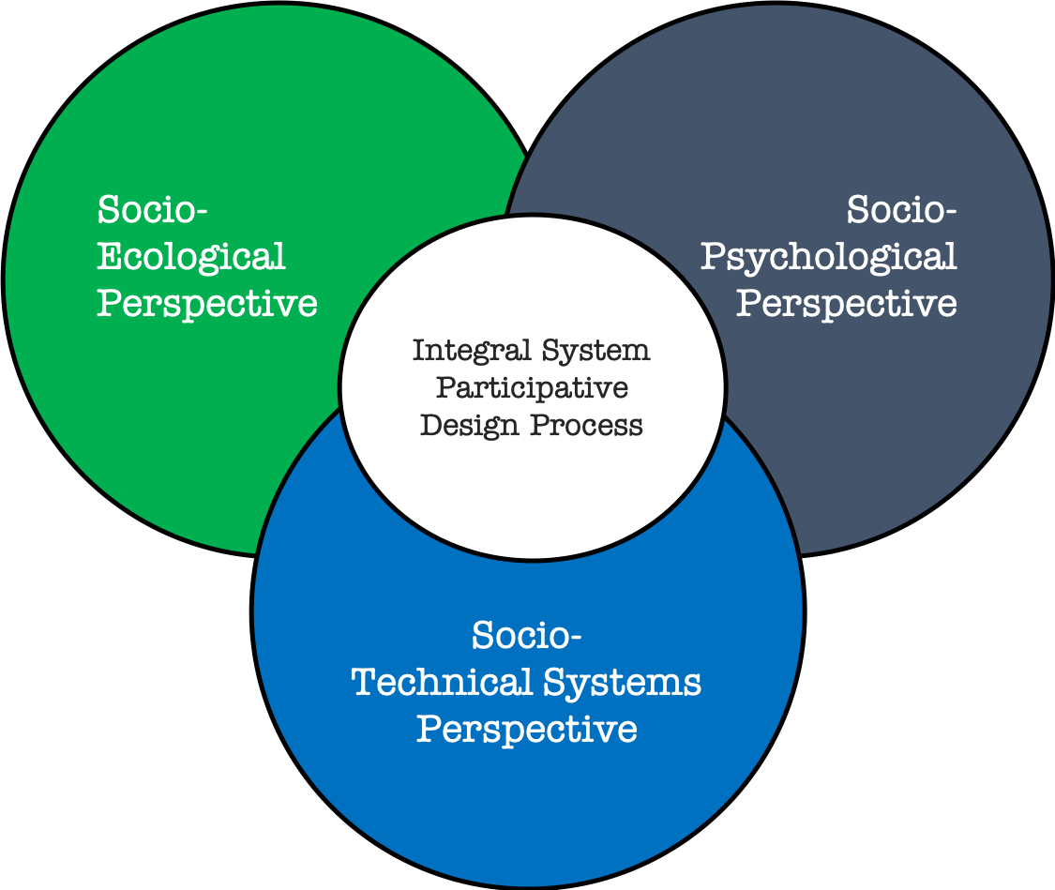
Today’s Journey
Socio-
Ecological
Perspective
Socio-Psychological
Perspective
Day 2: 2nd case
Day 1: 1st case
In a Digital – Instantaneous, Limitless & Nonlinear-dynamic – World
Notes:
Perspectives are used differently in a new context to achieve humanity
MENSEN toevoegen!

Slide 5
program
Morning:
Welcome & Introductions
Overview HTT
HTT case – Part I
Afternoon:
HTT case – Part II
Framework Deliberation (to be decided)
Rest of the Day & Tomorrow

Slide 6
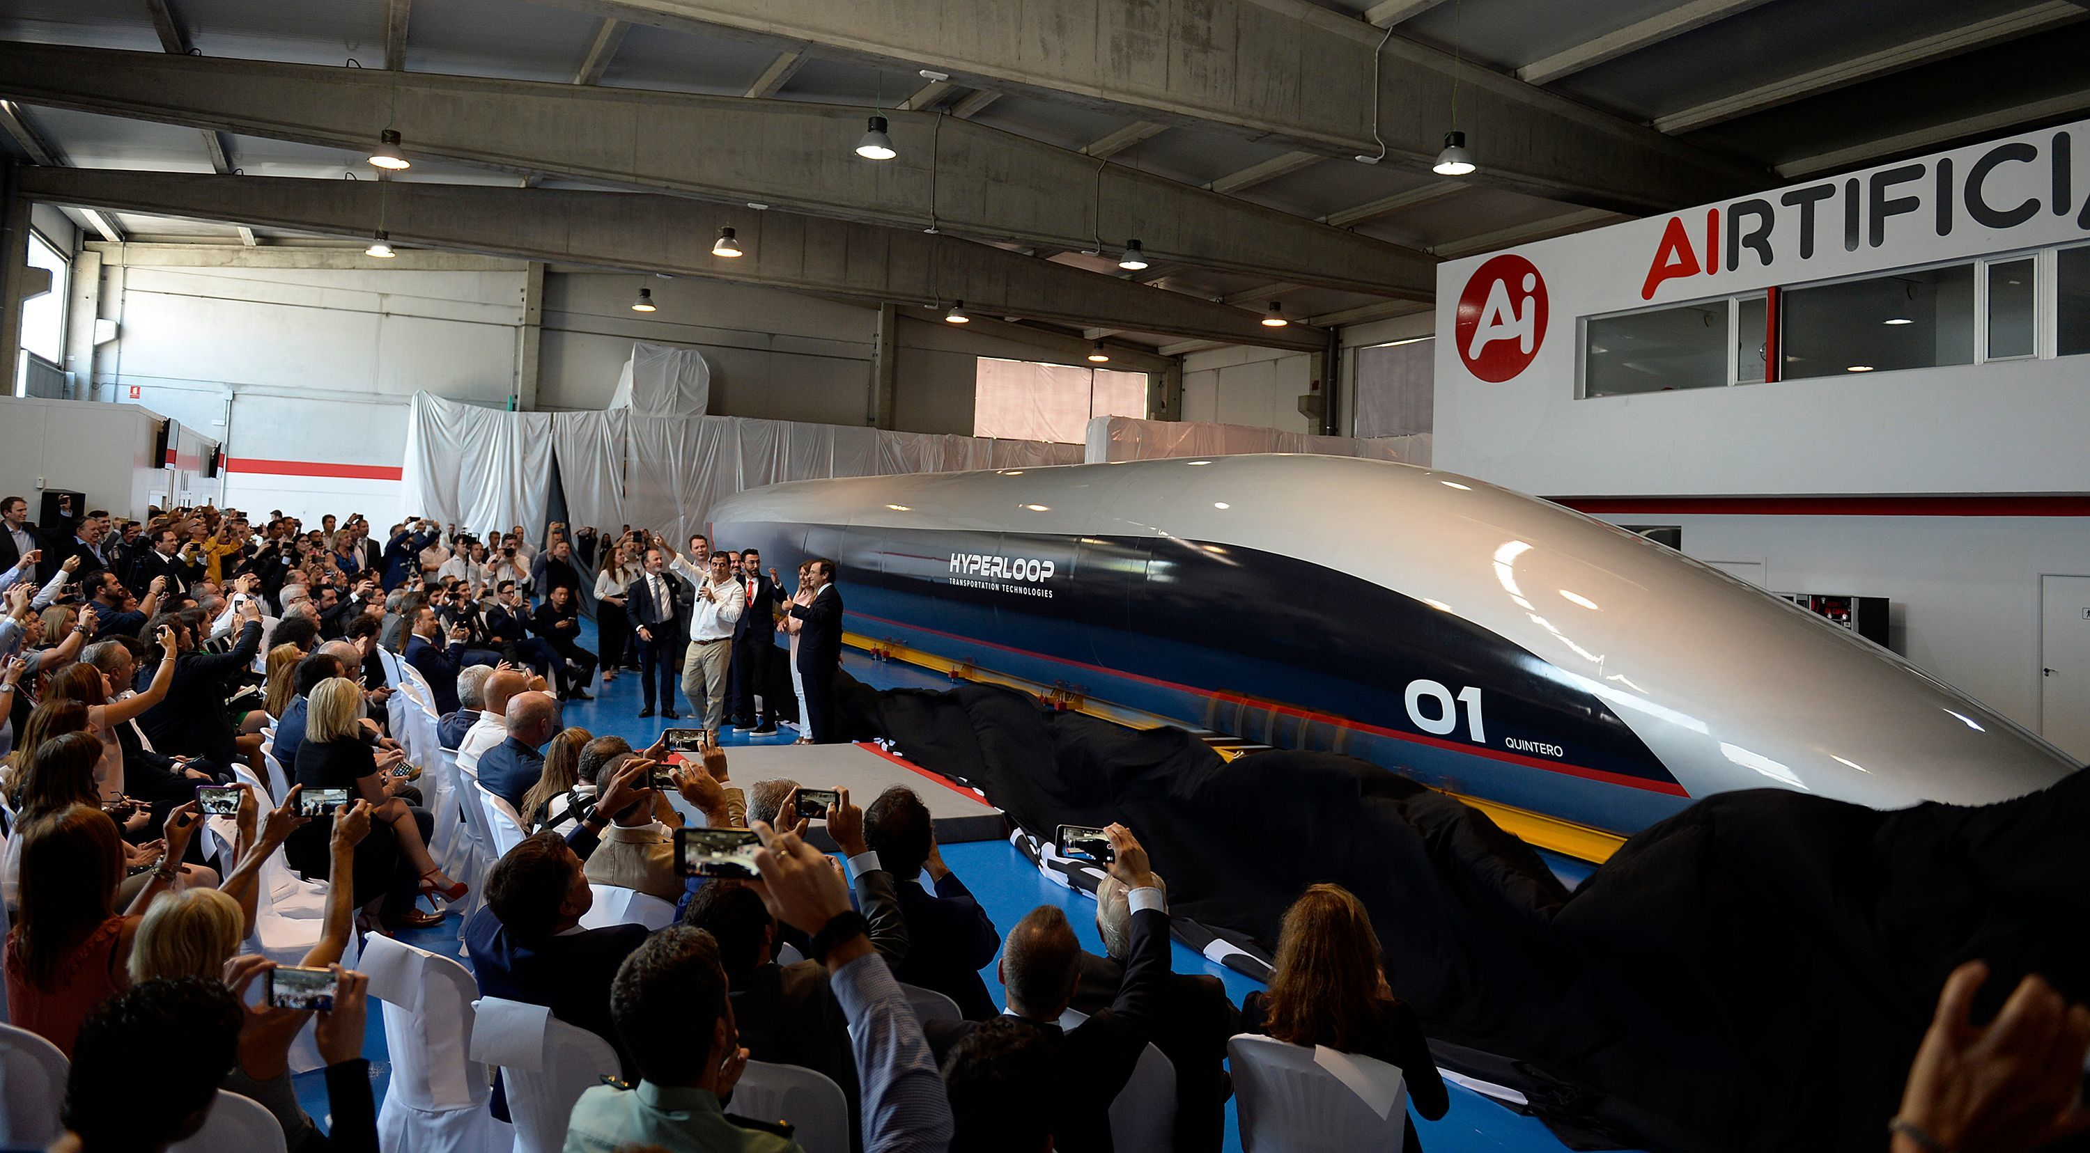
Introduction

Slide 7
Introduction
Our HTT Sponsors/Management Team:
Bernd Stephan, Alexandre Zisa and Andrea La Mendola
Our HTT Hosts:
Valéry Quintard (France)
Michelle Hahm (LA)
Hayato Hori , Special Projects (LA)

Slide 8
Characteristics of HTT that are Critical to the Design Session:
Global, tied together over the internet
Project-based organization design
Multi-tiers of crowd (“the onion”)
Stock or cash shouldn’t matter in how work is done
When work is paid for by stock, the work must be value added since the more stock allocated, the more diluted the stock value
Gradients of confidentiality is of great concern since highly competitive, and the company is building the market and technology simultaneously
Currently about 50 staff, and 100 active collaborators (including reps of organizations and individuals) and about 700 additional vetted collaborators that aren’t being utilized

Slide 9
Characteristics of HTT that are Critical to the Design Session: (continued)
IP generation is very important requiring highly skilled scientists and engineers, and highly talented marketing to describe this model, and HR staff able to support this type of environment.
Safety and quality control of the product is critically important
In California, the law is very strict on distinguishing between employees and contributors. We cannot tell contributors what to do; we do not manage them. This is very important to our model. Contributors are NOT employees
Desired soft skills: collaborative, risky, supportive, loyal, takes initiative, can work on one’s own, can create an internal network, can bring an outside network to help, has patience when management can’t react as quickly as desired because of the multiple strategic horses it is riding

Slide 10
DESIGN
CHALLENGE

Slide 11
Mission of the Design Session:
Figuring out how to manage the crowd better.
Design Challenges & Constraints:
Maintaining engagement when not assigned a task
Contributor-task matching
Contributor accountability
Selecting new contributors
Managing crowd contribution
Introduction of HTT people at the tables that will provide more info related to the challenges

Slide 12
Directions about what is needed by HTT
Examples of where you’ve seen answers to the questions managed successfully?
Wild and crazy ideas for answering the questions (nothing is too wild at HTT)
Examples of technologies that will help
Draw pictures of how your ideas fit Sr. Executives for going forward
Want something that can really have a chance to work
Assign someone at each table to keep time
Use your subgroup’s understanding of the HTT context, your experience in design and your group’s creativity to carry out the design task.
Each group can begin to converge its design ideas into a presentation for the plenary session after lunch. This presentation should reflect (1) an understanding of the context of HTT’s challenge and (2) specific design ideas in response to the design challenge. Be prepared to present on flipcharts after lunch in the plenary session.
Select a team members (s) to present.

Slide 13
Directions about what is needed by HTT
Examples of where you’ve seen answers to the questions managed successfully?
Wild and crazy ideas for answering the questions (nothing is too wild at HTT)
Examples of technologies that will help
Draw pictures of how your ideas fit Sr. Executives for going forward
Want something that can really have a chance to work
Assign someone at each table to keep time
Use your subgroup’s understanding of the HTT context, your experience in design and your group’s creativity to carry out the design task.
Each group can begin to converge its design ideas into a presentation for the plenary session after lunch. This presentation should reflect (1) an understanding of the context of HTT’s challenge and (2) specific design ideas in response to the design challenge. Be prepared to present on flipcharts after lunch in the plenary session.
Select a team members (s) to present.
Note:
Take into consider the STS Conceptual Foundation
Report out at (time)

Slide 14
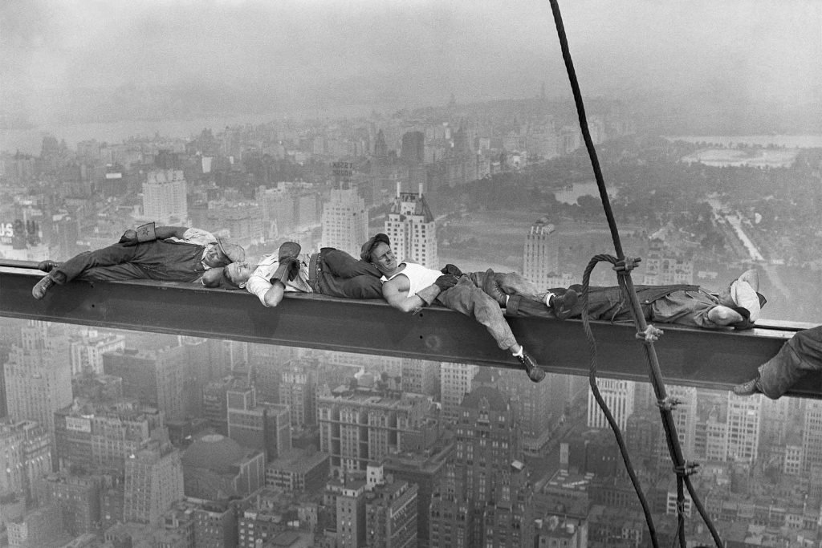
Group work & lunch Report-out at (time)

Slide 15
Group
Report Out

Slide 17
Some
Comments
Closing

Slide 18
AGM: Tutor Center @ 7:30-8:30 AM
(breakfast available)

Slide 19
Tomorrow’s Journey
Socio-
Ecological
Perspective
Socio-Psychological
Perspective
Day 2: 2nd case
Day 1: 1st case
Socio- Technical Systems Perspective
SMART City LA
Day 3: 3rd case
Notes:
Perspectives are used differently in a new context to achieve humanity
MENSEN toevoegen!

Slide 20
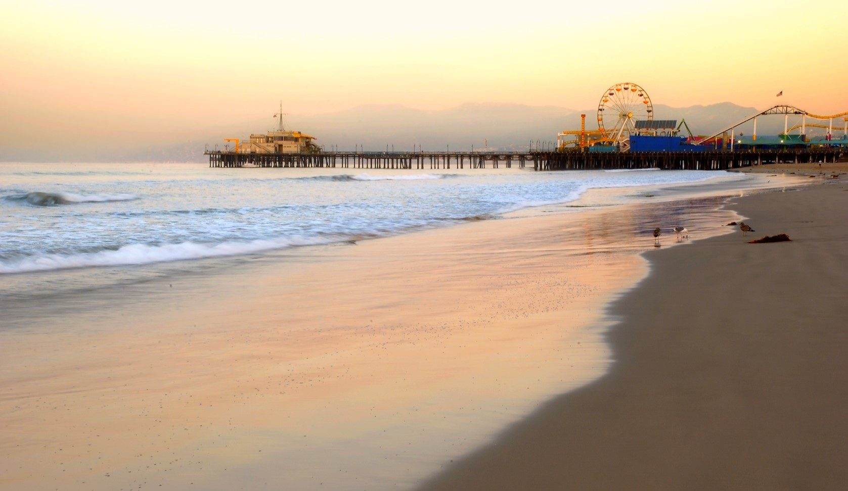
Afternoon (time indication)

Slide 21
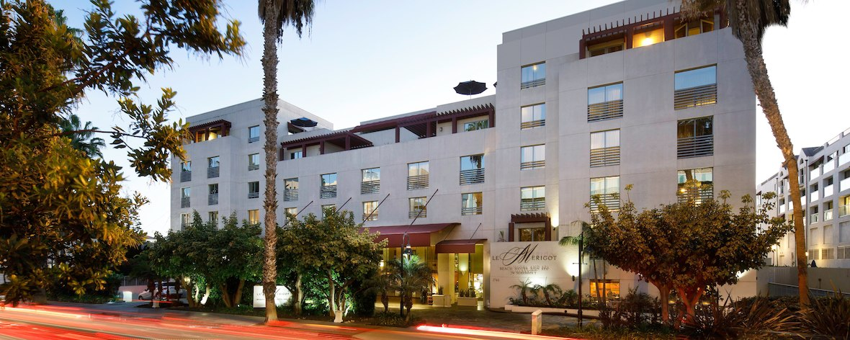
Evening (time indication)
JW Marriott Santa Monica Le Merigot - 1740 Ocean Ave, Santa Monica, CA 90401

Slide 22
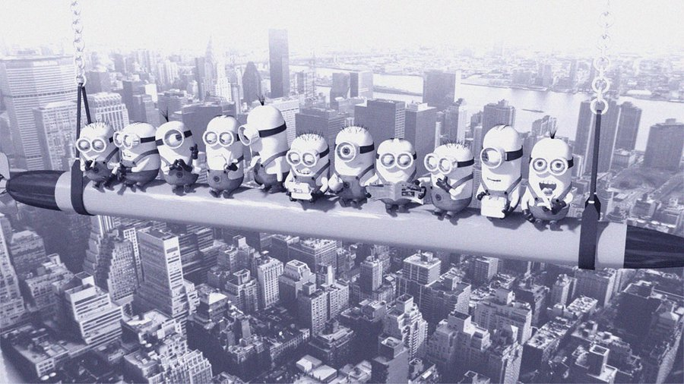
Evening (time indication)
JW Marriott Santa Monica Le Merigot - 1740 Ocean Ave, Santa Monica, CA 90401
See you soon

