Slide 1
(dummy slide, start day 1)

Slide 2
Organizing to Thrive in the Digital Era
33rd STS Roundtable & 6th Global Network Meeting
Los Angeles, 10-13 September 2019
Organizing to Thrive in the Digital Era
33rd STS Roundtable & 6th Global Network Meeting
Los Angeles, 10-13 September 2019

Slide 3
Hosted by
Co-sponsored
Notes:
Sue Mohrman- Center for Effective OrganizationsA
Ann `Majchrzak
Jerry Powers

Slide 4
”The DIGITAL ERA video to wake us up”

Slide 5
WHY are we HERE?

Slide 6
GOAL:
To remain viable as organizations and as STS designers,
we need “guidance” for designing in the digital era.
(As it sets new challenges & options - further on more on this).
WHY are we HERE?
MAIN FOCUS of our JOURNEY:
To explore new thinking and innovative approaches for organizing to thrive in the digital era.

Slide 7
TEAM

Slide 8
is in the ROOM
What is your name?
What brought you here?
What do you hope to take away?
Notes:
Ideas:
Go to the person you do not know the least.
Figure out who they are, and what brought them here?
And, one remarkable other thing

Slide 9
PROGRAM

Slide 10
STS
Conceptual
Foundation
Socio-
Ecological
Perspective
Socio-Psychological
Perspective
Integral System
Participative Design Process
Socio- Technical Systems Perspective
Notes:
The methodology of the Tavistock origins of the STS Conceptual Foundation was ACTION RESEARCH… As well as tacitly embedding direct participation as a key feature of the Socio-Technical Systems Design (STSD) paradigm, Tavistock’s action research evolved through three distinct “perspectives” or ways of knowing and “engaging” with the world. These 3 perspectives—socio-psychological perspective, socio-technical systems perspective, and socio-ecological perspective—were elaborated continuously thru the ‘classical’ and up to and during the ‘modern’ period of STSD. AND they are all linked and related to comprehensive organization design

Slide 11
STS
Conceptual
Foundation
Socio-
Ecological
Perspective
Socio-Psychological
Perspective
Integral System
Participative Design Process
Socio- Technical Systems Perspective
Digital World
Notes:
Perspectives are used differently in a new context to achieve humanity
MENSEN toevoegen!

Slide 12
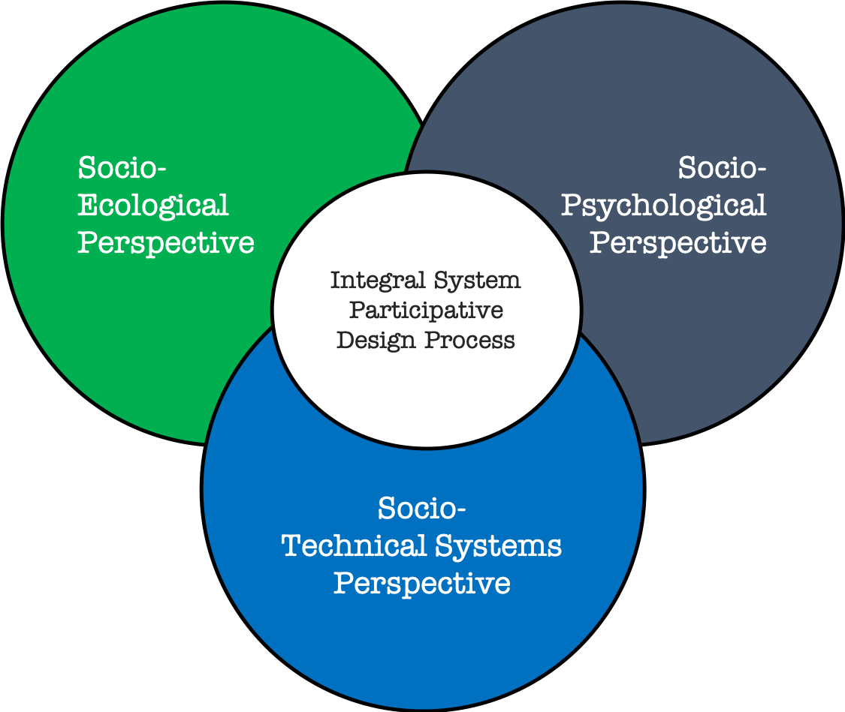
JOURNEY: 3 days - 3 cases
Socio-
Ecological
Perspective
Socio-Psychological
Perspective
Day 2: 2nd case
Day 1: 1st case
Technical Systems Perspective
Digital World
SMART City LA
Day 3: 3rd case
Notes:
Perspectives are used differently in a new context to achieve humanity
MENSEN toevoegen!

Slide 14
Be on time – the tree is growing
Be present – don’t hide behind the tree
Be engaged – water the tree
Respect others views – don’t cut off limbs
Have fun – enjoy the beauty of the growing tree
Notes:
We have a shared responsibility in maximizing the output of this learning journey. As we are on a tight schedule, please come back on time after the breaks. Make sure that everybody gets the chance to participate and contribute to the learning journey. Sometimes it means that you have to push the pedals less harder, in order to go faster together.

Slide 15
program
Morning:
Welcome & Introductions
STS Conceptual Foundation
STARLab – Part I
Afternoon:
STARLab – Part II
STS Conceptual Foundation Deliberation
Tomorrow & Evening

Slide 16
After the break…
Socio-
Ecological
Perspective
Socio-Psychological
Perspective
Integral System
Participative Design Process
Socio- Technical Systems Perspective
Notes:
Perspectives are used differently in a new context to achieve humanity
MENSEN toevoegen!

Slide 17
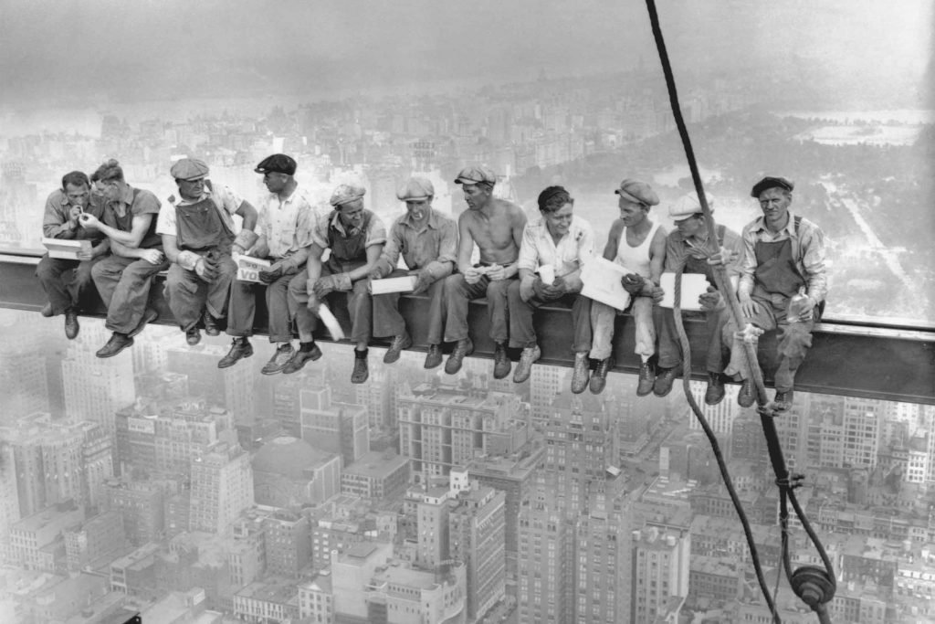
Break

Slide 18
to foundation presentation

Slide 19
Let’s continue…

Slide 20
STS Conceptual Foundation
DELIBERATION

Slide 21
Exercise 30 minutes
In your table group, using the perspective assigned to your group, discuss the question for 30 minutes & post your responses on the appropriate chart on the wall.
Based on the learning from the STARLab cases, what would you identify as key design parameters (up to 3) for each perspective in the digital era? (socio-ecological, socio-psychological and socio–technical systems)
Plenary 30 minutes - be prepared to share and deliberate
SmarT Organization Design Exercise

Slide 22
Exercise 30 minutes
In your table group, using the perspective assigned to your group, discuss the question for 30 minutes & post your responses on the appropriate chart on the wall.
Based on the learning from the STARLab cases, what would you identify as key design parameters (up to 3) for each perspective in the digital era? (socio-ecological, socio-psychological and socio–technical systems)
Plenary 30 minutes - be prepared to share and deliberate
Plenary
SmarT Organization Design Exercise

Slide 23
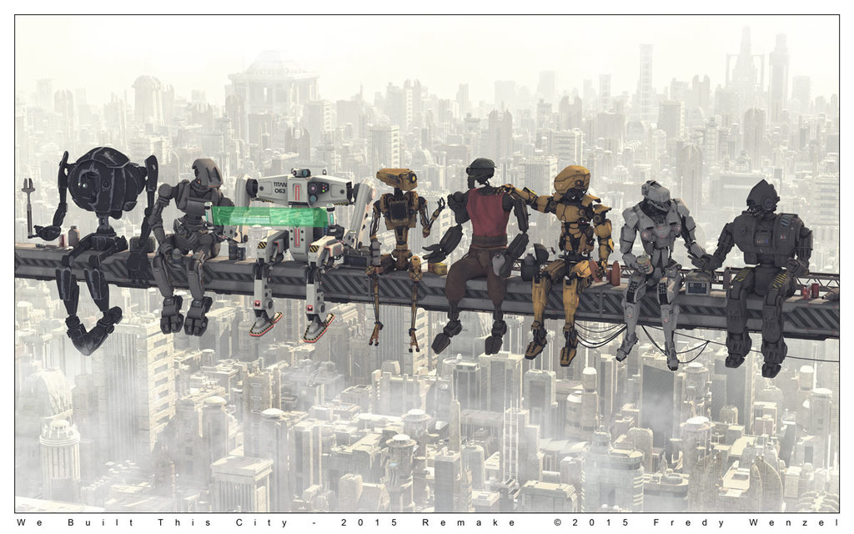
Let’s continue…

Slide 25
(suggestions)

Slide 26
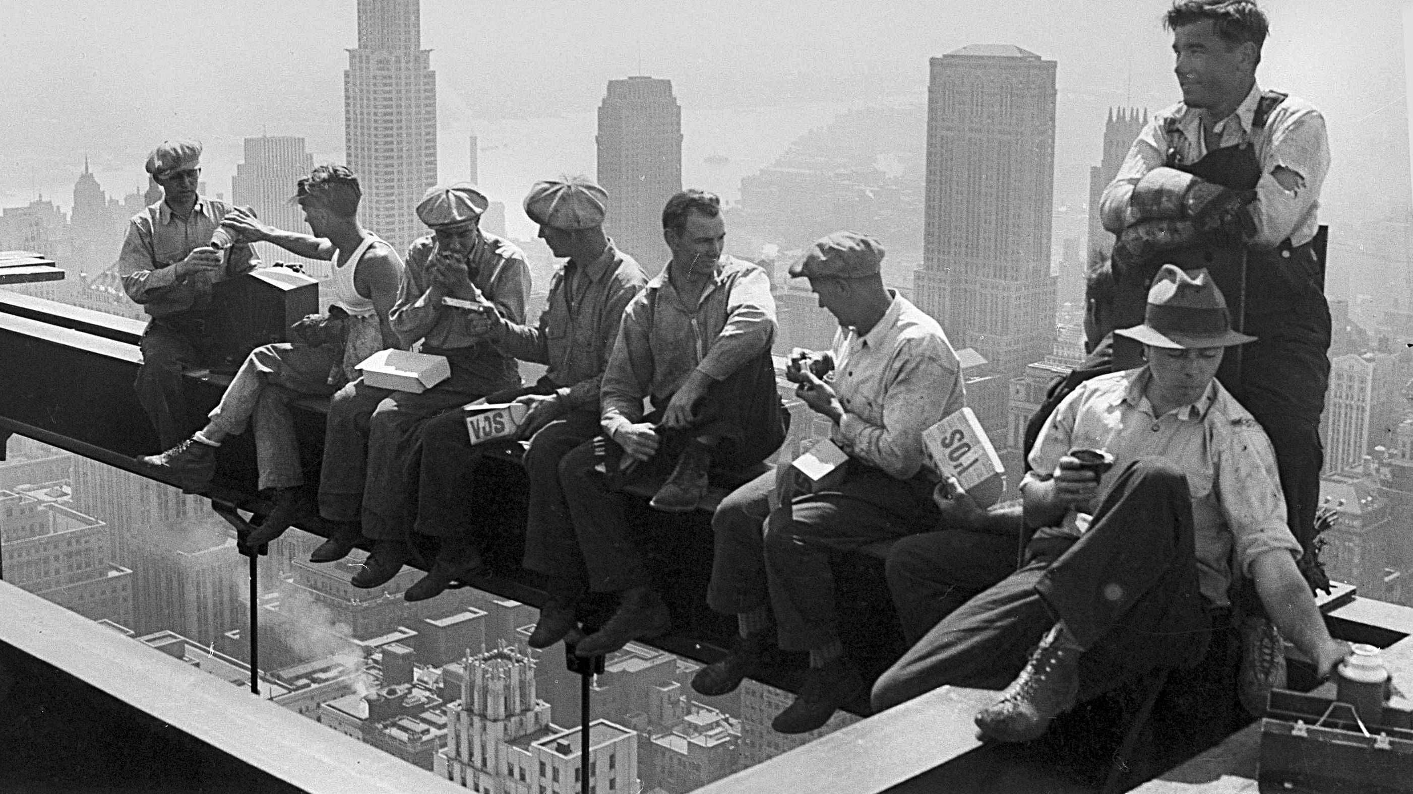
For Now: so long

