Slide 1
Positive Participative Innovation Merging Principles And Practices From Socio-technical Systems Design, Appreciative Inquiry And Design Thinking A Roadmap For Organizations And Networks That Want To Deliver More Impact, Value AND Enjoyment, ^{Quickly}
Prototype Workshop, Montreal, Sept 15-16, 2014
Bernard J Mohr, Don DeGuerre, Douglas Austrom

Slide 2
Intended Workshop Benefits
Discover the value of Design Thinking, SocioTechnical Systems Principles & Appreciative Inquiry for PPI
Practice core PPI tools and methods
Case Examples of what innovating for “More impact, value and enjoyment at less cost” looks like in real life
Strategies for navigating the politics of workplace innovation AND ... a customized plan for how to apply this “back – home”

Slide 3
PPI Process
Inquire (HHW)
Scale
Frame transformational topic
Mobilize
Collect stories
Test
Extract insights
Invigorate (HWW)
Imagine (HMW)
Model
Envision “wow” futures
Dream-storm innovations
Notes:
Draft a Focus and Frame
what is the topic .
that represents the direction we want to move in
and that energizes us
who will we involve in the inquiry, imagine and iterate phases? how? when?

Slide 4
Our Workshop Agenda – using the “live” case challenge of designing a global network, we will work through the PPI process
Inquire (How Have We/HHW)
Frame Transformational Inquiry Topic
Collect stories and other data
Extract Insights
Imagine (How Might We/HMW)
Envision “Wow” Futures
Dream-storm Innovations to create those futures
Model and iterate the innovations
Invigorate (How will we/HWW)
Test
Mobilize
Scale

Slide 5
Expectations of this Group
Two “deliverables” …
Pecha Kucha (20 slides, 20 seconds each) presentation Thursday night
Facilitate an engaging discussion on Saturday morning (approx. 2 hours) which includes…
Stress testing your storyboard or model of Glo.WIN that shows the concept and operation and possibilities for implementing it and
Coming to agreement on next steps between now and Leuven

Slide 6
Delivery Style
Fast moving
Iterative
Mash up ideas: “Do the Shuffle”
‘As if’ for real
Defined time-boxed tasks
You do the work, experience first and record burning questions.
Burning Questions: record any questions you have about content or process or what we are doing and why.

Slide 7
What hopes/aspirations and/or capacities do YOU bring to this workshop?
TASK: In Trios… take total of 10 mins
answer this question for each member
then summarize your discussion on a flip chart that has your names on it - print big and clearly.

Slide 8
Our journey to PPI and why we believe it has promise …
PPI

Slide 9
From Appreciative Inquiry: Essential Ideas and Practices for PPI
An explicit focus on:
What we want to create
Resources/strengths we have
People’s hopes and aspirations
Possibilities and solutions
Inquiry as change
Both/And
Emergence and improvisation
Transformative power of co-creation
Both/And

Slide 10
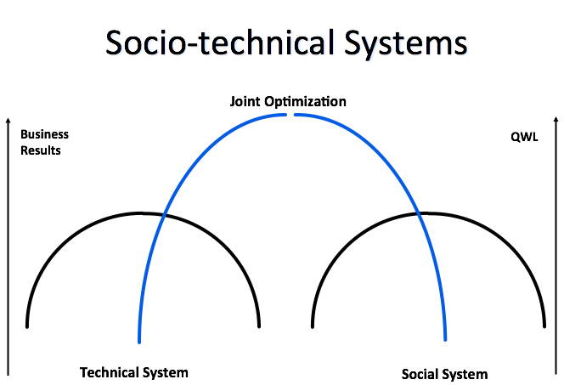

Slide 11
From Socio-Technical Systems Design Theory:
Essential Ideas and Practices for PPI
People who live in the systemic challenge are their own best experts to find solutions.
Everyone is capable of being an innovator.
People who will live with the outcome, design the innovations.
Innovation is not either social or technical -- it is always socio-technical.

Slide 12
From Design Thinking:
Essential Ideas and Practices for PPI
Human-centered and inclusive -- Effective solutions will be collaborative and developed with the people who will use them.
Systemic – Design a solution within its larger context.
Elegant -- Complex problems require simple, clear solutions.
Desirable and inspiring -- Successful solutions advance the human experience, give meaning to people’s lives, and raise their hopes and expectations.
Transformational -- Exceptional problems demand solutions that may be radical and even disruptive.
Sustainable -- Every solution needs to be robust, responsible and designed with regard to its long-term impact on the environment and society.
*
Notes:
A disciplined approach to design process emphasizing the importance of …
Clear design challenge
Collecting good “customer” data
Rapid iteration
along with …
Deep understanding of context for design challenge
Creativity in the generation of insights and solutions
Rationality in analyzing and fitting various insights to the innovation challenge

Slide 13
Desired Outcomes of Design Thinking
Desirability
Rational Choice
Feasibility
Viability
Notes:
What do people want?
What is technically and organizationally feasible?
What is financially viable?

Slide 14
The Innovation Context
Widespread disconnection within the global domain (ecosystem) of people that share a passion for healthy innovative communities of work
Little knowledge sharing across silos (functions, academic disciplines, generations)
Not invented here - cultural barriers
Linguistic and publication barriers
We dont know who is in the domain
Slow progress
Institutional failures (eg Ebola virus spread)
Burnout/disengagement (Gallup - 70-80% disengaged)
Big data creates information overloads

Slide 15
The Starting Innovation Challenge
How might we …create a global workplace innovation network (Glo.WIN) of individuals, organizations and other groups passionate about building healthy, humane and innovative communities of work.

Slide 16
Infrastructure of Innovation
Multi-Functional Teams
• By mixing people from different disciplinary and educational backgrounds we have a better chance of coming up with unexpected solutions
Time-boxing
• Many people notice that they work best with deadlines and concrete timelines. Likewise an innovation project with a beginning, middle and end is more likely to keep the team motivated and moving forward.
Iteration
• A new cultural norm emerges when a commitment is made to failing forward and constant renewal. The process is fast paced, imperfect and will surface your personal opinions on how GloWin can best express its mission and values

Slide 17
Forming Teams of 5-6
Maximum diversity: gender, age, education levels, practice, geography
Five teams of 5 or 6 people each
Members will “do the shuffle”
Form quickly (90 seconds)
Introduce yourselves (name, where from, what you do, why you are here) 20 minutes total

Slide 18
Inquire

Slide 19
INQUIRE (How Have We/HHW)
…using our past/present as springboard for creating the future
Frame Transformational Inquiry Topic
Collect stories and other data
Extract Insights

Slide 20
Frame Transformational Inquiry Topic
What we ask determines what we find
What we find determines how we talk
How we talk determines how we imagine together
How we imagine determines what we achieve together

Slide 21
An Airline’s Transformational Topic
Exceptional Arrival Experience!!!
Service Recovery!
Lost
Luggage
Less
Lost
Baggage

Slide 22
A Medical Center’s Transformational Topic
Problem = unplanned absences
Fewer unplanned absences
Higher rates of attendance
A workplace culture of being here and loving it

Slide 23
A great, transformational topic…
Has strategic/business relevance
“this is worth investing time and money in”
Represents real curiosity
desire for more knowledge/proficiency in topic
Is seen as highly desirable system-wide
“this would be great for us all”
Is more than incremental
Bold, evocative, challenges status quo,

Slide 24
TASK: Identifying OUR Transformational Topic
Complete Task in 20m | Purpose of Task : To Identify an Inquiry Topic That Meets the 4 Criteria for a Transformational Inquiry Topic
Step 1 - 2m | Select self managing group roles (Timekeeper, facilitator, recorder)
Step 2 - 2m | Team facilitator reviews the purpose (above) and steps of this task (below).
Step 3 – 16m | Using the previously described “innovation challenge” , complete the phrase “ An Inquiry Into,,,,,” For each draft version ask….”How well does it meet our four criteria” Keep working on iterations until the whole group says “YES, that’s it” Print the final version clearly on a flip chart in big letters Be ready to share your Transformational Inquiry Topic in 1 min

Slide 25
INQUIRE (How Have We/HHW)
…using our past/present as springboard for creating the future
Frame Transformational Inquiry Topic
Collect stories and other data
Extract Insights

Slide 26
Collecting Qualitative and Quantitative Data
Stories and interviews (sometimes with extreme users) are useful for moving tacit knowledge to the explicit realm. Other methods for capturing qualitative data exist eg photo journals
Additional useful information exists in quantitative form. (what we call “data”)
In a “real-life” PPI process we would have time to identify and collect and debrief other non-narrative quantitative data that we might want related to the innovation challenge

Slide 27
Hints for Developing Story Questions
Three Basic Elements to the Typical AI Question
1. A Positive Preface introducing your TOPIC
…then a two part question
2. High point discovery
3. Image of desired future

Slide 28
Example and Suggested Questions for Today
PREFACE: We have all been part of human networks that included people from various backgrounds, living in different locations and having different approaches to (insert your topic of inquiry here)…but who share common interests.
Tell me a story about an experience in such a network at its very best. What useful benefits were being generated in the network? How did the network members overcome challenges of difference in values, language, approach to problems, time zones etc. ie what structures, mechanisms or systems were useful?
If you could wave a magic wand and create the ideal global workplace innovation network for individuals, groups and organizations passionate about building healthy, humane and innovative communities of work, what would that network look like, who would be in it, how would it function?

Slide 29
TASK: Collecting Qualitative Data - (15+15)= 30mins
Using the sample questions provided earlier, interview one other person in this workshop for 15 m
take notes
help your interviewee give details by prompting him/her
manage your time carefully

Slide 30
INQUIRE (How Have We/HHW)
…using our past/present as springboard for creating the future
Frame Transformational Inquiry Topic
Collect stories and other data
Extract Insights

Slide 31
TASK: Extract Insights (A) – 40 mins
In your team, share the information collected from your interviews, figure out and be prepared to report (via flip chart) on…
What insights do we now have about structures, mechanisms or systems that are useful in helping network generate useful benefits for each other?
Based on your interviews, what resources/strengths/capacities (for building the ideal global workplace innovation network) do we have within this group of people?
What hopes and aspirations exist for the ideal global workplace innovation network, what would that network look like, who would be in it, how would it function?

Slide 32
TASK: Extract Insights (B) – 20 mins
In your team, reflect on what you just heard from the other teams
What insights do we now have about structures, mechanisms or systems that are useful in helping network generate useful benefits for each other?
Based on your interviews, what resources/strengths/capacities (for building the ideal global workplace innovation network) do we have within this group of people?
What hopes and aspirations exist for the ideal global workplace innovation network, what would that network look like, who would be in it, how would it function?

Slide 33
Imagine

Slide 34
Our Workshop Agenda – using the “live” case challenge of designing a global network, we will work through the PPI process
Inquire (HHW/How Have We)
Frame Transformational Inquiry Topic
Collect stories and other data
Extract Insights
Imagine (HMW/How Might We)
Envision “Wow” Futures
Dream-storm Innovations to create those futures
Model and iterate the innovations
Invigorate (HWW/How will we)
Test
Mobilize
Scale

Slide 35
Imagine (HMW/How might we)
How might we … create a global workplace innovation network of individuals, organizations and other groups passionate about building healthy, humane and innovative communities of work

Slide 36
Imagine … How might we (HMW)
In the Imagine phase we will use the stories and insights discovered in your inquiry.
This will take us from inspiration to ideas, from stories to strategic directions.

Slide 37
Inquire (HMW): Envision “WOW” Futures using Image Theatre
Create still images, body sculpting in small groups to express your wildest dream for GLoWin
Warm up with 10 second objects
Notes:
a car, a fried breakfast, a clock, a washing machine, a fire
Develop the Activity:
Encourage groups to think about using different levels with their body shapes, eg high, medium and low.
You could choose objects from a play you are rehearsing or a theme you are exploring (see the drama lesson on Evacuees).
Groups can also be given a couple of minutes to devise an object of their own which the rest of the class try to guess.
You could make it a rule that after 10 seconds they must be completely frozen in position.
On the other hand it can be fun if they are able to make objects that use movement.
You can use the shapes created as a quick way into creating ideas for physical theatre.

Slide 38
Task: Image Theater
Imagine your wildest dream for Glo.Win.
What does it look like?
One at a time build a group statue of that image without talking. Hold it until we get a picture of it.
Process. How was that? What ideas did you have? How did it come together?
Do the shuffle and do it again.
Notes:
Doug and Bernard use phones to take and print pictures

Slide 39
Imagine (HMW) …
Dream-storm Innovations
Transition from Metaphor towards Model
More detailed ideas
Think expansively and without constraints

Slide 40
“Air-Rules” for Dream-Storming
Defer judgment
Encourage wild ideas
Build on the ideas of others
Stay focused on the topic
Be visual - use sketches or diagrams
One conversation at a time
Go for quantity
Notes:
IDEO holds these rules sacred. They are geared to increase both the volume and originality of ideas.
Teams will practice these as they start brainstorming solutions.
And it’s not easy… I know that personally I struggle with “deferring judgment”, are there any here that you recognize as particularly challenging?
In addition to practicing these behaviors, teams have a chance to flex their creativity - its a very energizing and fun part of the experience!

Slide 41
TASK: Dream-Storming
In three groups of nine, dreamstorm innovative ideas for Glo.WIN based on your WOW visions.
Silently cluster your ideas and finally name the clusters as innovation themes.
Vote for the five innovative ideas you like best based on …
Novel, exciting and easy to understand
Relevance to the transformation topic
Pragmatic potential

Slide 42
Imagine (HMW):
Modeling and Prototyping
Make the abstract tangible
Communicate the ideas
Identify and test assumptions
Build the ideas
Notes:
Customer co-creation incorporates techniques that allow managers to engage a customer while in the process of generating and developing new business ideas of mutual interest. They are among the most value-enhancing, risk-reducing approaches to growth and innovation.
Learning launches are designed to test the key underlying value-generating assumptions of a potential new-growth initiative in the marketplace. In contrast to a full new-product rollout, a learning launch is a learning experiment conducted quickly and inexpensively to gather market-driven data.
Storytelling is exactly how it sounds: weaving together a story rather than just making a series of points. It is a close relative of visualization—another way to make new ideas feel real and compelling. Visual storytelling is actually the most compelling type of story. All good presentations—whether analytical or design-oriented—tell a persuasive story.

Slide 43
Imagine (HMW):
Modeling and Prototyping
Storytelling
Storyboarding
Write a blurb/article
Photo montage
3D dioramas
Role plays, skits
Videos
User scenarios
Experience journeys
Thought experiments
Concept illustrations
Notes:
Storytelling is exactly how it sounds: weaving together a story rather than just making a series of points. It is a close relative of visualization—another way to make new ideas feel real and compelling. Visual storytelling is actually the most compelling type of story. All good presentations—whether analytical or design-oriented—tell a persuasive story.

Slide 44
Imagine (HMW): Modeling
Modelling is about constructing a prototype of your best ideas generated during the dreamstorm.
Create a tangible diagram or 3-dimensional model of “Glo.WIN” that shows the concept and operation.
Rough, sketchy, messy, imperfect. Fast iterations. Different groups.
Stand up, draw it or build it, throw it out and start again. Get lively but not too much discussion right now. It will be fast. Let’s just see it first.

Slide 45
VISUALIZING ORGANIZATIONAL CONCEPTS
VENN DIAGRAM
RELATIONAL MAP
RELATIONAL MAP
PROCESS MAP
METAPHOR MAP

Slide 46
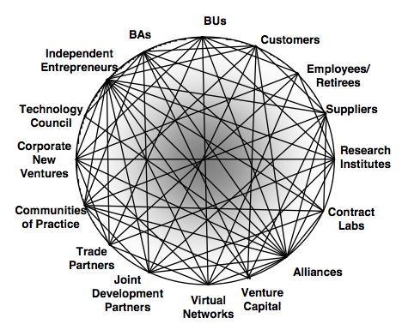
An Innovation Ecosystem

Slide 47
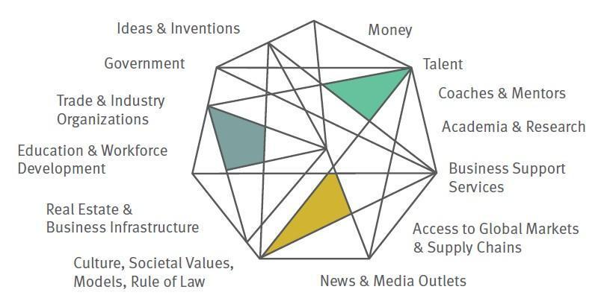
An Innovation Ecosystem

Slide 48
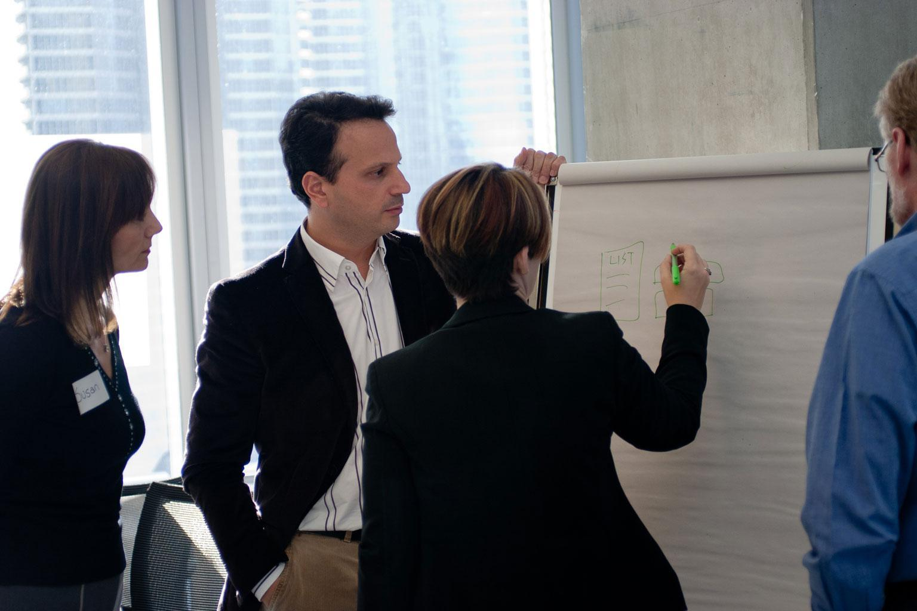
Notes:
Rather than take an idea that sounds great and backing it with millions of R&D dollars, or even stage-gating an idea, you can learn a lot about its potential in extremely rapid, low-cost experiments.
So here….
Teams will storyboard and present an experiment that will help other teams – as well as themselves - better understand their favorite idea.
The other teams will rank you on this criteria - is your experiment Low Risk? (safe audience, low cost), is it Quick and Easy?, (can you run it in less than an hour?) and is it Generative? (this is important - is your experiment on target to evolve your idea, rather than challenge it).

Slide 49
Task: Model Two Iterations
20 minutes Produce a model
90 second Reports
5 minutes Feedback (stress test with stickies)
30 seconds Do the shuffle (mash up)
Do it again

Slide 50
Invigorate

Slide 51
Our Workshop Agenda – using the “live” case challenge of designing a global network, we will work through the PPI process
Inquire (How Have We/HHW)
Frame Transformational Inquiry Topic
Collect stories and other data
Extract Insights
Imagine (How Might We/HMW)
Envision “Wow” Futures
Dream-storm Innovations to create those futures
Model and iterate the innovations
Invigorate (How will we/HWW)
Test
Mobilize
Scale

Slide 52
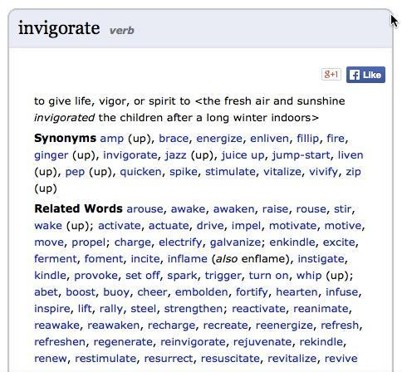

Slide 53
Invigorating the System
Connecting the network by implementing the model(s) and integrating the innovative ideas into the flow through an iterative set of activities …
Testing
Mobilizing
Scaling

Slide 54
Invigorate … HWW
Testing aka Agile Co-Creation
Rapid iteration, multiple cycles and learning loops
Series of field tests and simple, small, low cost experiments with users and stakeholders to …
Gather data, learn, and evolve your ideas
Test assumptions
Engage new participants and expand the community of stakeholders
Ensure that your innovations are viable, feasible, repeatable and scalable
Notes:
Iteration is a fundamental of good design. Iterate both by cycling through the process multiple times, and also by iterating within a step—for example by creating multiple prototypes or trying variations of a brainstorming topics with multiple groups. Generally as you take multiple cycles through the design process your scope narrows and you move from working on the broad concept to the nuanced details, but the process still supports this development.
For simplicity, the process is articulated here as a linear progression, but design challenges can be taken on by using the design modes in various orders; furthermore there are an unlimited number of design frameworks with which to work. The process presented here is one suggestion of a framework; ultimately you will make the process your own and adapt it to your style and your work. Hone your own process that works for you. Most importantly, as you continue to practice innovation you take on a designerly mindset that permeates the way you work, regardless of what process you use.

Slide 55
PPI Principles in Field Testing and Agile Co-Creation
From | To
Fail early to succeed sooner | Learn early, learn quickly, learn often
Expert learning and expert design | Co-learning and co-design

Slide 56
TASK: Design a Field Test
Design a small, safe experiment or field test to answer a specific question about one element of a model or a step in the process of implementing a Glo.WIN model. Parameters for your field test include…
Answers a question, tests an assumption.
Cheap (zero budget)
Quick (30 minutes)
Create a storyboard that describes how people would interact with or participate in your field test.

Slide 57
Suggestions for Story Boarding
Just start drawing
Focus on PEOPLE
Words – Less is more
Incomplete and imperfect
Share when good enough
Invite input from others – Post-its

Slide 58
Task: Mobilizing the Global Network
Given what we now think about what we should do, develop a storyboard describing how to mobilize a global network?
Who needs to be involved?
Where is the energy?
How will we ignite the energy? How will we engage them in agile co-creation?

Slide 59
TASK: Scale Your Innovations (20+10m)
Given what we now think about what we should do …
How WILL we … sustain this energy and build the global network?
How WILL we engage a broader team of stakeholders and partners in this journey?
What principles will guide us?
How will we structure the activity?
How will we enable this global network?
What resources are available?
Who will take “ownership”?

Slide 60
Taking it Home Part I
Addressing your Burning Questions about PPI
Competencies, knowledges and skills required to use PPI. Generate lists in groups.

Slide 61
Taking it Home Part II
What innovation opportunities are you facing that could be addressed using a Positive and Participative approach to innovation?
Design challenge
Participants – aka stakeholders
High level design or approach
Relationships and enabling infrastructure
Resources
Steps to get started

Slide 62
TASK: Taking it Home Part II
Who has a back home case that they would like to consider the use of PPI with?
Choose five or more
Who wants to work on exploring/planning PPI on which case
30 minutes in groups and 20 minutes reporting and expanding ideas created in groups

