Slide 1
An Emergently Wicked Large-Scale Crowd-Based
Collaborative Startup: What’s New about HTT?
A. Majchrzak, T.Griffith. O. Alexy, D. Reetz
Notes:
Image for foreshadowing Image for foreshadowing Links to crowds, sociotechnical collaboration, generative dynamics, boundary spanning

Slide 2
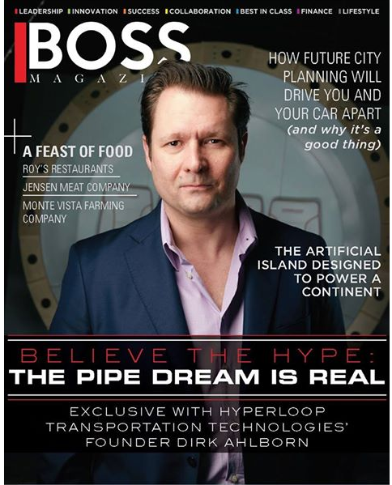
Dirk Ahlborn: The Entrepreneur
Serial entrepreneur
Initially banker
Moved to LA to work at Girvan Institute of Technology, a NASA-funded tech incubator
Launched Jumpstarter Inc, a non-profit platform helping entrepreneurs gain help from crowds
Posted a new venture: HyperloopTransportation System shortly after Musk’s design concept. Immediately gained tremendous crowd traction Team and History

Slide 4
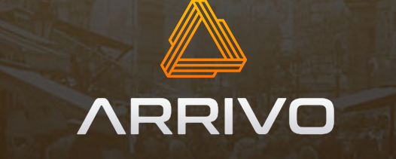
Not Alone
How does HTT compete?
Keep overhead low so controls its own future
Partner for implementation
Few full-time staff
Get the best able, not just most available
Global, no real HQs
Focus on transportation system, not just hyperloop
Exclusive license to low-energy passive levitation technology
We're now 200 people on three campuses in LA and Nevada. We're engineers, welders, machinists, designers and builders. (betw $50-$250M)
Edgewaters
Investment
CEO:
80 people

Slide 5
40,000
(10 salaried; 10 stock)
800

Slide 6
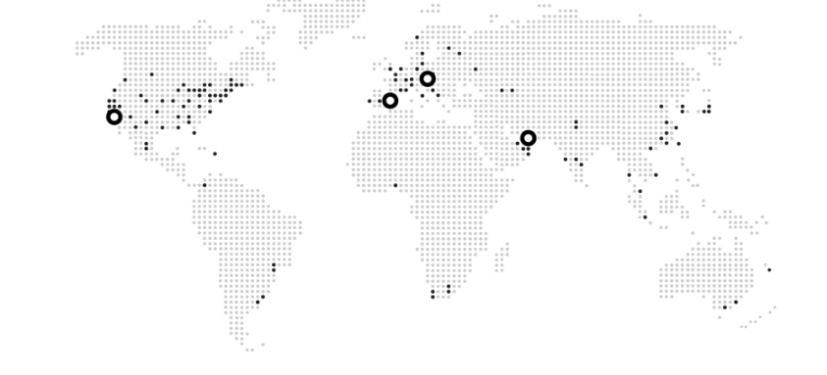
25
& UAE & Toulouse & Jakarta
49
38

Slide 7
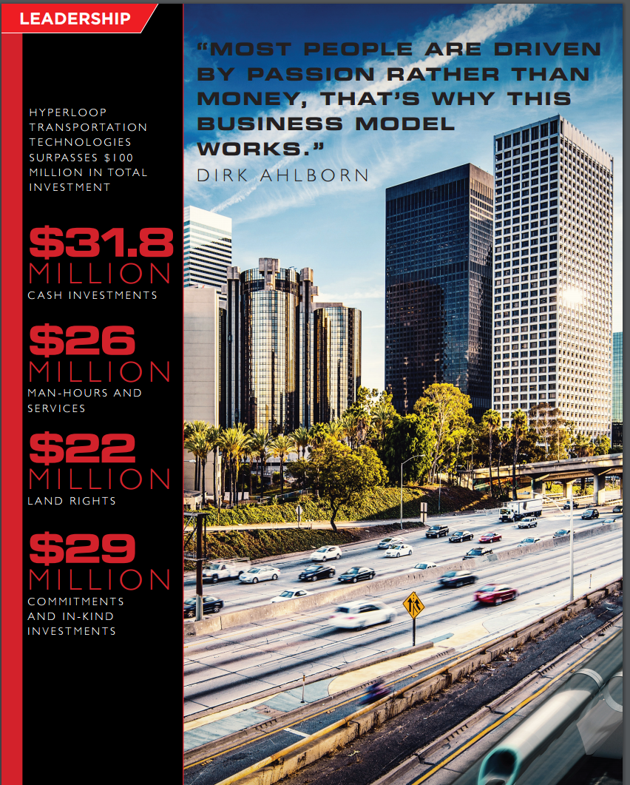

Slide 8
Hyperloop Ecosystem R&D Projects provided by 60,000 Community Hours in Exchange for Stock Options

Slide 9
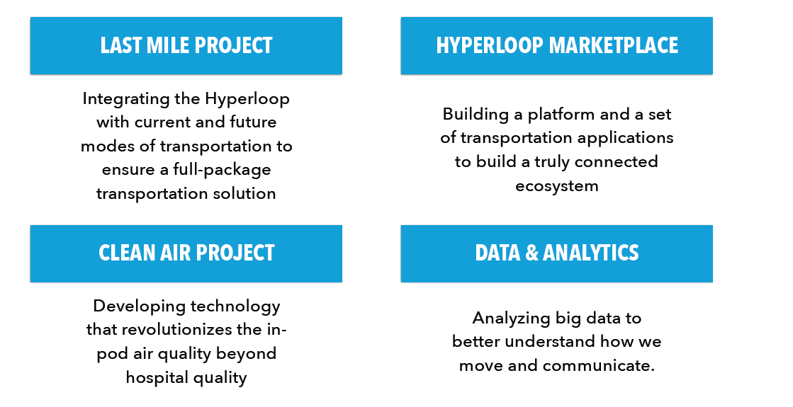
Hyperloop Ecosystem R&D Projects provided by 60,000 Community Hours in Exchange for Stock Options
Augmented
windows
Absorbent
Concrete
20% energy
Surplus
Vertical
farming

Slide 10
Research Question: Does HTT’s Organizational Design challenge Current Organization Design Theory?

Slide 11
Research Methodology
Joined the Global Operations Team
10-20 hrs/week commitment
Responsible for fostering collaborative platform use
Responsible for engaging the 40,000 crowd
Engaged academics in critical analysis comparing HTT’s organization design against traditional organization design to identifying differences

Slide 12
Difference #1: How are tasks divided? THEY AREN’T
& unpredictable

Slide 13
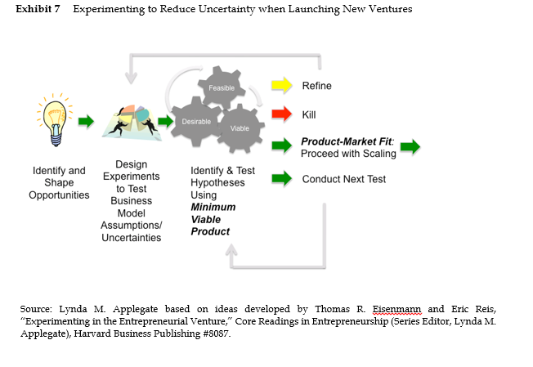

Slide 14
Branching rather than Dividing Tasks
Initial Today
# grps 25 188 Who belongs: Org Chart Need
Whatever You Want suggestions for improving FB@W
BRANCHED TO:
Suggestions for FB@W Improvements, Suggestions for Improving HTT. Creating a design assumptions document. Request Help, Way we Work, Introduce Yourself, Culture, what are your needs?

Slide 15
Difference #2: How are Tasks Allocated? THEY AREN’T
& unpredictable

Slide 16
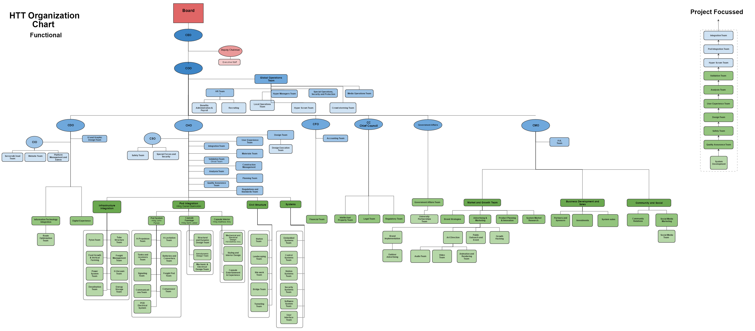
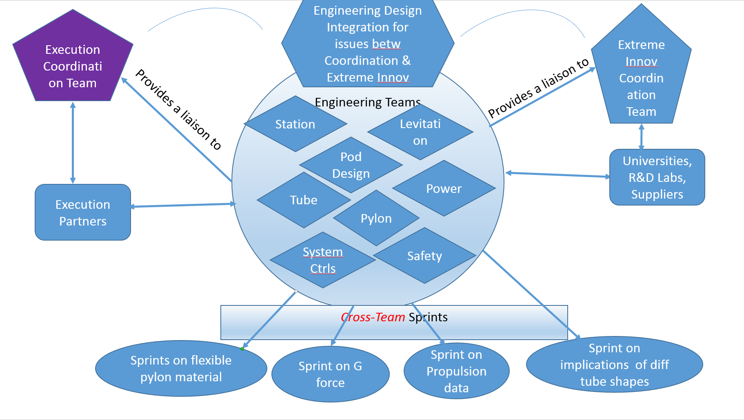
Organizational Structure: Constantly Changing*
From: Hierarchical
To: Problem-Opportunity Matching
50 teams
*conceptual, not actual, for protection of IP

Slide 17
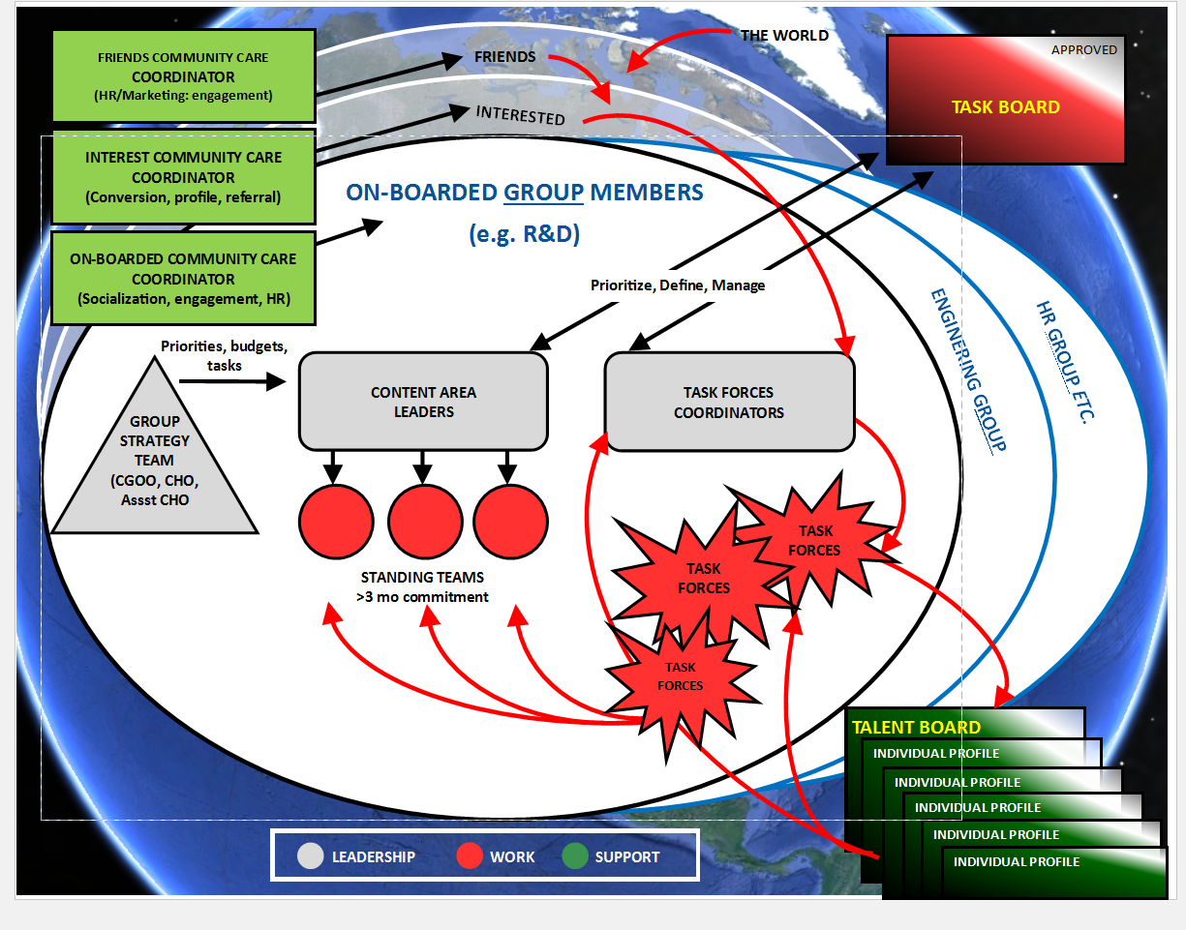
Not an official HTT doc. Created by authors for explanatory purposes

Slide 18
Difference #3: How are People Motivated? Culturally balance exclusion and inclusion
& unpredictable

Slide 19
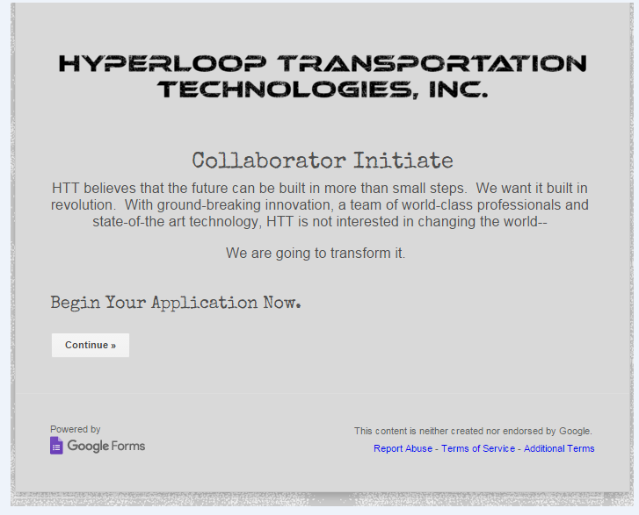
HTT: Crowdsourcing Vetting into HTT Core
Stage 1: Open invite to all: “Please explain what you can contribute to our success”
Stage 2: Invited to apply:
Application includes:
CV
Specification of Skills
Relevant experience
Agreement to commit to 10 hours/week
Stage 3: Sign NDA and contract to commit to role
Stage 4: Close down applications

Slide 20
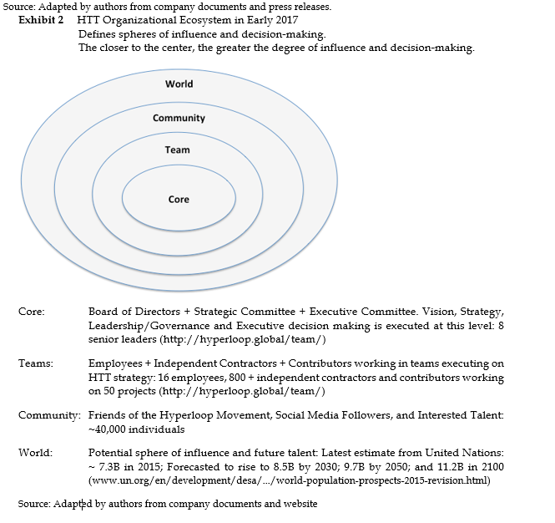

Slide 21
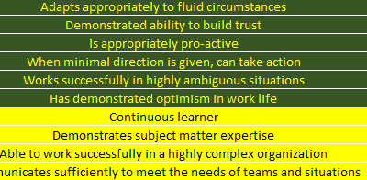
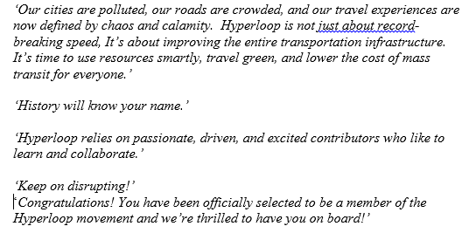
Cultural “Guardrails” and “Movement”

Slide 22
Difference #3: How balance info-sharing without IP loss? Create “secret virtual spaces” that everyone knows exist
& unpredictable

Slide 23
“Secret” workers
Under contract
Secret
Secret
Secret
Secret
Senior managers must
convince everyone else
that they can move forward
without knowing the IP
(For illustrative purposes only)

Slide 24
Difference #4: How make decisions: Cooperate but disrupt
& unpredictable

Slide 25
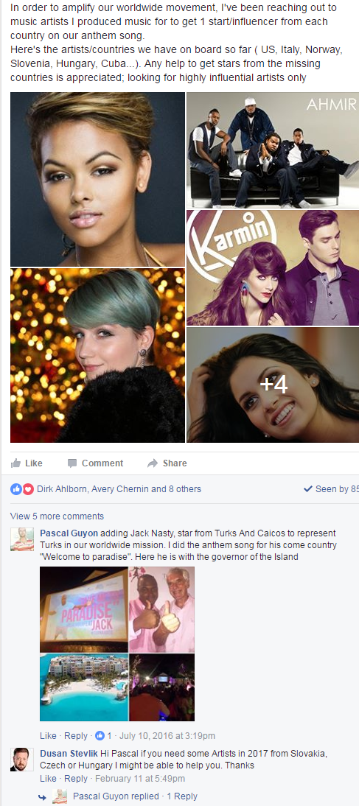
Disrupt but Cooperate
Urgent request: We are putting togethe
Take a look at this: https://www.youtube.com/Any comment on this technology?

Slide 26
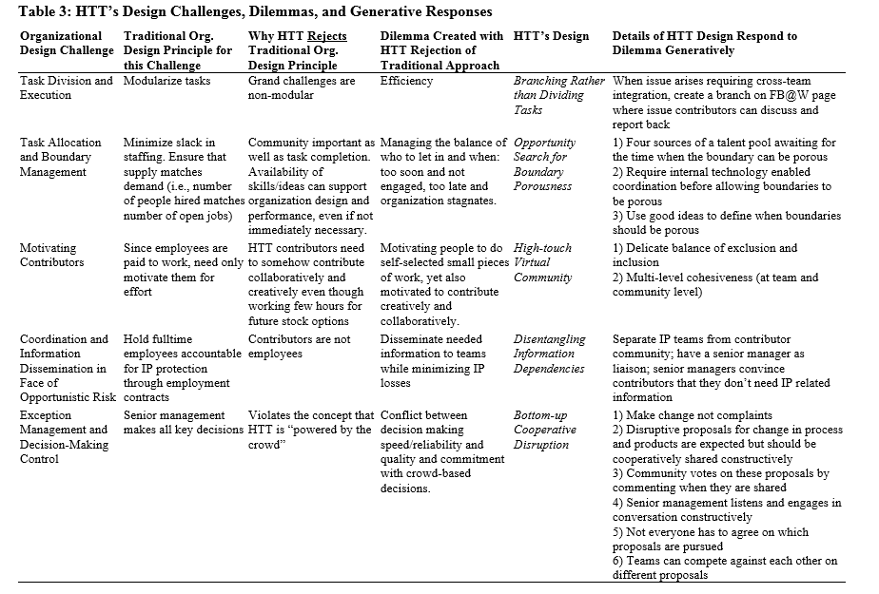

Slide 27
Does HTT provide a unique organizational form?
A large hybrid “crowdsourced” organization with engineering deadlines, world-changing view, & incredibly complex engineering challenges and interdependencies unlike Wikipedia
Innovations & opportunities constantly create new dependencies, resource needs, & bottom up need for organizational redesign and shifting priorities unlike OSS
What is HTT doing differently from others you know about?

Slide 28
EWOCs (Emergently Wicked Organizational Collaborations): a New Organizational Form?

