Slide 1
Transforming Relationships for
High Performance:
A Sociotechnical Systems Approach
September 9, 2015
Jody Hoffer Gittell
Professor, Brandeis University
Executive Director, Relational Coordination Research Collaborative

Slide 3
Today
What is relational coordination?
How does it impact performance?
How do our organizations support RC – or not?
Where to start? A relational model of organizational change

Slide 5
Flight departure process:
A coordination challenge
Operations Agents
Baggage Agents
Ramp Agents
Gate Agents
Ticket Agents
Cabin Cleaners
Passengers
Caterers
Freight Agents
Fuelers
Flight Attendants
Mechanics
Pilots

Slide 6
Findings
Relationships shape the communication through which coordination occurs ...

Slide 7
For better...
Frequent
Timely
Accurate
Problem-solving communication
Shared goals
Shared knowledge
Mutual respect

Slide 8
… or worse
Functional goals
Specialized knowledge
Lack of respect
Infrequent
Delayed
Inaccurate
“Finger-pointing” communication

Slide 9
This process is called
relational coordination
“Communicating and relating
for the purpose of task integration”

Slide 10
Does relational coordination matter for performance?

Slide 11
Investigated performance effects of relational coordination
Nine site study of flight departures over 12 months of operation at Southwest, American, Continental and United
Measured relational coordination among pilots, flight attendants, gate agents, ticket agents, baggage agents, ramp agents, freight agents, mechanics, cabin cleaners, fuelers, caterers and operations agents
Measured quality and efficiency performance, adjusting for product differences

Slide 12
Relational coordination drives
flight departure performance
SWA1
CON2
SWA2
Quality/efficiency performance index
CON1
UNI3
UNI1
AMR1
AMR2
UNI2
Relational coordination

Slide 13
Patient care:
A coordination challenge
Case Managers
Attending Physicians
Nurses
Physical Therapists
Nursing Assistants
Patients
Social Workers
Technicians
Referring Physicians
Administrators

Slide 14
Same study conducted in hospital setting
Nine hospital study of 893 surgical patients
Measured relational coordination among doctors, nurses, physical therapists, social workers and case managers
Measured quality and efficiency performance -- and job satisfaction, adjusting for patient differences

Slide 15
Relational coordination drives surgical performance
Hosp6
Hosp4
Hosp8
Quality/efficiency performance index
Hosp5
Hosp9
Hosp3
Hosp7
Hosp1
Hosp2
Relational coordination

Slide 16
Institute of Medicine report
“The current system shows too little cooperation and teamwork. Instead, each discipline and type of organization tends to defend its authority at the expense of the total system’s function.” (2003)

Slide 17
Physicians recognize the problem
“The communication line just wasn’t there. We thought it was, but it wasn’t. We talk to nurses every day but we aren’t really communicating.”

Slide 18
Nurses observe the same problem
“Miscommunication between the physician and the nurse is common because so many things are happening so quickly. But because patients are in and out so quickly, it’s even more important to communicate well.”

Slide 19
Elder care:
A coordination challenge
Nursing Aides
Activities Staff
Nurses
Dietary Staff
Therapists
Resident and family
Housekeeping Staff
Case Managers
Referring Physicians
Attending Physicians

Slide 20
Coordination is lacking
“The problem is that doctors in acute care don’t understand what happens in long-term care or rehab. …In post-acute there’s a knowledge gap about what is going on in acute care. There often aren’t very good processes in place, so patient transitions can be very ad hoc…”

Slide 21
Staff see the same problem
“The problem here is that people don’t talk – and it’s the residents who lose. The nursing aide knows when a resident is having trouble eating or mobilizing or is feeling down. But who is listening? Here everything has to go through the chain of command.”

Slide 22
Study conducted in nursing homes
Fifteen nursing home study of 105 residents
Measured relational coordination between 234 nursing aides, nurses, dietary staff and housekeeping staff
Measured resident quality of life, adverse events, and staff job satisfaction, adjusting for resident and staff characteristics

Slide 23
Relational coordination drives elder care performance
LTC12
LTC5
LTC8
LYC14
Performance index
LTC7
LTC9
LTC10
LTC6
LTC4
LTC3
LTC15
LTC2
LTC11
LTC1
LTC13
Relational coordination

Slide 24
RC has been tested in many contexts
Surgical care
Medical care
Emergency care
Intensive care
Maternity
Primary care
Chronic care
Elder care
Pharmacy sector
Airlines
Manufacturing
Banking
Retail sector
Accounting
Early child education
Higher education
Professional services

Slide 25
…and in 19 countries
United States
Canada
Denmark
Norway
Austria
Switzerland
Netherlands
Belgium
Scotland
Ireland
France
Ecuador
Japan
Korea
China
Pakistan
Israel
Australia
New Zealand

Slide 26
Efficiency & financial outcomes
Increased employee productivity
Increased profit growth
Improved operational excellence
Reduced turnaround time
Reduced product development costs
Reduced length of hospital stay
Reduced total cost of hospital care
Reduced inpatient hospitalizations
Reduced total costs of chronic care

Slide 27
Quality & safety outcomes
Increased on-time performance
Increased product development quality
Increased patient satisfaction with care
Increased patient intent to recommend
Improved postoperative pain/ functioning
Improved quality of chronic illness care
Increased quality of life for elderly
Reduced customer complaints
Reduced medication errors
Reduced hospital acquired infections
Reduced patient fall-related injuries

Slide 28
Client engagement
Increased evaluation, enrollment and retention of clients
Increased trust and confidence in care team
Increased self-management
Increased community linkages
Increased family readiness for caregiving
Increased family engagement with teachers
Increased ability to cope with needs of child
Reduced parenting stress

Slide 29
Clients/Customers
Manager
Relational coproduction
Co-Workers
Co-Workers
Relational coordination

Slide 30
Worker engagement
Increased job satisfaction
Increased career satisfaction
Increased professional efficacy
Increased use of competence at work
Increased work engagement
Increased involvement at work
Increased proactive work behaviors
Increased motivation at work
Increased equity of contribution
Reduced burnout

Slide 31
Why does RC improve
worker outcomes?
Enables workers to achieve
better quality outcomes
less wasted effort
less stress

Slide 32
Learning & innovation
Increased psychological safety
Increased learning from failures
Increased reciprocal learning
Increased innovation
Increased collaborative knowledge creation

Slide 33
Relational coordination increases
operational capacity
adaptive capacity

Slide 34
Relational coordination pushes out the quality/efficiency frontier to increase value creation
Quality & Safety Outcomes
Relational coordination
Efficiency & Financial Outcomes

Slide 35
For a review of 74 studies from 19 countries, see
Gittell and Logan (2015). “The Impact of Relational Coordination on Performance and
How Organizations Support Its Development.”
Working Paper, Brandeis University.

Slide 36
Why does RC improve performance?
Relationships of shared goals,
shared knowledge and mutual respect help workers to see how they connect
around the customer

Slide 37
Why does RC improve performance?
Relationships of shared goals,
shared knowledge and mutual respect
provide an organizational culture that supports process improvement

Slide 38
How do our organizations support relational coordination – or not?

Slide 39
Organizational structures that support RC
Relational Coordination
Shared Goals
Shared Knowledge
Mutual Respect
Frequent
Timely
Accurate
Problem Solving
Communication
Structures
Select & Train for Teamwork
Shared Accountability & Rewards
Shared Conflict Resolution
Leader & Supervisor Roles
Boundary Spanner Roles
Relational Job Design
Team Meetings
Shared Protocols
Shared Information Systems
Performance Outcomes
Quality & Safety
Efficiency & Finance
Worker Engagement
Client Engagement
Innovation & Learning

Slide 40
Vertical/bureaucratic structures weaken relational coordination
Nursing Aides
Activities Staff
Nurses
Dietary Staff
Therapists
Housekeeping Staff
Case Managers
Referring Physicians
Attending Physicians

Slide 41
Horizontal structures support relational coordination
Nursing Aides
Activities Staff
Nurses
Dietary Staff
Therapists
Housekeeping Staff
Case Managers
Referring Physicians
Attending Physicians

Slide 42
For theory and findings see:
Gittell, Seidner & Wimbush (2010). “A Relational Model of How High Performance Work Systems Work,” Organization Science.
Gittell & Douglass (2012). “Relational Bureaucracy: Embedding Reciprocal Relationships Into Roles,” Academy of Management Review.

Slide 43
Bottom line
Structures can WEAKEN relational coordination or SUPPORT relational coordination,
depending on their design and implementation

Slide 44
But where would you start?
Relational Coordination
Shared Goals
Shared Knowledge
Mutual Respect
Frequent
Timely
Accurate
Problem Solving
Communication
Structures
Select & Train for Teamwork
Shared Accountability & Rewards
Shared Conflict Resolution
Leader & Supervisor Roles
Boundary Spanner Roles
Relational Job Design
Team Meetings
Shared Protocols
Shared Information Systems
Performance Outcomes
Quality & Safety
Efficiency & Finance
Worker Engagement
Client Engagement
Innovation & Learning

Slide 45
Changing structures is not enough
Change rarely occurs simply by changing organizational structures
Relational patterns are deeply engrained in organizational cultures and professional identities
Need to change relational patterns directly
Also need to change the work itself

Slide 46
Three kinds of interventions needed
Relational interventions to build the new relational dynamics
Work process interventions to connect new relational dynamics to improvements in the work itself
Structural interventions to support the new relational dynamics

Slide 47
Relational model of organizational change
Relational Coordination
Frequent
Timely
Accurate
Problem Solving
Communication
Shared Goals
Shared Knowledge
Mutual Respect
Structural Interventions
Select & Train for Teamwork
Shared Accountability & Rewards
Shared Conflict Resolution
Leader & Supervisor Roles
Boundary Spanner Roles
Team Meetings
Shared Protocols
Shared Information Systems
Performance Outcomes
Quality & Safety
Efficiency & Finance
Client Engagement
Worker Engagement
Learning & Innovation
Relational Interventions
Create Safe Space
Appreciative Inquiry/Coaching
Relational Assessment
Work Process Interventions
Assess Current State
Identify Desired State
Experiment to Close the Gap

Slide 48
Relational model of organizational change
Middle & Top Leadership
Relational Coordination
Frequent
Timely
Accurate
Problem Solving
Communication
Shared Goals
Shared Knowledge
Mutual Respect
Structural Interventions
Select & Train for Teamwork
Shared Accountability & Rewards
Shared Conflict Resolution
Leader & Supervisor Roles
Boundary Spanner Roles
Team Meetings
Shared Protocols
Shared Information Systems
Performance Outcomes
Quality & Safety
Efficiency & Finance
Client Engagement
Worker Engagement
Learning & Innovation
Relational Interventions
Create Safe Space
Appreciative Inquiry/Coaching
Relational Assessment
Work Process Interventions
Assess Current State
Identify Desired State
Experiment to Close the Gap
Frontline Leaders & Workers

Slide 49
A tool for research – and for change
Relational coordination is a fully validated and “unbounded” measure of teamwork
You can measure relational coordination
Within workgroups
Between workgroups
Across highly distributed networks
Can include clients and customers
Can measure at any level of leadership
And across levels of leadership

Slide 50
Survey questions
RC dimensions | Survey questions
1. Frequent communication | How frequently do people in each of these groups communicate with you about [focal work process]?
2. Timely communication | How timely is their communication with you about [focal work process]?
3. Accurate communication | How accurate is their communication with you about [focal work process]?
4. Problem solving communication | When there is a problem in [focal work process], do people in these groups blame others or try to solve the problem?
5. Shared goals | Do people in these groups share your goals for [focal work process]?
6. Shared knowledge | Do people in these groups know about the work you do with [focal work process]?
7. Mutual respect | Do people in these groups respect the work you do with [focal work process]?

Slide 51
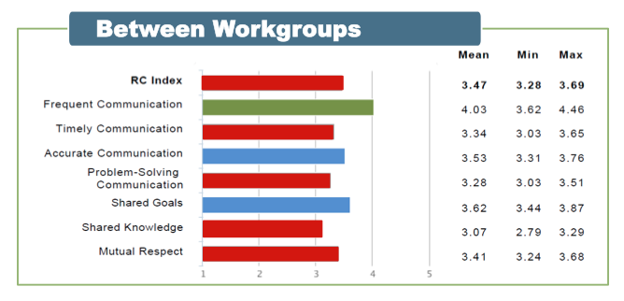
Seven dimensions of RC

Slide 52
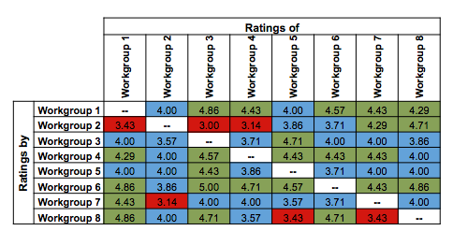
RC matrix

Slide 53
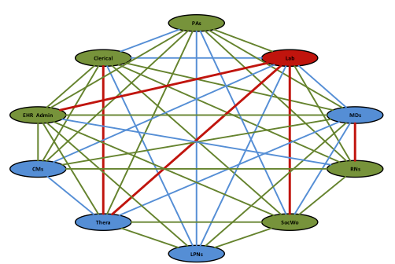
RC network

Slide 54
A tool for change
Measures can be shared with participants to inform their change efforts
“Looking into the mirror”
“Putting the elephant on the table”
A starting point for new conversations
A starting point for innovation and change
Visit http://rcrc.brandeis.edu

