Slide 1







#euwinleuven

Slide 2




Total Workplace Innovation.
Trips to the future.
#euwinleuven
Notes:
From psychology to action?
How to upscale your idea?
Importance of Wpi
Investments in technology: well under way?
And what in WPI?
Programme by DG GROW
Success of EUWIN!

Slide 3
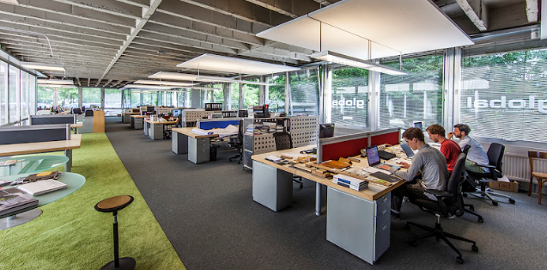
#euwinleuven

Slide 4
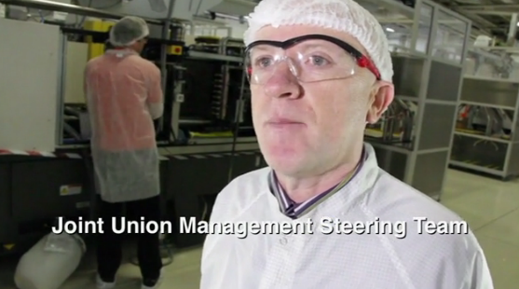

#euwinleuven

Slide 5
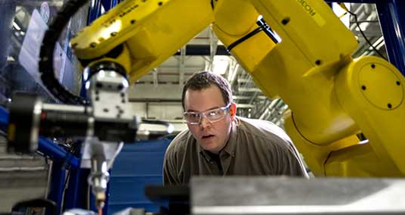

#euwinleuven

Slide 6
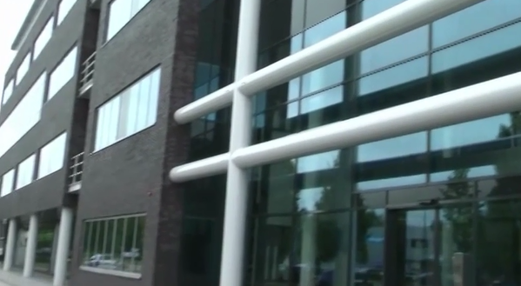
#euwinleuven

Slide 7



Thank you for the opportunity!
http://portal.ukwon.eu/
#euwinleuven
You can contact us:
Steven Dhondt: steven.dhondt@tno.nl
Peter Totterdill: peter.totterdill@ukwon.net
Geert Van Hootegem: geert.vanhootegem@soc.kuleuven.be
Mieke Van Gramberen: mieke.vangramberen@flanderssynergy.be
Grzegorz Drozd: grzegorz.drozd@ec.europa.eu
CLICK HERE
TO VISIT
OUR
WEBSITE

Slide 8
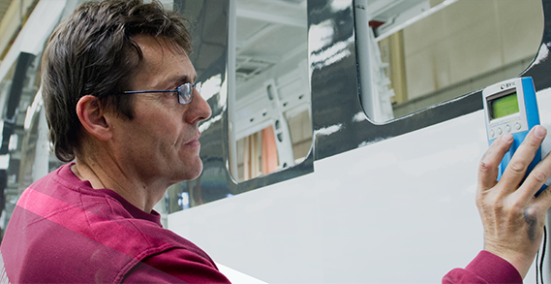

#euwinleuven

Slide 9
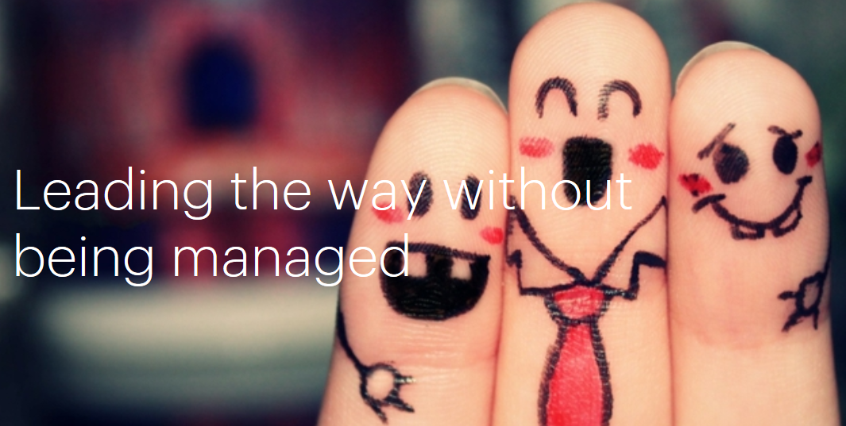

#euwinleuven

