Slide 1
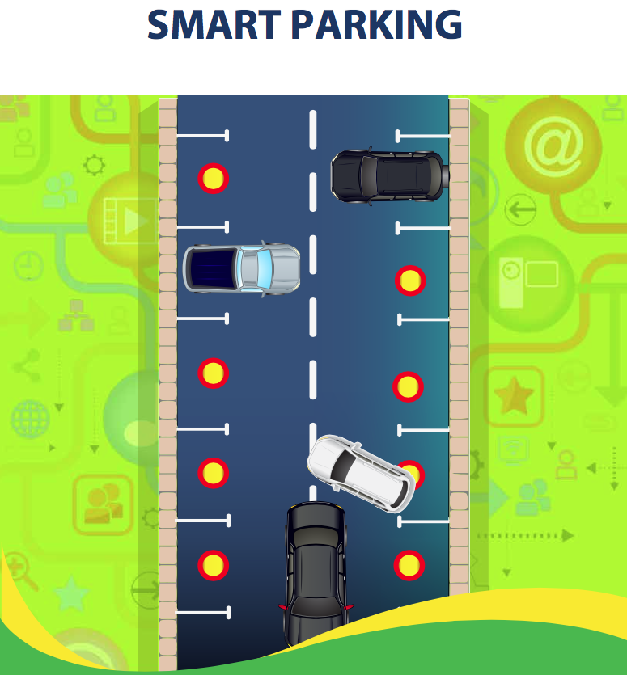
ORGANIZATION DESIGN CHALLENGES

Slide 2
1. Assemble LA Smart City constituents to coalesce on Smart Parking purpose, system boundaries, mutual benefit? [SMART Organization Design socio-ecological perspective] 2. Define the workflow and measures required for an effective work system that results in Smart Parking Value Creation? [SMART Organization Design socio-technical systems perspective] 3. Enable the shift in IT to a larger strategic role regarding SMART Transportation within the LA ecosystem? [SMART Organization Design socio-psychological perspective]
3 Distinct + Inter-related, In-Parallel
ORGANIZATION DESIGN CHALLENGES—90 Minutes

Slide 3
2. Define Workflow + Measures for an effective Work System
Example: Organization Design Challenge FORMAT
QUESTIONS for UNDERSTANDING—20 Minutes
LA Metropolis Socio-Technical System
a) What are key Activities in the process of Smart Parking value creation?
e.g. parking inventory management, parking of vehicles, payment for parking, maintenance of parking infrastructure
b) Who are major Actors – human + technical – in the service system?
c) How does Information get transferred among these roles? What are the feedback loops?

Slide 4
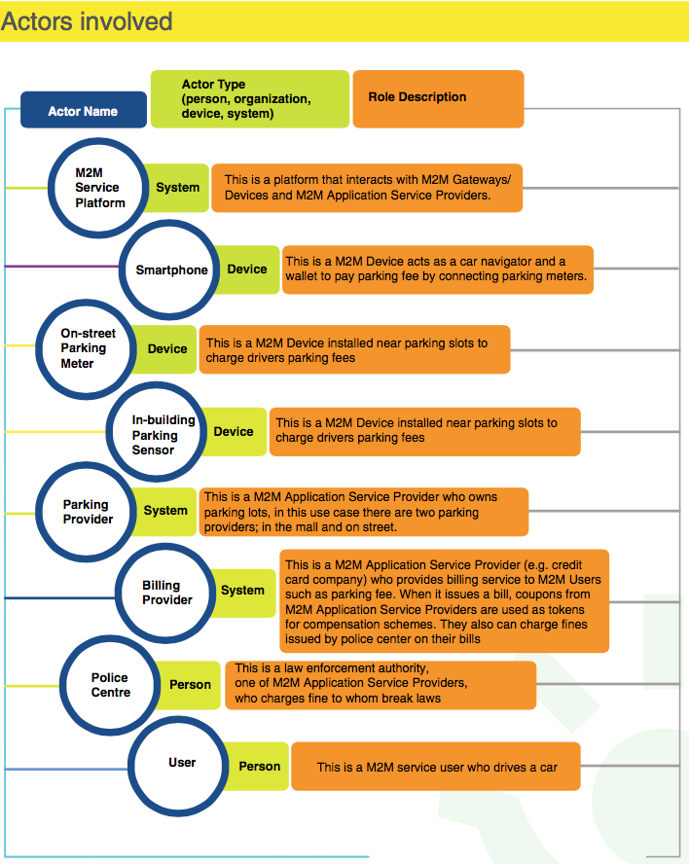

Slide 5
DESIGN TASK—70 Minutes How might we design a Workflow for key activities that jointly optimizes constituents needs and makes optimal use of technology? What might be Measured in a way that learning can be scaled to the entire SMART PARKING ecosystem for rapid innovation?
2. Define the workflow and measures required for an effective work system that results in Smart Parking Value Creation? [SMART Organization Design socio-technical systems perspective]
(‘Scouting Other Design Work’: 15 Minutes)

