Slide 1
Conceptual Foundation for SmarT Organization Design
(In a Digital, Hyper-Connected & Time-Compressed World)
SOCIO-ECOLOGICAL
Perspective
Integral System
Participative
DESIGN PROCESS
SOCIO-PSYCHOLOGICAL
Perspective
SOCIO-TECHNICAL SYSTEMS
Perspective

Slide 2
‘Whole/Integral System’ Organization Design = Socio-Ecological + Socio-Psychological + Socio-Technical Systems
SOCIO-ECOLOGICAL
Perspective
EFI
StarLab Alliance
HTT
LA SMART CITY
Healthcare
Integral System
Participative DESIGN
PROCESS
Healthcare
Healthcare
SOCIO-PSYCHOLOGICAL
Perspective
EFI
EFI
SOCIO-TECHNICAL SYSTEMS
Perspective
StarLab Alliance
StarLab Alliance
LA SMART CITY
HTT
HTT
LA SMART CITY
Notes:
For today’s design challenge, we will be focusing on the development of a “complex system”, namely, a SMART CITY., a development that many would say began in Europe but has spread quickly to North America and around our world where, by the year 2050, 60% of the global population will live in cities.
Our focus is on the urban environment that resides within Los Angeles County, known as the Greater Los Angeles Metropolitan Area

Slide 3
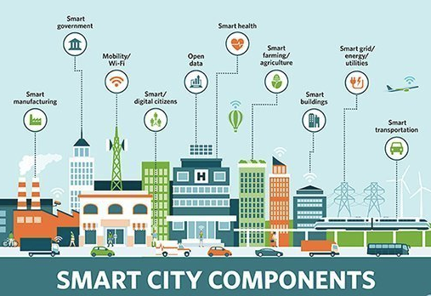
‘SMART CITY’ DEVELOPMENT in LOS ANGELES, CA
Notes:
There is a range of definitions of a “SMART CITY”, but there is apparent consensus that: A SMART CITY incorporates ICT, IoT and digital technology
to enhance the quality and performance of urban services such as energy, transportation and utilities,
in order to reduce consumption, wastage, and overall costs. A SMART CITY is a “community” of SMART SERVICE SYSTEMS…
such as smart infrastructure, smart health systems, smart industry, smart education systems, smart security systems and smart transportation systems.
Our focus in this session will be a component of “smart transportation”, namely, SMART PARKING.

Slide 4
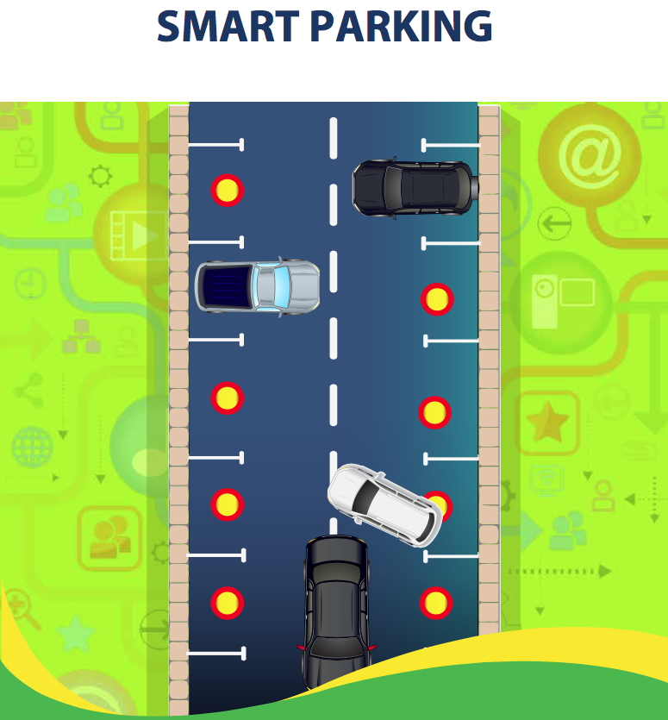
Notes:
Our focus in this session will be a component of “smart transportation”, namely, SMART PARKING.

Slide 5
“SMART” Service System is a socio-economic-technical system that is a dynamic configuration of people, technology, information, and organization(s) connected by value propositions for mutual value co-creation, AUGMENTED WITH COGNITIVE SYSTEMS (e.g. AI) Spohrer, J. et al., (2017) “Steps toward a science of service systems”. Computer. 40 (1). Spohrer, J., et al., (2017) What Makes a System Smart?; in “The Human Side of Service Engineering”
Notes:
A “SMART” Service System (such as SMART PARKING) is a socio-economic-technical system that is a dynamic configuration of people, technology, information, and organization(s) connected by value propositions in mutual value co-creation, AUGMENTED WITH COGNITIVE SYSTEMS (e.g. AI): Spohrer, J. et al., (2017) “Steps toward a science of service systems”. Computer. 40 (1). Spohrer, J., et al., (2017) What Makes a System Smart?; in “The Human Side of Service Engineering” (pp.23-24)

Slide 6
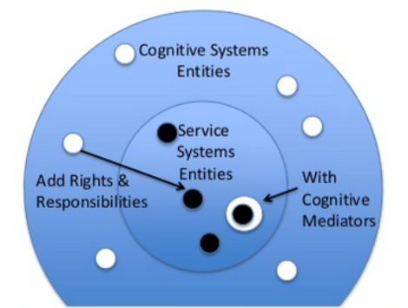
Smart Service Systems
MISSING STABLE MEMBRANE
For Co-operation between Naturally Intelligent & Artificially Intelligent Systems
Notes:
However, as identified by Jim Spohrer et al., “the current state of the art in smart service systems is MISSING a key component. All of the service system entities like ‘people and organizations’ have rights and responsibilities attached to them. However, not so for AI systems.
Why is this important? Because Rights and responsibilities are key to the development of TRUST, and trust is key to the development of collaborative interactions within a service system.
So, what’s missing in most smart service systems is a STABLE MEMBRANE that would encapsulate technology in a way favorable for co-operation of naturally intelligent and artificially intelligent systems.
However, here in the metropolis of LA, a public-private consortium led by USC Marshall School of Business & Viterbi School of Engineering has developed an innovative platform called the Intelligent IoT Integrator (I3) that addresses many of these issues and has thereby been a catalyst for SMART CITY development in LA.

Slide 7
For more information, please visit http://i3.usc.edu/
Welcome
University of Southern California
A Joint Project: Led by Marshall and Viterbi
Intelligent IOT Integrator (I³)
University of Southern California
A joint project: Marshall and Viterbi
I3.usc.edu
‹#›S1

Slide 8
‘SMART CITY’ DEVELOPMENT in LOS ANGELES, CA
Notes:
We begin with a PRESENTATION by Jerry Power on the Intelligent IoT Integrator (I3), followed by a PANEL discussion with the 3 CIOs from LA County, LA City and Long Beach City who will provide an overview of the SMART CITY vision and in particular, the SMART PARKING initiative

Slide 9
ORGANIZATION DESIGN CHALLENGES

Slide 10
For more information, please visit http://i3.usc.edu/
Welcome
University of Southern California
A Joint Project: Led by Marshall and Viterbi
Intelligent IOT Integrator (I³)
University of Southern California
A joint project: Marshall and Viterbi
I3.usc.edu
‹#›S1
Notes:
NOW, we turn the MIC over to Jerry Power for a very brief presentation about this ‘INTELLIGENT IoT INTEGRATOR’.

