Slide 1
Inter-organizational Design Session
Global STS Network
Annual Meeting
September 2014
Montréal

Slide 2
Inter-Organization STS Design Session Facilitators
Doug Austrom
Hakim Benichou
Don de Guerre
Doug Gamble
Nina Gregg
Laura Jacobs
Seth Maenen
Betsy Merck
Carolyn Ordowich
Pam Posey
Peter Sorenson

Slide 3
Agenda for Session
8:30 – 9:00 AM
Introduction to Session and Inter-organization STS Model Prototype
9:00 – 10:20 AM
Presentation of examples of actual inter-organizational networks with shared prosperity as (part of) their purpose and Discussion
10:20 – 10:30 AM BREAK
10:30 – 11:30 AM
Inter-organization STS design challenge based on a real example
11:30 AM – 12:00 PM
Reflection on the model and insights regarding its implementation for your own work
12:00 – 1:30 PM LUNCH on your own

Slide 4
Purpose of the Session
To continue developing a learning community of STS designers who share ideas and experiment together to build an STS model of inter-organization design to apply in our own practice.
We hope this exchange will result in a 2nd prototype of the model that can be applied by us all throughout the next year so that we can write-up cases of our experiences to share in Leuven in September 2015 where we can adapt the model again.

Slide 5
Philosophy about Model Building
We have built this prototype based on three beliefs about models:
Agility
Models should be built with minimal critical specifications as experiments. We use the model to better understand our design actions, learn from the results and iterate the model again.
Transparency
All models contain assumptions. If the models are to be trusted and used, these assumptions must be made clear.
Integration
Models need to be built on good theoretical foundations, e.g. STS theory, but at the same time we need to be open to different “how's” (methods and tools) for applying the model as each design is unique to its context.

Slide 6
The Inter-organization sts design model prototype
The Inter-Organization Design Session

Slide 7
STS Collaboration Platform
As practitioners of STS design, our distinguishing proficiency is the design of humane, open, and scalable STS Collaboration Platforms organized around mutually beneficial stakeholder value propositions – within enterprises, across sectors (for profit, not for profit, government, and industry), organizing contexts (individuals/teams, firms, networks, ecosystems), and business models.

Slide 8
Contrast of Collaboration
Techno-bureaucratic world
STS world
Governance system is hierarchical command-and-control. Even in benevolent systems, human beings are seen as parts, resulting in very narrow participation, especially in adaptive planning and organization values.
Purpose is often determined by a particular perspective because the squeaky wheel gets heard.
Governance system values using everyone's input, regardless of level and function, insider or outsider, in the formation of mutually beneficial partnerships.
Purpose aims to strengthen the whole ecosystem simultaneously from the broadest lens of perspectives – social, technical, financial, ethical, legal, environmental, etc.

Slide 9
Contrast of Collaboration
Techno-bureaucratic world
STS world
In the social system, hierarchical power is the driver of relationships and this is grounded in all the support systems as well.
In the technical system, only specialist or expert knowledge may be deemed legitimate to draw on and analysis considered the favored thinking approach.
In the social system, informal and formal relationships have equal consideration and all support systems need to actively support the collaboration.
In the technical system, multiple intelligence sources are used – expert and “hands on” as well as cognitive, emotional and others and both analysis and synthesis are valued. Knowledge is not only about facts, but also paradigms that underlie its creation.

Slide 10
The STS Collaboration Platform builds meta-trust
Symbiotic partnerships depend on a shared framework of values and beliefs in order to allow the very first event of collaboration to take place.
These are shared values and beliefs in:
humanistic values that foster free will, autonomy, challenge, mastery, community, a sense of purpose and reciprocity
participative democracy principles that allow everyone to sense, learn and act on events in real time
adaptive planning to facilitate evolution
non-bureaucratic organization structures and systems to avoid inefficiency and infeasibility
Participants draw on the STS Collaborations Platform capabilities to organize their own emergent work.

Slide 11
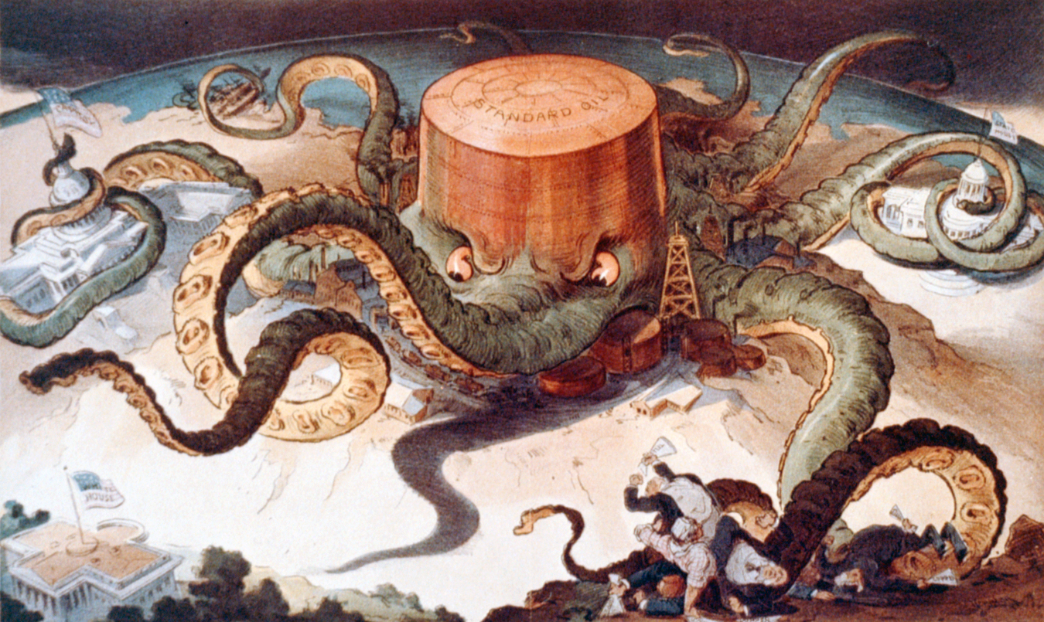
Notes:
Without the STS Collaboration Platform there is a grab for power and self-interest dominates!

Slide 12
Driving forces
COLLABORATION
Hindering forces
Strategic/
organizational
variables
Knowledge development Resource needs Economies of scale Reciprical interdependence Breaking out of lock-in situations | Limited cognition beyond own knowledge domain Perceived lack of control Perceived lack of control over the environment Internal conflicts
Government support Legal framework Market/social opportunities | History of conflict and distrust Regulatory obstacles Power relations
Institutional/
Societal variables
Scharfman M.K., Gray B & A. Yan (1991), The Context of Interorganizational Collaboration
in the Garment Industry, Journal of Applied Behavioural Science, 27 (2), 181-208
Notes:
Collaboration is not easy even with shared values – many forces both help and hinder it!

Slide 13
Our model, built on the translation of Trist’s ideas about self-regulation within interdependence, creates two kinds of design processes:
STS Collaboration Platform – infrastructure for collaboration [planned]
Network initiatives/projects - work system design [emergent]
STS Collaboration Platform: The Nexus of Network and Ecosystem Enterprises
Adaptive Planning
Network Initiatives/Projects
Work System Design
Non-bureaucratic Organization Structures
& Systems
Innovative
Objectives
HIGH level of complexity of social boundaries
Social System
Purpose
LOW level of complexity of social boundaries
Optimization Objectives
Task Certainty
Technical System
Task Uncertainty
Participative Democracy Principles
Humanistic Values
Notes:
The complexity requires two levels of design

Slide 14
Network Work System Design
The Network work system design model is comprised of three key elements:
Purpose
Social System
Technical System
Each element is described by a continuum that places the initiative or project in its appropriate context.

Slide 15
Network Initiatives/Projects
Work System Design Model
Innovative
Objectives
Purpose
HIGH level of complexity of social boundaries
Social System
LOW level of complexity of social boundaries
Optimization Objectives
Task Certainty
Technical System
Task Uncertainty

Slide 16
Powerful integration of North-American & European STS
North-American STS
Deliberations
Discretionary coalitions
Lowlands STS
Interdependence & interference in the system
E_{S(to,t)} = f[O_{S(to,t) ,}I_{S(to),} N _{(to,t)}]
Flow-based decision-making cycles
N _{(to,t)} = f[S_{(to) ,}O_{S(to,t),} I]

Slide 17
When was the computer invented?

Slide 18
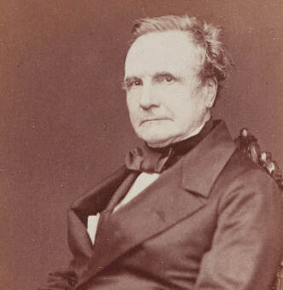
1820…

Slide 19
1820…

Slide 20
The design challenge
Innovative
Objectives
Purpose
HIGH level of complexity of social boundaries
Social System
LOW level of complexity of social boundaries
Optimization Objectives
Task Certainty
Technical System
Task Uncertainty

Slide 21
The design challenge
How Babbage designed
Innovative
Objectives
Purpose
HIGH level of complexity of social boundaries
Social System
LOW level of complexity of social boundaries
Optimization Objectives
Task Certainty
Technical System
Task Uncertainty

Slide 22
The design challenge
How Babbage designed
Innovative
Objectives
How the design turned out
Purpose
HIGH level of complexity of social boundaries
Social System
LOW level of complexity of social boundaries
Optimization Objectives
Task Certainty
Technical System
Task Uncertainty

Slide 23
The Babbage fallacy
Interorganizational innovation is extremely hard to design because:
Designers and participants have a distorted or limited understanding of the purpose they are designing for
Task uncertainty is enormous and often/usually/always underestimated
The system that is needed to tackle the design challenge rarely/never sits together in the same room

Slide 24
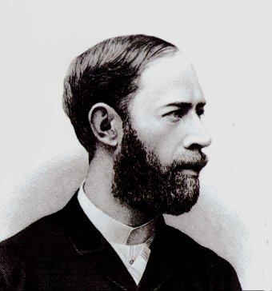
1887…
Notes:
Heinrich Rudolf Herz
Hertz did not realize the practical importance of his experiments. He stated that,
"It's of no use whatsoever[...] this is just an experiment that proves Maestro Maxwell was right—we just have these mysterious electromagnetic waves that we cannot see with the naked eye. But they are there."^{[10][11][12]}Asked about the ramifications of his discoveries, Hertz replied,
"Nothing, I guess."^{[10]}His discoveries would later be more fully understood by others and be part of the new "wireless age". In bulk, Hertz' experiments explain reflection, refraction, polarization, interference, and velocity of electric waves.
Guglielmo Marconi

Slide 25
The design challenge
Innovative
Objectives
Purpose
HIGH level of complexity of social boundaries
Social System
LOW level of complexity of social boundaries
Optimization Objectives
Task Certainty
Technical System
Task Uncertainty

Slide 26
The design challenge
How Herz designed
Innovative
Objectives
Purpose
HIGH level of complexity of social boundaries
Social System
LOW level of complexity of social boundaries
Optimization Objectives
Task Certainty
Technical System
Task Uncertainty

Slide 27
The design challenge (at that time)
How Herz designed
Innovative
Objectives
The subsequent design potential
Purpose
HIGH level of complexity of social boundaries
Social System
LOW level of complexity of social boundaries
Optimization Objectives
Task Certainty
Technical System
Task Uncertainty

Slide 28
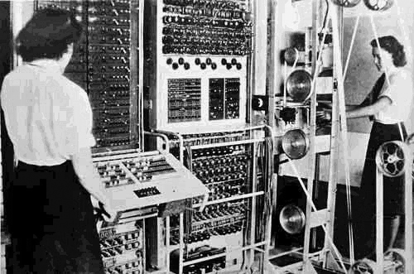
The design challenge (at that time)
How Herz designed
Innovative
Objectives
The subsequent design potential
Purpose
HIGH level of complexity of social boundaries
Social System
LOW level of complexity of social boundaries
Optimization Objectives
Task Certainty
Technical System
Task Uncertainty

Slide 29
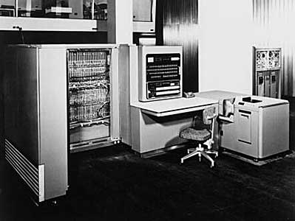
The design challenge (at that time)
How Herz designed
Innovative
Objectives
The subsequent design potential
Purpose
HIGH level of complexity of social boundaries
Social System
LOW level of complexity of social boundaries
Optimization Objectives
Task Certainty
Technical System
Task Uncertainty

Slide 30
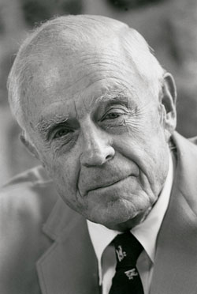
IBM president Thomas J. Watson jr.
in 1953
"as a result of our trip, on which we expected to get orders for 5 machines, we came home with orders for 18”

Slide 31
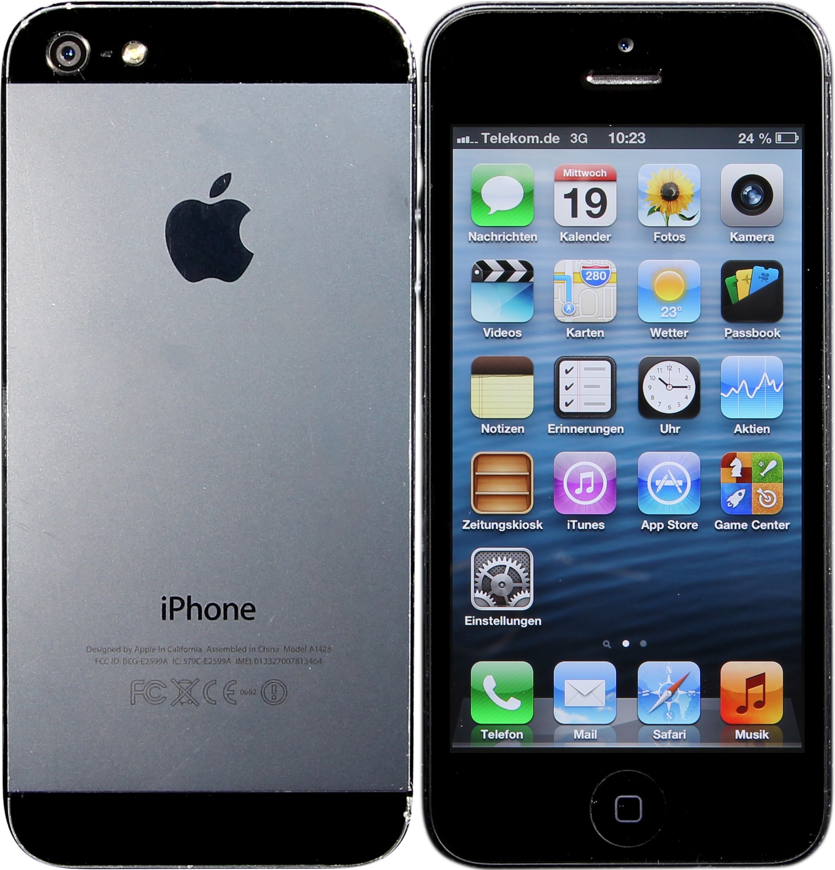
The design challenge (at that time)
How Herz designed
Innovative
Objectives
The subsequent design potential
Purpose
HIGH level of complexity of social boundaries
Social System
LOW level of complexity of social boundaries
Optimization Objectives
Task Certainty
Technical System
Task Uncertainty

Slide 32
The Hertz fallacy
“we just have these mysterious electromagnetic waves that we cannot see with the naked eye. But they are there”
Notes:
Heinrich Rudolf Herz
Hertz did not realize the practical importance of his experiments. He stated that,
"It's of no use whatsoever[...] this is just an experiment that proves Maestro Maxwell was right—we just have these mysterious electromagnetic waves that we cannot see with the naked eye. But they are there."^{[10][11][12]}Asked about the ramifications of his discoveries, Hertz replied,
"Nothing, I guess."^{[10]}His discoveries would later be more fully understood by others and be part of the new "wireless age". In bulk, Hertz' experiments explain reflection, refraction, polarization, interference, and velocity of electric waves.
Guglielmo Marconi

Slide 33
The Hertz Fallacy
Asked about the ramifications of his discoveries, Hertz replied:
"Nothing, I guess”
"It's of no use whatsoever[...]
this is just an experiment”
Notes:
Heinrich Rudolf Herz
Hertz did not realize the practical importance of his experiments. He stated that,
"It's of no use whatsoever[...] this is just an experiment that proves Maestro Maxwell was right—we just have these mysterious electromagnetic waves that we cannot see with the naked eye. But they are there."^{[10][11][12]}Asked about the ramifications of his discoveries, Hertz replied,
"Nothing, I guess."^{[10]}His discoveries would later be more fully understood by others and be part of the new "wireless age". In bulk, Hertz' experiments explain reflection, refraction, polarization, interference, and velocity of electric waves.
Guglielmo Marconi

Slide 34
The Hertz Fallacy
Desiging a succesful interorganizational collaboration is:
Evolutionary
=> the design challenge is different at every stage
Multi-level
=> the collaboration platform needs to be designed
=> each project within the collaboration platform needs to be designed
Notes:
Heinrich Rudolf Herz
Hertz did not realize the practical importance of his experiments. He stated that,
"It's of no use whatsoever[...] this is just an experiment that proves Maestro Maxwell was right—we just have these mysterious electromagnetic waves that we cannot see with the naked eye. But they are there."^{[10][11][12]}Asked about the ramifications of his discoveries, Hertz replied,
"Nothing, I guess."^{[10]}His discoveries would later be more fully understood by others and be part of the new "wireless age". In bulk, Hertz' experiments explain reflection, refraction, polarization, interference, and velocity of electric waves.
Guglielmo Marconi

Slide 35
Network Development
The three design elements – purpose, social system and technical system – are developed in stages for collaborative projects:
Step One – Pre-design
Step Two – Start-up
Step Three – Setting up a collaborative structure
Step Four – Implementing and making progress
Step Five – Adapting the design
Step Six – Knowledge codification and transfer

Slide 36
First step: pre-design
To specify an issue/problem that’s worth designing for
Usually this requires some annoyance, anger or frustration
Literature: critical juncture, a punctuated equilibrium, disruptive events, exogenous shocks, jolts

Slide 38
Primary design purpose:
Getting attention for the issue of deforestation
Primary type of task uncertainty:
Not succeeding in mobilizing the public, the media, the politicians to pay attention to the issue of deforestation

Slide 39
The design challenge
Innovative
Objectives
Purpose
HIGH level of complexity of social boundaries
Social System
LOW level of complexity of social boundaries
Optimization Objectives
Task Certainty
Technical System
Task Uncertainty

Slide 40
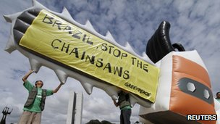
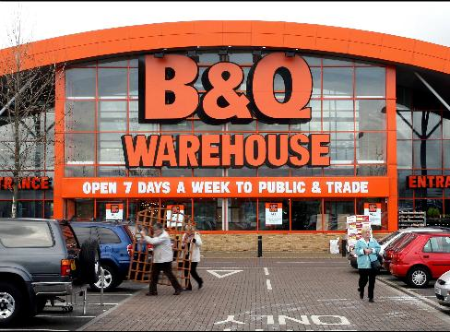
1975
1987
1971
1961

Slide 41
Second step: start-up
Now that we have the attention, what are we going to design for now?
=> Sustainable forestry practices!
What are the means we need to tackle this challenge?

Slide 42
Innovative
objectives
Purpose
HIGH level of complexity of social boundaries
Social System
Optimization objectives
LOW level of complexity of social boundaries
Task Certainty
Technical System
Knowledge-
management
Task Uncertainty

Slide 43
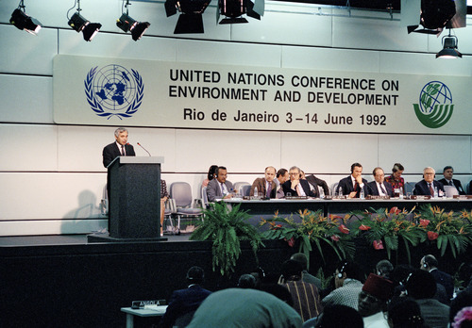
1987
1992
1988
1989

Slide 44
Third step: setting up a collaborative structure
Now that we have a good idea about what sustainable forestry practices might look like, how can we design for them to become real?
Multi-party supply chain collaboration

Slide 45
Innovative
objectives
Organizational
design
Purpose
HIGH level of complexity of social boundaries
Social System
LOW level of complexity of social boundaries
Optimization objectives
Task Certainty
Technical System
Knowledge-
management
Task Uncertainty

Slide 46
WWF 95 Buyers’ group

Slide 47
Fourth step: implementing and making progress
As more experience becomes available on how to implement sustainable forestry, how can this experience be used to improve and expand sustainable forestry more effectively and efficiently?
=> We need to bring the consumer into the fold!

Slide 48
Innovative
objectives
Purpose
HIGH level of complexity of social boundaries
Social System
LOW level of complexity of social boundaries
Optimization objectives
Task Certainty
Technical System
Progress in
goal accomplishment
Task Uncertainty

Slide 49
Innovative
objectives
Purpose
HIGH level of complexity of social boundaries
Social System
LOW level of complexity of social boundaries
Optimization objectives
Task Certainty
Technical System
Progress in
goal accomplishment
Task Uncertainty

Slide 50
Fifth step: adapting the design of the collaborative structure
Some initiatives immediately took on bord independent certification, other did not
Some schemes had strict performance-based metrics, other did not
Some schemes required field inspection by independent auditors, others did not
Some initiatives invited stakeholders into the development of standards, others did not…

Slide 51
Innovative
objectives
Adapting the
Organizational
design
Purpose
HIGH level of complexity of social boundaries
Social System
LOW level of complexity of social boundaries
Optimization objectives
Task Certainty
Technical System
Progress in
goal accomplishment
Task Uncertainty

Slide 52
Sixth step: knowledge codification and transfer
Increasing isomorphism in forestry certifications, in order to be credible and viable
Yes, you need field inspections, and a sound methodology for carrying those out
Yes, you need to consult with independent stakeholders, and a transparent procedure to show how that is done
Yes, you need performance-based metrics, and you need a valid and reliable way to measure these
…

Slide 53
Innovative
objectives
Adapting the
Organizational
design
Purpose
HIGH level of complexity of social boundaries
Social System
LOW level of complexity of social boundaries
Optimization objectives
Task Certainty
Technical System
Knowledge-
management
Task Uncertainty

Slide 54
Sixth step: knowledge codification and transfer
Governments preferring only the best certification schemes
PWC report: FSC certification the preferred choice of the industry's top 100 (2007)
Goldman Sachs, Citigroup, Morgan Stanley

Slide 55
The point is…
Innovative interorganizational networks are
Complex
Multi-level
Evolutionary
These are not random phenomena
Let’s find out how these steps work, and let’s help others to take those steps more effectively and more efficiently

Slide 56
Further presentation and discussion of examples of actual inter-organizational networks
The Inter-Organization Design Session

