Slide 1
For more information, please visit http://i3.usc.edu/
Welcome
University of Southern California
A Joint Project: Led by Marshall and Viterbi
Intelligent IOT Integrator (I³)
University of Southern California
A joint project: Marshall and Viterbi
I3.usc.edu
‹#›S1

Slide 2
Communications Technology Management (CTM)
CTM Mission Summary
Welcome to CTM:
A consortium funded Center of Excellence at the Marshall School of Business
A unique group that looks at technology driven disruption as an opportunity enablers and threat indicators that must be understood.
Founded in 1985 when the world was a very different place
Market Value
Key Questions: How does rapidly changing technology impact business issues?
How does tech impact consumer and business markets?
How does tech impact commercial operations and business practices?
How does tech impact corporate culture; can performance be optimized?
How can a company provide shareholder value in a world where change has become the norm?
What are the opportunities and risks that await over the horizon?
CTM Members: CTM attracts companies that consider technology as a strategic weapon that can be used to create a competitive business advantage. CTM influences these companies and the companies influence Marshall..
Business Processes and Culture
People and environments need to be managed for max potential in an evolving workplace
Business Disruption
Consumers have redefined how they entertain themselves and how the interact with businesses and with each other
Internet of Things, Automation, and Big Data
Tech is makes big-data a real-time asset that allow firms to be customer context senstivie.
The Process
"What people think of as the moment of discovery is really the discovery of the question." - Jonas Salk
"We thought that we had the answers, it was the questions we had wrong." - Bono
CTM’s paramount objective is to create a collaborative environment that includes industry, academia, or other interested parties that provide a means to focus on the issues that serve to shape our future (opportunities and threats) from a business perspective.
The rapid rate of technological evolution creates a growing number of disruptors that continually need to be assessed, considered, and responded to.
The CTM members work together to develop an understanding and to find pathways for forward action.
I3.usc.edu 13
For further information: Jerry.power@marshall.usc.edu or www.marshall.usc.edu/ctm

Slide 3
CTM Newsletter
Linear innovation comes when people are motivated and do their job well.
Disruptive innovation occurs when outside perspectives are inserted in an open environment and allowed to flourish.

Slide 4
Scheduled for release summer 2019
Time is the customer’s most precious resource
People shop on-line because it is convenient and saves them time
Customers patronize suppliers that respect customer time
Customers consider time spent with a company an “investment”
Reducing time requirements improves the customers ROI
Respecting customer time demonstrates respect for the customer
Real-time does not mean instantaneous
Real-time means efficient and effective
Real-time means better than the competition
Real-time companies increase quality experiences (e.g. movies)
Real-time understanding includes partners and other participants
Transformations that improve customer perception are critical
Transformations that improve internal efficiencies are low priority
Companies need to know where/how customers spend time with them
Companies need to understand customer interactions with competitors
Becoming a real-time company is a journey – not a destination
There are 4 levers that can be used to improve real-time performance
Product/Service
People
Process
Data

Slide 5
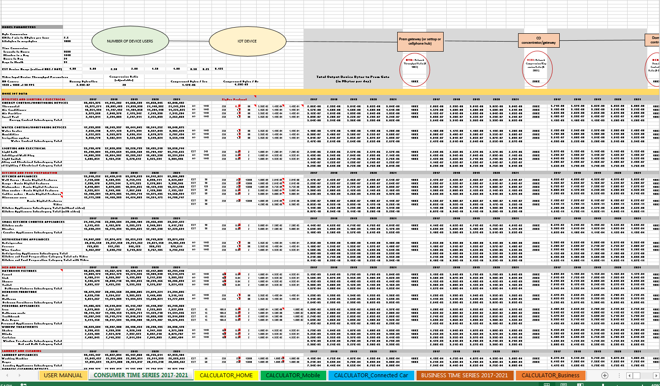
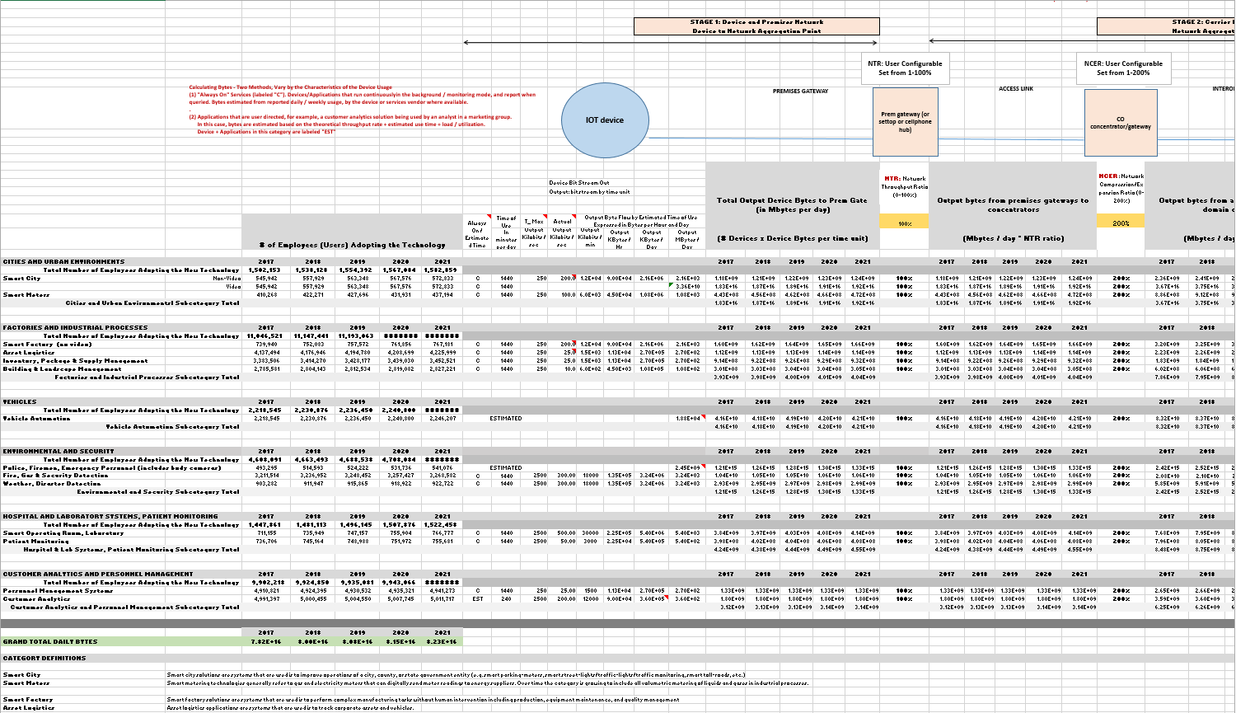
Communications Technology Management (CTM) IOT Modeling

Slide 6
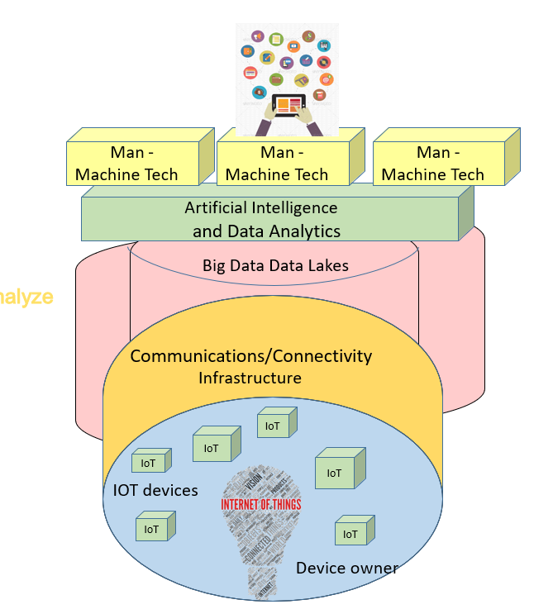
Key Concepts
Apps
Data
Man
-
Man
-
Man
-
“The ultimate goal is transforming the raw data to insights and actionable knowledge.
The data can help create effective representation forms for human users and machines creating automation.”
Typically, this requires management of many data streams from multiple sources, multiple owners, multiple device-types. It also requires (near-) real time analytics and visualisation and/or semantic representations.
Policies, functionality, data, and everything else is constantly changing and needs to be managed.
Machine Tech
Machine Tech
Artificial Intelligence
and Data Analytics
Big Data Data Lakes
Data
IOT
Analyze
Communications/Connectivity
Infrastructure
IoT
Devices
+
Sensors
IoT
IoT
IoT
Action
IOT devices
IoT
IoT
I3.usc.edu 3

Slide 7
IOT Impact on Business
Business Sectors | IOT Impact
Business Communications | IOT provides data about the environment and the person. Just like targeted marketing improves advertising response rates, targeted business communications can improve employee (and partner) performance
Data Sciences & Operations | Most data science efforts are conducted against off-line databases. Off-line data supports historical and trend analysis but as IOT data comes on line, data science techniques can be applied to manage a company in real-time.
Finance and Economics | Finance as based on off-line data; books are closed and financial data is reviewed to determine business health and to drive management decisions. In an IOT world, employees and assets report their condition real-time making finance much more of strategic function with automated reporting functions.
Accounting | IOT provides real time asset and WIP tracking.
Management and Operations | Data from IOT devices drives evolutionary changes to all employees. Job functions may be redefined. New training may be required. New organizational and reporting structures may be necessary.
Marketing | Marketing has shifted to digital content and digital metrics but these efforts are very general in nature with measures of clicks and location at best. With IOT, there is much more data and much more granularity that allows improvements to targeting and even the display of digital content becoming more personal.

Slide 8
About I3 - Intelligent IOT Integrator (I3)
Developed by the University of Southern California
Marshall School of Business (sustainable business practices)
Viterbi School of Engineering (realization experience);
and the support of the City of Los Angeles’
Chief Information Officer and Chief Data Officer
Our intended impact is:
IOT device data supports a understanding of customer behaviors that drive product/service development.
IOT data are a prerequisite for advanced analytics programs that drive better management decisions.
An IOT marketplace creates a point of demarcation serves to delimit data ownership.
An IOT controller manages security close to the device without forcing complex device requirements.
A shared, IOT data river transforms the Internet from a connectivity tool to a context awareness tool
The I3 system is a new, public/private, open-source, community driven development effort.
Universities, companies, and individuals are contributing to its realization.
I3 creates an IOT data marketplace that connects independently owned devices with data to applications.
I3.usc.edu 2

Slide 9
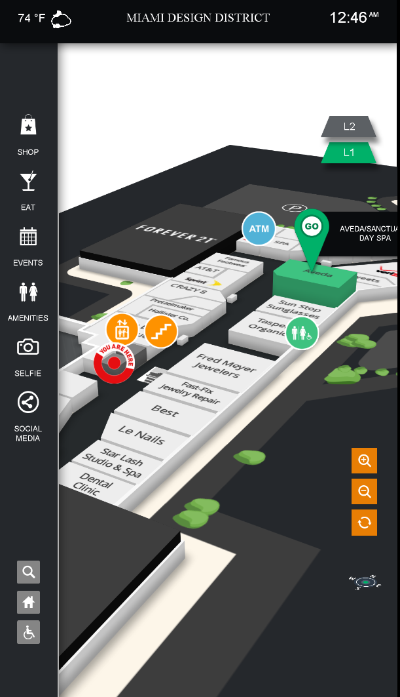
Key I³ Project Goal:
Accelerate IOT adoption and market evolution, at the application and device level, by making device owners active participants in the IOT ecosystem.
Public Interface and Analytics Cluster
Mobile Devices
SmartLINK
Develop a platform- and a tool that allows the device owners to participate.
Device Owners control distribution of their data (and the resulting rewards)
Need trust for any transaction; Trust management is a critical function
User Managed Security AND Operational Trust are both important components
A Proven/Tested Distributed/Scalable System Architecture
Expect multiple operational entities which will need to interact to exchange data & incentives

Slide 10
Trust: A Critical Component
Trust Rating
Incentives
Data Policy
Usage Description
Application owners rate device owners for data fidelity
Device owners rate applications for trustworthiness
Higher trust reduces need for incentives
Applications and Device Owners compete to win the trust of the others needed as the market becomes more efficient
Transparency and Satisfaction
Trust Rating
IOT Data
Permission Grants

Slide 11
Data Ownership/Permission
Device owners “own” their data and give it to the I³ domain controller for safekeeping. Rules in I³ determine who can see the owners data.
If you can “see” it, you can make a copy that the applications then own.
Users can report whether they trust applications to safeguard their data.
The more trust the greater the visibility granted by the users.
There is no single definition of privacy that applies to all users and all applications.
Read only access
Only location data
Full read/write access
Controller Options
I³ Domain Controller
Reasonable system defaults
User malleable defaults
App - specific opportunities
“I own my data
I determine the rules
I decide who I trust
I manage my own privacy”
Centralized permission management allows fine grain control
without burdening IOT devices with extra management overhead

Slide 12
An Incentive/Application Driven Marketplace
Applications may need to apply for access to data.
Access requests can include data security policy, usage statements, privacy statements.
Access requests can also include incentives such insurance discounts, coupons, or cash.
Device/Data owners can accept or refuse access requests.
Device owners can set permissions to accept all requests from trusted entities.
Device owners can provide access to different (including anonymized) streams of data as a function of the role / trust level.
The greater the ‘trust quotient’ the lower the incentives.
Users can revoke permissions if trust is violated.
Data Application
$
terms
data
I³ Platform
$
terms
data
Owner

Slide 13
A Leveraged View of IOT Networks
From This: To This:
App
App
App
App
App
App
Apps no longer have to justify themselves to device owners.
Data can be accessed as needed and in a shared environment
Users no longer have to develop a trust relationship with each app developer.
I³ provides user control of data dissemination and apps are user rated based on trust.
I³ Domain Controller
Dev
Dev
Dev
Dev
Dev
Dev
ecosystem
ecosystem
ecosystem
I3.usc.edu 5

Slide 14
Data Brokers: Digitally Managing Data Stream Content
The ONLY constant in government systems is that things change.
CIOs have to anticipate and pre-prepare for change
Application
Application
Application
Application
Application
Application
Data Filter
Data Filter
I3
System
I3
System
I3
System
Data Filter
Data Filter
Option 1
IOT device
Option 2
Option 3
IOT device
IOT device
‘Smart’ devices that filter data at the source, reducing the value for future (TBD) application. Changes may require significant effort.
It does reduce communication costs if these are usage sensitive services.
Application based data management replicates functions in multiple places in multivendor environments.
Can be difficult to manage for consistent policy application
External filters, can be easily activated or changed as policies change.
Different filters can be applied to different applications and different devices.

Slide 15
I3 Networks
Protocol/processes still in design.
No central/local data repository
Validation system ensures integrity
I3 Validation System
Nodal
permission
Application
Application
Data Lake
I3 Independent Node
Application
Application
Application
Data Lake
IOT Devices
IOT Controller
Application
Data Lake
IOT Devices
IOT Devices
I3 Independent Node
I3 Independent Node
data flows
IOT Devices
IOT Controller
IOT Devices
IOT Controller
IOT Devices
IOT Devices
IOT Devices
IOT Devices

Slide 16
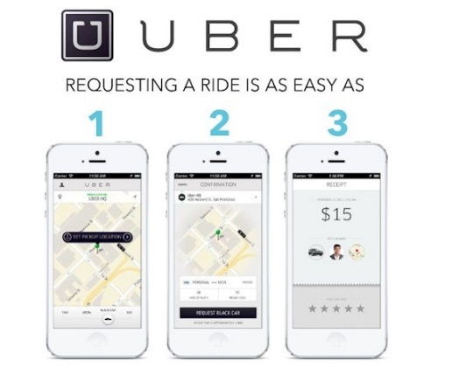
The “Uberization” of IoT
Uber | IOT 2.0
People buy cars | People buy IOT devices
Cars are not fully utilized | Device data is not fully utilized
Uber provides a system that allows people to realize economic value from under utilized assets | IOT 2.0 provides a system that allows IOT device owners to realize economic value from their underutilized assets
People want to self-manage their hours and maintain their independence | IOT owners want to self-manage their device data and maintain their independence.
Uber provides shared business transportation to as an alternative to dedicated company cars | IOT 2.0 allows shared IOT devices as an alternative to dedicated IOT data silos
Just like Uber
IOT 2.0 lowers the cost of IOT device ownership
IOT 2.0 increases the convenience for applications
‹#›
I3.usc.edu
Notes:
In many ways I3 represents the uberization of IOT data.
Uber realized that people buy cars and those cars are often under utilized. By the same token, people buy IOT devices and those devices generally feed a specific application even though the same data generated by a device could bring value to many other applications.
Uber provides the software system needed to let car owners find others in need of transportation so they can use their cars to provide a service to these other people. As Uber would say, “Get your side Hustle on”
In the same way, people might buy an IOT device and it is generating data for some application that provides value for that person. People can register their devices with I3 and I3 will try to link these data producers with applications that need data. When a match is made, incentives flow back to the device owners allowing the IOT devices to act as a person’s side hustle.
In uber, people manage their hours and tell the system when/where they want to work. In I3, the device owners are totally in charge of when/how their data is offered into the data marketplace.
And while Uber is primarily knows as a service for consumers, their services can be used by companies to reduce or eliminate the need for corporate cars. By the same token, I3 can be used by governments and companies to break down the silos so each division or application does not need dedicated IOT infrastructure.
We believe that if a single IOT device can support many applications, the cost of the device is reduced because its cost is amortized over a larger application pool. We also believe that if a single application can see a greater variety of data coming from these devices, they will be able to make better decisions thereby increasing the value of the application. These two market components serve to drive each other forward, reduce the cost of IOT networks, and therefore will accelerate IOT market demand.

Slide 17
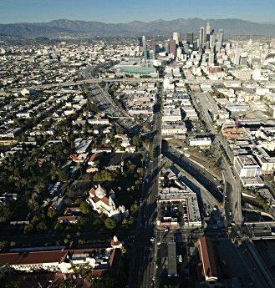
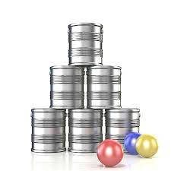
I3: Unlocking the potential of IoT
Cities are in a difficult spot:
Employees are rapidly headed toward retirement, with little funding to cover attrition.
Citizen needs and demands are increasing. Funding to expand services is scarce.
Technology offers a possible solution, but technology costs are high and citizens are wary
Technology costs are coming down (but not fast enough)
Technology silos provide benefit, but the silos impose limitations
A new paradigm is needed that increases IOT device technology leverage ratios
A new paradigm that increases data repository leverage ratios.
And this has to be accomplished without challenging departmental independence
It is easier to change technology than to change an organizational culture.
The key forward is to focus on the word “leverage”
Tools, technology, data, resources…
You have to throw one ball and knock down many cans!

Slide 18
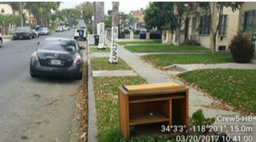
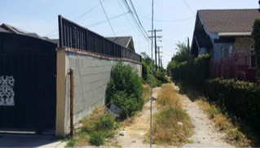
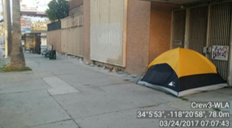
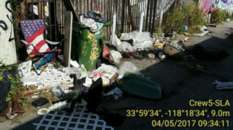
Clean Streets Project
Potential Application Concept:
Currently, data are manually collected and evaluated: inefficient, costly
Sanitation Department of LA and IMSC are developing a framework to automatically detect the cleanliness of streets as well as any special objects in need of removal.
Abandon Bulky Items 🡺
Overgrown Vegetation 🡺
Unexpected Structure 🡺
Special Removal Services 🡺

Slide 19
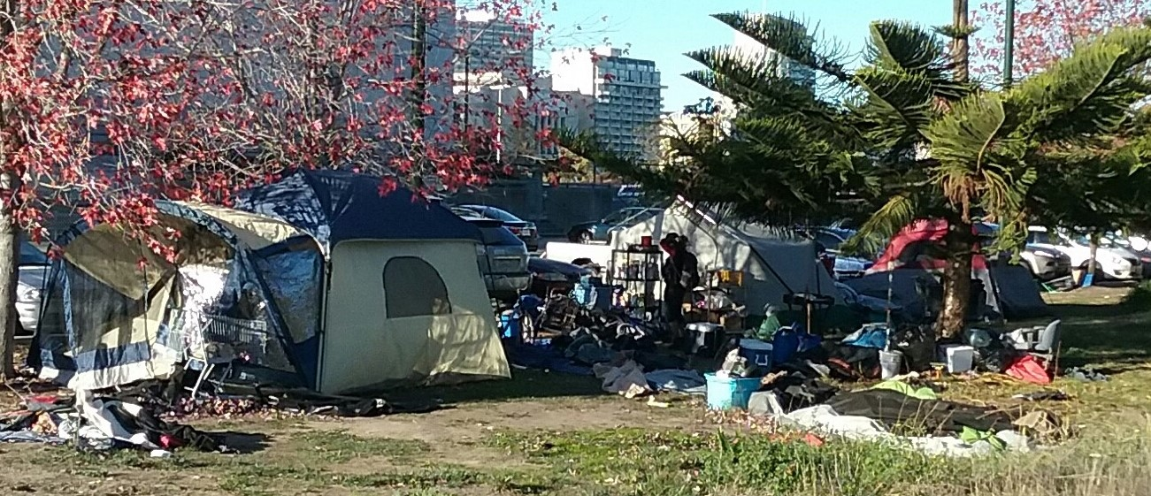
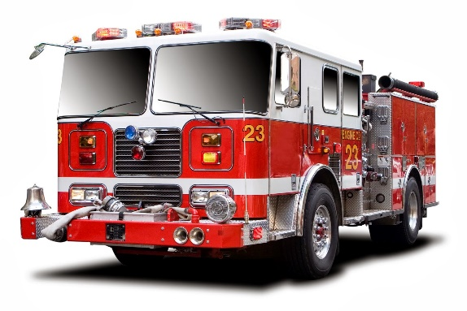
Firespotter Project
Potential Application Concept:
Fires used by small stoves for cooking and heating.
“Good” Fires
Some fires spread to nearby buildings and structures.
“Bad Fires”
Early detection of fires about to go bad can save property and lives
Thermal cameras (privacy protection) coupled with system intelligence allows early detection and dispatching.
Thermal detection can locate dangerous fires before smoke/flames are visible.
Video Analytics to Self Detect Emergency
Situations
Alert Monitoring
I3.usc.edu

Slide 20
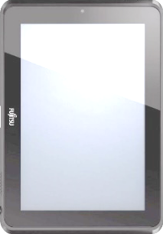
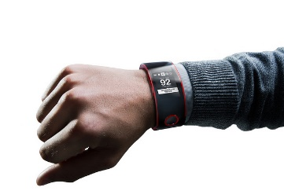
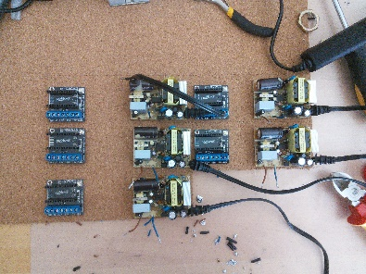
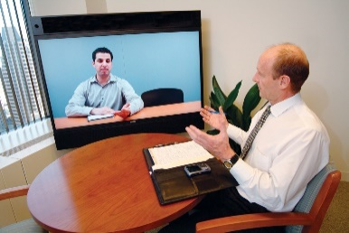
Healthcare Coordination Project
Potential Application Concept:
Many private and governmental agencies involved in supporting elderly and handicapped.
IOT tech can improve efficiency but crates data sharing complexity
There is a ‘consumer’ component and a HIPAA component that must be distinct but allow opt-in interactions
Tablet/video conference
I3 IOT
HIPAA Compliant environment
Consumer AI Based
Report Generator
Alert Monitoring
Research Programs
Pill mgmt., pulse monitoring🡺
Sensor and video conferencing🡺
HIPAA AI Based
Report Generator
Alert Monitoring
Research Programs
I3.usc.edu 23
Report Generator
Alert Monitoring
History Logs
Research Base

Slide 21
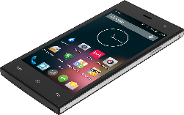
Child Family Services
Potential Application Concept:
At risk children can be equipped with a programmed smartwatch
Smartwatch can be used to message extended family members or social workers during times of need (non-emergency)
Smartwatch also provides a discrete “911” signal for emergency help
Smartwatch monitors heartbeat to determine if removed. Unexpected removal may flag social working wellness check.
Smartwatch can receive reminders related to school, dinner, bedtime, etc.
The goal is to automate check-in processes so social workers can intervene when needed
I3 IOT
Family Services Database
I3.usc.edu 23
Report Generator
Alert Monitoring
History Logs
Research Base

Slide 22
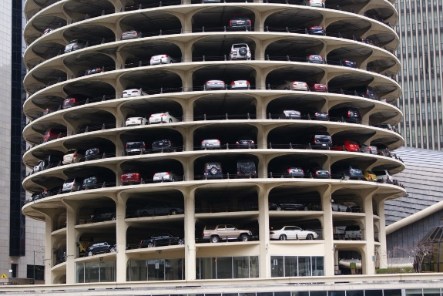
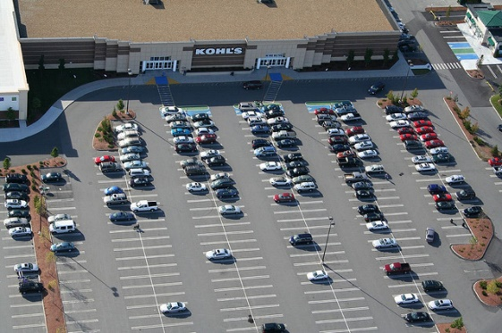
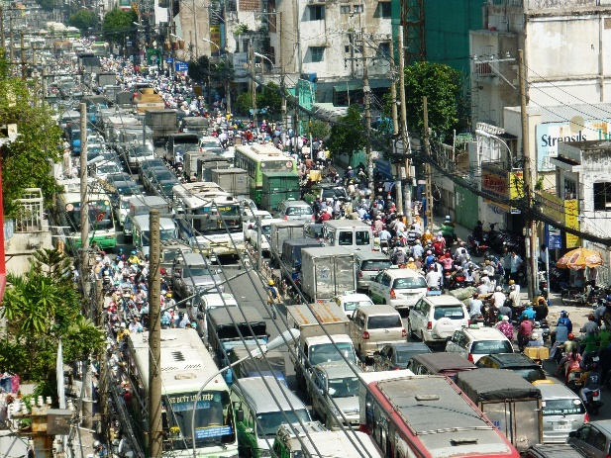
Parking Finder Project
Potential Application Concept:
By Directing Cars to an Open Parking spot, time, gas, congesting is minimized
No more hunting for a parking spot
Meter based parking detection requires maintenance
Embedded sensors difficult to install
Many multiple parking lots with different management
Video analytics provides low cost easily deployed solution
Services like reserved parking, VIP monitored parking, also possible
Video Analytics to Detect Open Parking
Link to Traffic Nav System (e.g. Waze)

Slide 23
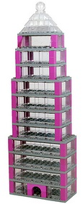
Concierge Concept
Potential Application Concept:
City loses visibility of emergency service in high rises:
Beacons on each floor provides technology based solution
Dedicated Inter-building tracking of emergency services is expensive
I3 can be used to create an concierge service
Track residents for safety
Monitor maintenance support
Track Delivery Services
Concierge services improves security, reduces vacancy rates.
Supports smart building enviromentals/power
ALSO improves ability to track emergency services
Possible discount an permitting fees

Slide 24
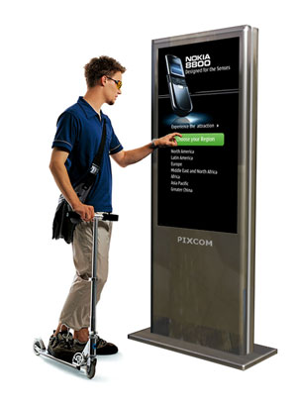
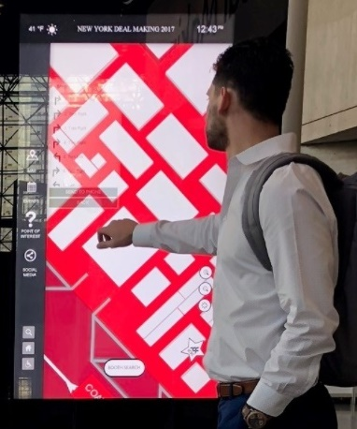
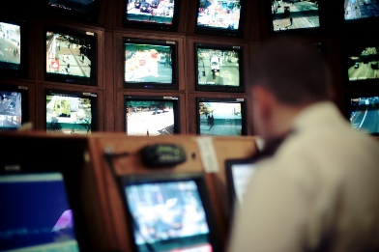
Multifunction Kiosk Stream Manager
Potential Application Concept:
Allows city to support multiple kiosks from different vendors from a common application set.
Geographic targeted kiosks
Functionally targeted kiosks
Kiosk vendors
Generate independent ad content
Provide kiosk local content
City Operations
Provides city-wide content to multiple kiosk vendors for common look/feel
Provides managed video link to police for area security.
Provides emergency services support
Manages citizen access (opt-in) so citizens are recognized across different vendor ecosystems
Can feed city specific data to kiosks in support of city operations personnell
Local ad server
Local content server
Police/security
Citizen coordinator
common city info server
common map application

Slide 25
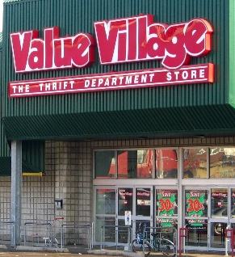
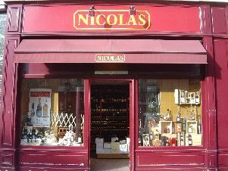
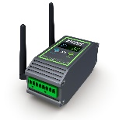
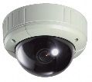
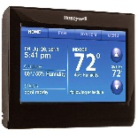
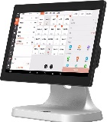
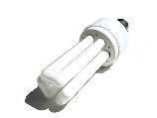
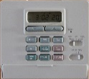
IOT Business Districts
Potential Application Concept:
IOT data from multiple independent businesses can be consolidated to created a managed/coordinated data lake that supports a business district
By consolidating data, small/local merchants can have access to the larger amounts of data that larger firms have.
Business District data can be used to drive incremental. local merchant business services (coupons, advertising, security,…)
Business District data can be used to support consortium suppliers
Business District data can be used to support business area customers
Business District data can be used to improve business district operations
In future, data could be as important as tax incentives in efforts to secure corporate moves
Application
Application
Application
Business District Data Lake
I3 IOT

Slide 26
Crowd Sourced Analytics
Potential Application Concept:
Entrepreneurs can readily find data and request access permission. Data analytics can then be used to enhance the value of the raw IoT data to create new data sets that can be sold
A data-centric crowdsourced economy emerges data is enriched and data analysts build on the work of others.
Hurdles in the data economy which require data entrepreneurs to develop and maintain individual relationships with every IoT device owners are reduced.
Data Analytics Entrepreneur
Data Analytics Entrepreneur
Data Analytics Entrepreneur
Data Lake
Data Analytics Entrepreneur
I3 IOT

Slide 27
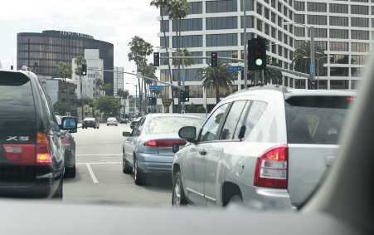
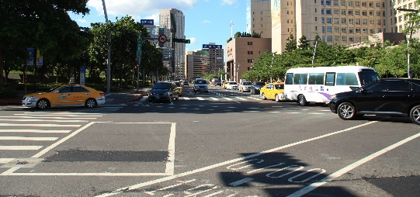
Smarter Cars (and Trucks)
Potential Application Concept:
Vehicle to vehicle communications
Vehicle to smart road communications
Automobiles will evolve toward autonomous vehicles over time. Each step being smarter and smarter.
Smart cars are not IOT devices but complete IOT systems
The functionality of a ‘completely’ smart vehicle will include multiple smart IOT channels
Diagnostics Channel
Entertainment Channel
Intra-vehicle Communications
Roadway Communications
Usage Channel
Personal Communications
Some data supports private operations (different destinations) other data supports city services (different departments)
Wireless carrier
I3 IOT
Private services
Vehicle Dealer
Vehicle Manufacturer
Independent Service Agent
Insurance Company
Bank/Lease/Finance Company
Entertainment Service company
Text/Voice Communications
Internet Provider
Owner/Fleet Manager/Family
City services
Traffic Management
Wayfinding
Road Repair
Emergency Services Routing

Slide 28
Context Sensitive Entertainment
Potential Application Concept:
Targeted advertising allows delivery of location specific advertising based on geolocation data.
IOT allows a greater range of context indicators to shape content delivery.
More data types means greater variability in what data individuals will release. Permission maximized of people are actively involved opt-in processes.
Techniques include and go beyond advertising to include personalized entertainment content, entertainment-plus services (franchise games, commentary, ..)
IOT Can be combined with AR technology, theme park experiences, etc
Entertainment Applications
Entertainment Applications
Entertainment Applications
In car entertainment that uses traffic data to personalize entertainment content
Entertainment Applications
I3 IOT
AR “theme” parks with experiences that are distributed throughout a city
Movies that dynamically adjusts content based on time-of-day, weather, …
Traffic Data
Weather Data
Location Data
Event Data
more
Advertising that is triggered by crowd size and demographics
Live events that are more than visual – detect and recreate environmental variables

Slide 29
Learnings
Complex issues require complex ecosystems (n:n relationships)
Ecosystems are harder to manage than partnerships
Solid deliverables provide ecosystem touchstone
There needs to be a “win” for all player types
The “win” has to consider both tech and business goals
Need to be comfortable with their business to participate
Companies have a think long term to justify near term infrastructure investments
USC Marshall | Verizon | City of Los Angeles | Niksun
NetObjex | TU Wien | CradlePoint | Kiana
Traction Labs | USC ISI | Orange Barrel | SmartLink
Fantasmo | USC Etc | SmartP3.City | USDB
TechMahindra | Avata | Synchromatics | Ether2
Korea University | Wizr | MimoCloud | Valarm
USC Viterbi | Inria | DiscoveryIOT | Metro
USC Facilities | USC IT | USC Hospitality | Oracle

Slide 30
NIST GCTC Program
The I3 Consortium is an action cluster under the Data Governance SuperCluster within the NIST (National Institute of Standards and Technology) GCTC (Global City Team Challenge) program.
GCTC has been formed to develop a forum to accelerate deployment and shared experiences related to smart cities and smart communities.
Applications
PPI (Pivotal Points of Interoperability)
Infrastructure
I3
PPI (Pivotal Points of Interoperability)
Devices
Long-Term Goal
“To establish and demonstrate replicable, scalable, and sustainable models for incubation and deployment of interoperable, secure, standard-based solutions using advanced technologies such as Internet of Things (IoT) and Cyber-Physical Systems (CPS)
and demonstrate their measurable benefits in cities and communities.”

Slide 31
The Direction Forward: CTM/I³
I3 is actively seeking corporate partners to participate in the process.
Partner value can be derived from:
Partner use of opensource platform as basis for value-add projects
New Partner research that the I3 platform allows
New Partner products based on the business research behind the program,
Exposure to future hires with IOT experience
Interactions with thought leaders/others in the I³ community
I³ can be used as a platform that corporations can build commercial products upon. The platform is opensource but corporate value-added may be licensed.
Anyone (corporations, individuals, universities..) can contribute to the I³ development process
I³ systems are rigorously tested before software is released; dependable software must be quality assured and supported.
www.I3-IOT.net
Join I3 Today
Manager@I3-IOT.net

Slide 32
Other Current CTM Activities

Slide 33
Project Management in Complex Multifunctional Environments
Project Management Tracking System
An IOT rich data environment is difficult to manage, and to develop on because it is super-dynamic.
New Tools and Management paradigms are needed.
‘Testing’ a possible solution
Includes an AI engine at its core
AI knows the available digital assets and knows project histories.
Current request conditions become queries to identify knowledge that improves efficiency of current projects
External modules can suggest vendors, standards, regulatory issues, and subject matter experts that might provide additional value to the project.
I³ will auto-register IOT devices with the AI engine as devices come on line to keep data resources current.
Database of available City IT associated resources
External Data Reference Engine
(standards, regulatory, subject matter experts, vendors,
Etc.)
Searchable AI Engine
Platform Systems
Forms/Templates
IOT Devices
APIs
Database Systems
Keyword management system
Goal: Create a AI engine that knows the state of each project so that it can recommend strategies forward from there.

Slide 34
For more information, please visit http://i3.usc.edu/
Thank You!
University of Southern California
A Joint Project: Marshall and Viterbi
Intelligent IOT Integrator (I³)
University of Southern California
A joint project: Marshall and Viterbi
I3.usc.edu
‹#›

