Slide 1
Accelerating Change
cultureQs
Accelerating Change
through
Stakeholder Engagement
Eric Lynn
Global STSD Network Meeting – Leuven, Belgium, 10 September 2015
Eric Lynn ● www.cultureQs.com

Slide 2
Initial Questions …
Accelerating Change
Change
What is Change … really?
How do we encounter the new situation?
How do we encourage Stakeholder Engagement?
How can we design a change process to significantly increase its chances of success?
Eric Lynn ● www.cultureQs.com

Slide 3
Change …
Accelerating Change
Change is ubiquitous. We live in a dynamic world: we have always done so and always will.
We need to learn to accept and embrace change as a natural part of life …
… Embrace the opportunities it offers
… Take the fear out of it
Eric Lynn ● www.cultureQs.com

Slide 4
Change …
Accelerating Change
Problems in organisation change initiatives arise when we forget/ignore the basics. People drive change. People need purpose, orientation, space to make own decisions … and honesty.
… We can only initiate successful change TOGETHER WITH people … We cannot do it TO them
Invite people to work with you!
Eric Lynn ● www.cultureQs.com

Slide 5
Change …
Accelerating Change
Successful change focuses on the business, not on the change. - What are we trying to achieve together? - How are we going to do it? … Focus of cultureQs - Why is this important?
cultureQs invites and enables generative conversations about core personal and group motivators. The people then very quickly are able to begin Shaping their new Workplace … together.
Eric Lynn ● www.cultureQs.com

Slide 6
Stakeholder Engagement …
Accelerating Change
Engagement is intrinsic … an inner conviction. It is impossible to 'convince' or 'persuade' someone to engage. We can however enable people to engage by …
Inviting
Encouraging
Inspiring
Eric Lynn ● www.cultureQs.com

Slide 7
Culture
Accelerating Change
Culture is the Soul of the Organisation
… We therefore need to nurture the soul to ensure a healthy organisation.
Healthy intrinsically motivated people engage; add value for themselves and the organisation; results improve; the business benefits and grows; new opportunities arise.
Eric Lynn ● www.cultureQs.com

Slide 8
Culture
Accelerating Change
The continuously evolving dynamic interaction of mindsets and gutsets of actors in the system(s).
Eric Lynn ● www.cultureQs.com

Slide 9
Seven Core Layers of Culture
Accelerating Change
We do not encounter and engage with each other as representatives of a specific cultural group.
We engage as individual human beings with our personal intrinsic motivators.
national
culture
ethnic
culture
A
Human Being
organisation
culture
belief
professional
culture
age /
generation
gender
Eric Lynn ● www.cultureQs.com

Slide 10
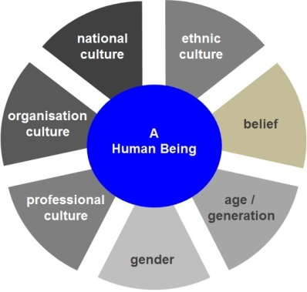
Human Interaction Dynamics
Accelerating Change
Eric Lynn ● www.cultureQs.com

Slide 11
Accelerating Change
cultureQs is a Change and Integration Accelerator that uses powerful questions to inspire participants to reflect on the foundations of their beliefs, attitudes and behaviours.
While engaging in deep meaningful conversations, people connect quickly, enabling the invisible borders that hinder collaboration to fall away.
Wasteful conflict is reduced; people (re-)focus on the personal and professional questions that matter; innovative potential is released and performance is enhanced.
It provokes the mindset change that results in behaviour change.
Eric Lynn ● www.cultureQs.com

Slide 12
Foundations of …
Accelerating Change
Deep Meaningful Conversations that Connect … Quickly
Appreciative Inquiry (Focus on Positive Potential)
Dialogue
(Bohmian Dialogue)
Story-Telling
Eric Lynn ● www.cultureQs.com

Slide 13
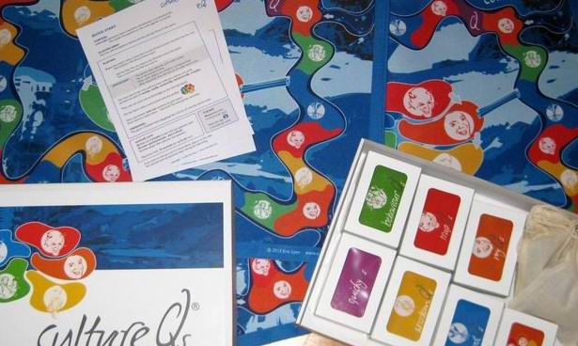
Questions …
… that challenge and expand our perspective of the world
Accelerating Change
fundamental drivers and beliefs
personal preferences
real case studies of challenges that inevitably occur in organisational life
behaviour patterns
thought-provoking quotes from traditional and modern sources
impulses from everyday reflections on life
Eric Lynn ● www.cultureQs.com

Slide 14
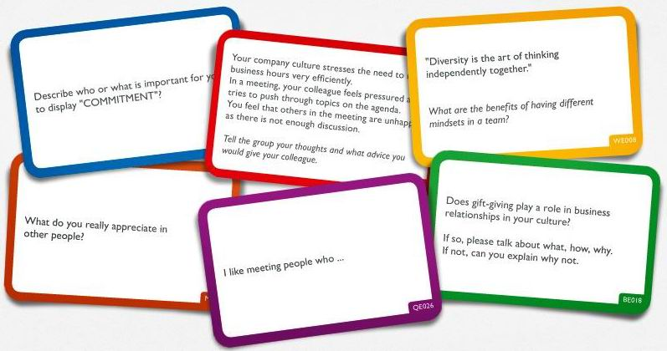
Select from 370 Questions …
… that challenge and expand our perspective of the world while focusing on the Core Business Question
Accelerating Change
Eric Lynn ● www.cultureQs.com

Slide 15
Embedding cultureQs into a Change Process
Accelerating Change
Group Context
Core Question
Transfer to Group's
Business Challenges
via Core Question
The Debriefing:
Deepening, Clarifying,
Understanding Insights
Engaging,
Experiencing,
Developing Insights
Eric Lynn ● www.cultureQs.com

Slide 16
Applications
Accelerating Change
Shaping your
Working Culture
Transforming
Your Organisation
Post-Merger
Integration
Start-Ups
Management
Team Integration
International Team
Integration
Project Team
Integration
Personal
Development
Collaborative
Innovation
Conflict
Resolution
Intercultural
Training
Interactive Keynotes
for
Conferences & Events
Leadership
Development
Diversity
Initiatives
Mobilising
Large Groups
Eric Lynn ● www.cultureQs.com

Slide 17
Dialogic Conversations
Uncovering Hidden Potential
Understanding Human Relationship
Accelerating Change
Enabling the Emergence of Collaboration that
Enables Organisations to Thrive in Change
In Dialogue, a group of people can explore the individual and collective presuppositions, ideas, beliefs, and feelings that subtly control their interactions. (David Bohm)
It is a collective observation. It is an arena for collective learning.
It is a space, an opportunity for a collective form – a culture – to emerge.
Appreciative Inquiry is the cooperative search for the best in people, their organisations, and the world around them. It involves a systematic discovery into what gives a system "life" when it is most effective and capable in economic, ecological, and human terms. (David Cooperrider & Diana Whitney)
Relationship is a process of self-revelation, and without knowing oneself, the ways of one's own mind and heart, merely to establish an outward order, a system, has very little meaning. So what is important is to understand oneself in relationship with one another. (J. Krishnamurti)
Eric Lynn ● www.cultureQs.com

Slide 18
Accelerating Change
How can we support you?
Let's open a generative conversation …
Eric Lynn
Berlin, Germany
eric@cultureQs.com
Tel: +49 176 67889006
Twitter: @cultureQs
Eric Lynn ● www.cultureQs.com

