Slide 1

Leadership Supportive for Creating Developmental Space in Teams and Leading to Better Team Results
Karin Derksen, Léon de Caluwé, Joyce Rupert & Robert-Jan Simons

Slide 2

Motive: extend previous research
Previous research led to a model of developmental space.
(Coenders, 2008; Derksen et al., 2011)
Teams are more satisfied about their results if they create more developmental space.
  (Derksen et al.,, 2014)
It seems that teams are confronted with a developmental space paradox.
  (Coenders, 2008; Derksen et.al, 2011; Derksen et.al, 2014)

Slide 3
Actively exchange and discuss information and perspectives (Mesmer-Magnus & DeChurch, 2009)
Creating value for the organization and team members themselves (Wenger, McDermot, & Snyder, 2002)
A collaborative agenda (Vangen & Huxham,
2003).
Reflecting
Organizing
Creating future
Dialoguing
Agreements, who is doing, what, when, how, etc.
Dialoguing is a space-creating way of communicating, and needed
to make diversity productive (Chrislip, 2002).

Slide 4
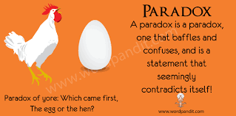
Developmental space paradox
Performance orientation (creating future – organizing) | Meaning-giving orientation (reflecting– dialoguing)
Accelerating Result driven Focussing Answering Moving forward Action oriented | Slowing down Delaying direction Broadening Questioning Standing still / moving backward Thinking oriented

Slide 5
Research questions
How can leadership support the creation of developmental space?
What kind of leadership, centralized (directive or supportive) or shared, emerges in teams working on complex tasks?
What influence does centralized (directive or supportive) or shared leadership have on creating developmental space?
How can teams be facilitated to develop a supportive kind of leadership to create developmental space?

Slide 6
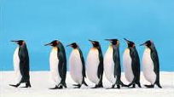
Leadership
Leadership is “a social influence process that must include at least two individuals acting in interdependent roles. At least one individual must act in a follower role, and at least one individual must act in a distinctively influential (leadership) role” (Seers, Keller, & Wilkerson, 2003, p. 79).
Two kinds of leadership:
  Centralized leadership (supportive & directive leadership style)
  (Euwema, Wendt, and van Emmerik, 2007)
  Shared leadership

Slide 7
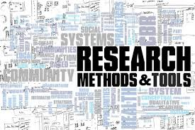
Method
Exploratory research consisting of two studies:
A multiple case study, observation of teams (n=10).
  according to Yin (2009) case studies are preferred for studying contemporary events when the relevant behaviors cannot be manipulated
A field experiment with teams (n = 6), because we were not quite sure if both kinds of leadership would occur in a natural setting.
  this gives the opportunity to randomly induce two ways of working on a similar assignment under almost equal circumstances (Bernard, 2000; Boruch & Foley, 2000).

Slide 8
The multiple case study (n=10)
Each team was observed once during a work session.
Our role: total researcher (Bryman, 2012).
Case selection: teams working on a complex task, teams with a formal leader and teams consisting of equals.
Data gathered by one researcher, all interactions were written down as precisely as possible.
Data analysis: interactions were labeled as developmental space activity and/or as leadership activity (all activities that were followed by the team).

Slide 9
Results

Slide 10
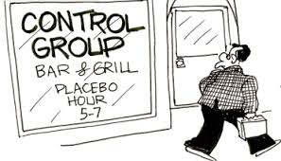
Field experiment (n=6)
Teams from one consulting firm. Got two different treatments. We tried to elicit shared leadership with one treatment. Teams had 10 hours during 2 days to work on a complex client’s question.
Treatment was randomly assigned.
One treatment (placebo): an observation assignment.
One treatment: working with activity cards.
During two days:
Each team member filled out a questionnaire 3 times.
Each team did at least a structured evaluation 3 times.
A ‘jury’ (clients and 3 independent consultants) judged the outcome of every team.
After 1 week 2 random team members of every team were interviewed (semi-structured).

Slide 11
Activity cards
Reflecting

Slide 12
Results

Slide 13
Conclusions
What kind of leadership supports creating developmental space?
A supportive leadership style (a leader preferring dialoguing and / or reflecting).
Shared leadership, but this does not appear naturally within teams.
The activity cards seem to elicit shared leadership and thus a leadership style supportive to creating developmental space.
A directive leadership style (a leader preferring creating future and/or organizing) seems to hinder creating developmental space and thus achieving a satisfying result.

Slide 14
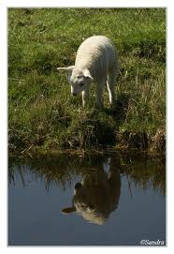
Reflections and Questions

