Slide 1
Collaborative enterprises & collaborative ecosystems
Charles Heckscher
August, 2017

Slide 2
More complex
More flexible / adaptive
COLLABORATIVE ECOSYSTEMS
Orchestrating networks for common purposes
Challenge: to coordinate independent actors
COLLABORATIVE ENTERPRISES
Leveraging resources around opportunities
1980-
????
Challenge: To flexibly integrate resources around emergent opportunities and customer needs
BUREAUCRATIC FIRMS
Product reliability on a large scale
1900-
1980
Challenge: to increase scale of production and scope of distribution
CRAFT / AUTONOMOUS PROFESSIONAL NETWORKS
Customization and personal relations

Slide 3
Collaborative enterprises

Slide 4
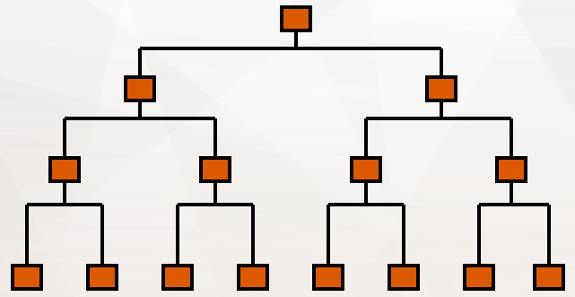
Bureaucracy
Strengths
Weaknesses
Clear expectations
Strong control
Simple conflict resolution
High reliability (in stable situations)
Lack of flexibility, resistance to change
Inward focus – poor customer communication
Few channels to other divisions: “Stovepipes”

Slide 5
The path from bureaucracy: decentralized organization
Semi-Autonomous Teams

Slide 6
Evolution of collaborative enterprise
Project
teams
Strategic
purpose
Initiatives
Notes:
Here the Japanese auto design story

Slide 7
Collaborative enterprise
Project
teams
Strategic
purpose
Initiatives

Slide 8
The key to the course
Commodity strategy (consistent & efficient)
Solutions strategy
(flexible & responsive)
Organizing by
defining jobs
Helping people
to work together
Management figures out how to do it and gets others to do it
Management shapes strategy, facilitates communication
Workers do job reliably, follow orders
Workers search better ways to contribute to shared goal
Focus on improving what you’re already doing (internal)
Focus on meeting outside needs (external)

Slide 9
Strategic purpose
Shared across the organization
External focus: competitive positioning
Internal analysis: distinctive competencies
3-5 year time frame
NOT
Moral
Vague (slogans)

Slide 10
Types of community
Gemeinschaft
Gesellschaft (mass society)
An alternative?
Deliberate community?

Slide 11
The dilemma of community
Community motivates, makes people feel proud, secure
BUT
Traditional community is closed, hostile to outside influence
Traditional community rewards loyalty more than performance

Slide 12
The dilemma of community:
Can we reconcile dynamism and diversity with community and trust ?
Openness
Mobility
Flexibility
Performance orientation
?
Trust
Collaborative community

Slide 13
Collaborative community: deliberate purpose
Orientation to meaningful ends
Discussion and deliberation of these ends
Consistent application through organization systems (accountabilities, authority, rewards) through interactive process management

Slide 14
Collaborative community:
The culture of contribution
Traditional craft culture | Culture of contribution
Who is in control? | What can you contribute?
Focus on craft excellence | Focus on purpose
Deference to position | Respect for capability
Conflict avoidance | Constructive conflict

Slide 15
Collaborative community:
Interactive process management
Deliberate processes
  Roles & responsibilities, milestones, resources, accountability mechanisms, output verification
+
Interactively managed
  Developed with engagement of key stakeholders (doctors, administrators, nurses, others)
  Learning loops and structured redesign moments

Slide 16
What do people need in a process organization?
Good understanding of purpose / strategy
Ability to manage through influence rather than power
Problem-solving techniques and skills
Good will and flexibility
Ability to juggle responsibilities and deal with ambiguity
Willingness to take and encourage risks
Ability to learn

Slide 17
Accountability
Traditionalistic craft | Bureaucratization | Marketization | Collaboration
Peer review and discipline Focused on maintaining values of profession Rarely invoked | Administrative assessments and discipline Focused on meeting standardized targets Periodic (yearly) reviews | Market choice Focused on customer satisfaction Standardized measures | Multisource reviews Focused on contribution to purpose Frequent, multidimensional feedback

Slide 18
Collaborative enterprise: core elements
Coordinating focus | Strategic purpose
Routines & relations | Teams Interactive process management
Performance management | Strategic scorecard Multisource appraisal
Careers | Capability focus 3-5 year commitments
Learning | Learning by monitoring Communities of practice
Structures | Project teams and initiatives Matrixed authority
Culture | Ethic of Contribution

Slide 19
Difficulties of collaborative organizations
Lack of clear job descriptions
Multiple commitments
Evolving, uncertain objectives and strategies
Cannot promise job stability and caring

Slide 20
Resistances and obstacles to change
People want to preserve autonomy, security
Higher and lower levels can’t talk freely
Differences in culture, knowledge block communication
Loss of clear accountability -- people report to multiple bosses
People worry that their careers will suffer

Slide 21
The trend

Slide 22
Collaborative ecosystems

Slide 23
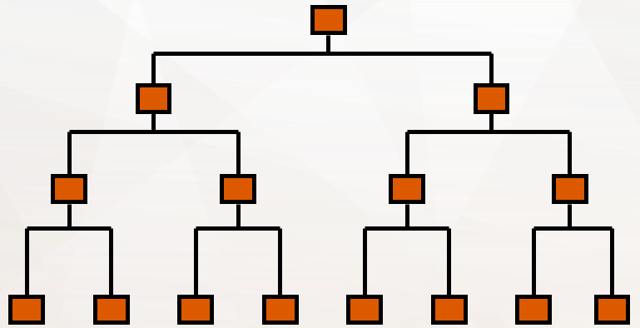
Mental models
1
2
3
4

Slide 24
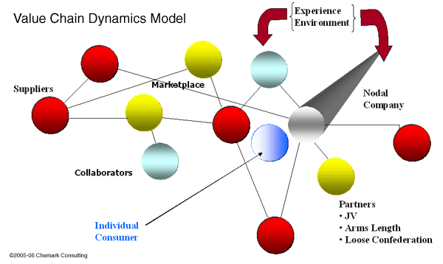
Enterprises in ecosystems

Slide 25
From collaborative enterprises to ecosystems
Collaborative enterprises
  Clients with market power
  Internal hierarchies of authority
  Established purpose and culture
Ecosystems
  Plural stakeholders and purposes
  Interdependencies rather than authority
  Alignment rather than direction

Slide 26
1. Ecosystem organizing is a network problem
  How do you coordinate many creative, independent actors with loose ties?

Slide 27
Networks are not organizations
Network thinking based on:
  Self-organizing systems (as opposed to directed hierarchy)
  Rich ties (open and diverse communities)
Examples / cases
Coalitions and alliances
Value chains
Voluntary associations
Open source software

Slide 28
2. Networks must be deliberately organized
  Network governance
  Orchestrators and coordinators

Slide 29
Network governance
Operates through influence / persuasion (can’t coerce)
Establishes the rules (processes) for self-regulation
    Decision-making
    Discipline
    Information-sharing
Can coordinate collective action

Slide 30
Some keys to complex network governance
Community of purpose
  Leadership, vision
  Value discussion
Deliberate process management
  Learning By Monitoring
Enforcement through reputation
Decision rights based on contribution

Slide 31
Organizing network / ecosystems the network orchestrator / coordinator
Mutualism Collective action
Network Coordinator
Network Orchestrator
Goal

Slide 32
Organizing network / ecosystems the network orchestrator / coordinator
Key qualities of network leaders
  Network centrality (rich ties, trust)
  Access to key sources of power (gatekeeper)
  Credible information
  Vision (plausible promise*)
* Shirky, Here Comes Everybody

Slide 34
EXTRA

Slide 35
Problems of projects and networks
Working in the task force
  Confronting poor performers and slackers
  Dealing with interpersonal conflict
  Building norms of openness and honesty
  Developing teamwork capabilities
  Maintaining ground rules and procedures
Coordinating the teams
  Setting goals and purposes
  Managing multiple accountabilities
  Assessing performance

Slide 36
Collaborative leadership
By collaborative we mean the process of facilitating and operating in multi-organizational arrangements to solve problems that cannot be solved or easily solved by single organizations. Collaborative means to co-labor, to achieve common goals, often working across boundaries and in multisector and multi-actor relationships. Collaboration typically is based on the value of reciprocity and can include the public

Slide 37
3. The culture of contribution: basic norms
Focus on the group mission.
Help others to succeed, recognize them; expect them to help and recognize you.
Surface conflicts and work them out.
Welcome diversity of capabilities and values: it helps get the job done.
Employees owe contribution to the mission, companies owe continued challenge.
Company and employees reciprocally commit to
help and continuity during change.

Slide 38
3. The culture of contribution – risks
Broken commitments
(can they be enforced?)
Distorted reputations
(can you get accurate public information on performance?)
Conflicts between peer judgments
and hierarchical judgments
Blurred accountability

Slide 39
Solutions:
The organizational problem
Resources
Opportunities
Product
Market
Product
Market
Product
Market
Product
Market

Slide 40
Solutions:
The organizational problem
Resources to
solutions opportunity
Opportunity to
new capabilities
Collaboration
Products
Product Platform
People
Market
Knowledge
Relationship
Relationships
Knowledge

Slide 41
The problem of collaboration
Across divisions
Across levels
Across staff-line distinction
Across the company boundary
  With outside allies
  With stakeholders

Slide 42
Managing cross-boundary opportunities is hard (very hard)
People want to defend their turf
Higher and lower levels can’t talk freely
Cultural differences block communication
It takes high trust to overcome differences in knowledge and skill
People report to multiple bosses – loss of accountability, clarity
People worry that their careers will suffer

Slide 43
Forty years of experiments
Collaborative systems
High-performance systems
Autonomous teams
Problem-solving groups
Job enrichment
1960s 1970s 1980s 1990s
“Empowerment”

Slide 44
Changing culture
Using management power:
  You can break a culture
  You can’t make a culture
Management can support new culture:
  Consistent policies
  Communication
  Modeling (walking the talk)

Slide 45
1. The loyalist culture: basic norms
The employee owes a hard day’s work,
the company owes security and care.
Do your job. Don’t interfere with others’ jobs.
Don’t start fights.
Don’t criticize peers (publicly).
Don’t challenge the boss (publicly).
Don’t tell people what they don’t need to know
Wait for your turn (it will come)
In case of doubt, check with the boss.

Slide 46
1. The loyalist culture – hidden dynamics
“Politics” (“Looking up and looking around”)
Please the boss, look for a protector
Compete with others for boss’s approval
Stick together against other units
Build and protect your empire
Avoid risk, don’t rock the boat, conform
Maintain group unity (equal or hidden rewards)
See Kanter, Men and Women of the Corporation; Jackall, Moral Mazes; Heckscher, Whie-Collar Blues

Slide 47
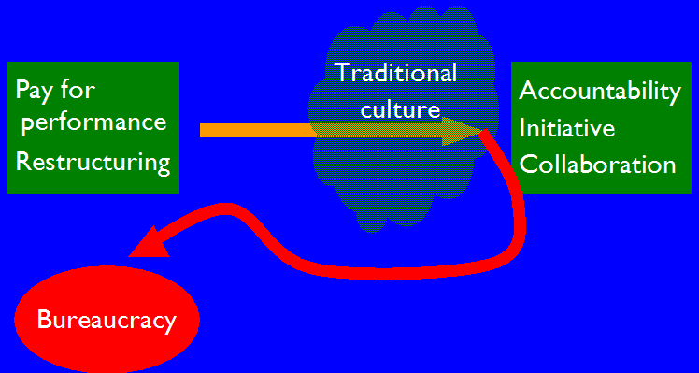
Loyalty – hidden dynamics:
Responses to change
  Retreat to autonomy
  Loss of informal "networks"
  Fear, loss of trust →
    more rule-based behavior
    more dysfunctional "politics“
  Dependence, passivity
  Waiting for a savior
  Waiting for a “return to normal”
Notes:
So you are left with worst aspects of bureaucracy
1. People walling selves off, focusing on narrow piece - less collaborative
2.People focused inward – less open to outside
3.People being passive, doing what they're told – less entrepreneurial
All this despite intention of greater entrepreneurship and teamwrk.
Picture typically looks very different to top mgt than to middle
If you don't recognize dynamc, trouble can sneak up on you
Downsizing often helps at first
Cost cutting
People pull together in crisis
But doesn't last
Can't get continuous improvement from head cutting
Employees settle back into defensive complacency
Signs may not be clear
Morale ok
But eating the seed corn

Slide 48
2. The free agent culture
Focus on your own success; always try to go higher and farther
Don’t trust anyone
The employee owes nothing, the company owes nothing

Slide 49
The free agent culture and change
Lots of energy and initiative
  Good at breaking the traditional culture
BUT
Little coordination
Little sustained strategy

Slide 50
Supporting the culture of contribution
Consistent policies
Process-focused work organization
Strategic scorecard & multisource feedback
Mission-focused careers
Stakeholder involvement

Slide 51
The shared purpose
  Understanding the business
  What are our challenges: competition, markets, technology?
  3-5 year time frame
NOT
  Eternal values
  A short-run “target”

Slide 52
The ethic of contribution
“Tough” performance orientation
  Deliver value
Contribute to the collective project
  Not just do your job
Embrace conflict and criticism
  Honest feedback

Slide 53
Skills
Performance management
Careers
Strategic purpose
Structure
Culture
Systems
Voice
Routines

Slide 54
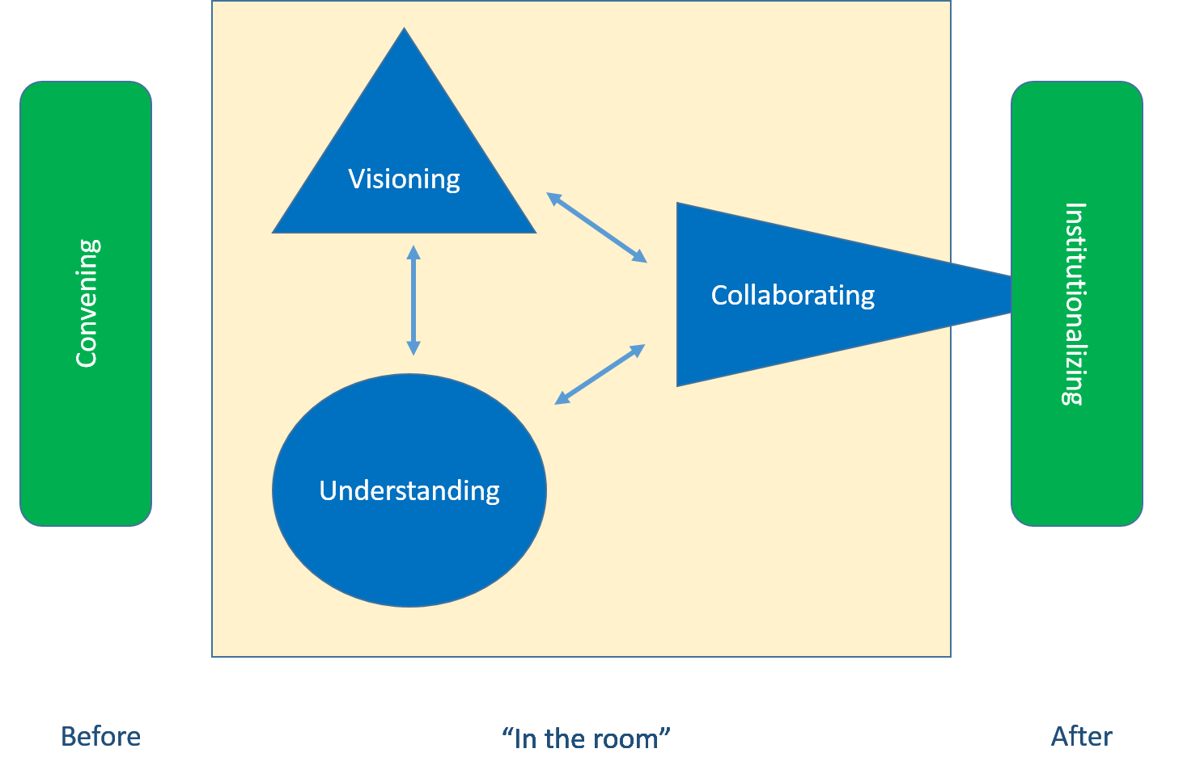
The UVC model of public conversation
Understanding, Visioning & Collaborating

