Slide 1

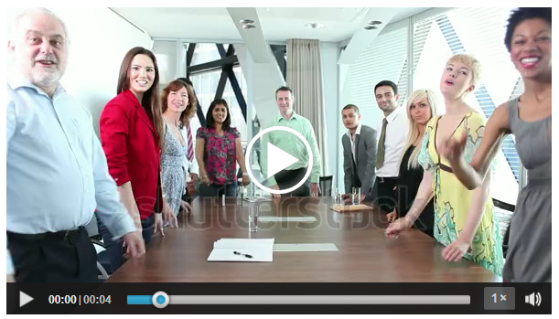
Mindful infrastructure as an enabler of innovation resilience behaviour in innovation teams
Peter Oeij
TNO & School of Management, Open University of The Netherlands
with Steven Dhondt & Jeff Gaspersz
IWOT 19 - International Workshop on Team Working
September 7, 2015
Catholic University of Leuven, Leuven, Belgium

Slide 2
Topic of presentation and research questions
-Is innovation resilience behaviour present in innovation teams?
-Does mindful infrastructure enable teams to have innovation resilience behaviour?
-What kind of ‘variations’ of mindful infrastructure are present as a ‘strategy’ that is being applied?

Slide 3
Main results
-Is mindful infrastructure present in innovation teams? > yes in 12 out of 18 teams
-Does mindful infrastructure enable teams to have innovation resilience behaviour? > yes, the 12 teams report presence of IRB
-What kind of ‘variations’ of mindful infrastructure are present as a ‘strategy’ that is being applied? > 8 implicit strategies are observed

Slide 4
Complexity
Defensive
behavior
Failing
innovation
process

Slide 5

-‘wicked’, unpredictable
-paradoxes, dilemmas, contradictions
-non linear
-local interactions, global patterns
Complexity
Defensive
behavior
Failing
innovation
process

Slide 6

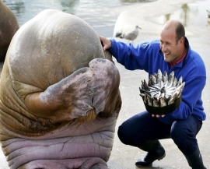
Complexity
Defensive
behavior
-confirmation bias
-control orientation
-mixed messages
-avoiding psychological discomfort
Failing
innovation
process

Slide 7
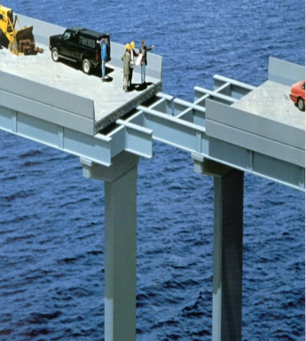
Complexity
Defensive
behavior
Failing
innovation
process
-‘circulair reasoning’
-resistance, frustration, irritation
-don’t see, don’t learn
-repeating ‘mistakes’

Slide 8
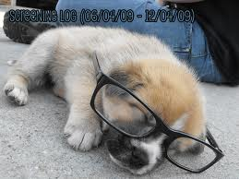
Complexity
Defensive
behavior
Team mindfulness
-manage the unexpected
- (1) weak signals, (2) resist simplification, (3) sense of experience (4) resilience, (5) defer to expertise
Failing
innovation
process

Slide 9

-‘wicked’, unpredictable
-paradoxes, dilemmas, contradictions
-non linear
-local interactions, global patterns
Complexity
Defensive
behavior
-confirmation bias
-control orientation
-mixed messages
-avoiding psychological discomfort
Team mindfulness
-manage the unexpected
- (1) weak signals, (2) resist simplification, (3) sense of experience (4) resilience, (5) defer to expertise
Failing
innovation
process
-‘circulair reasoning’
-resistance, frustration, irritation
-don’t see, don’t learn
-repeating ‘mistakes’

Slide 10
‘Mindful Infrastructure’
The capacity of a team to anticipate ‘unexpected’ problems and the capacity to contain such problems (after Weick & Sutcliffe, 2007)

Slide 11
‘Mindful Infrastructure’
The capacity of a team to anticipate ‘unexpected’ problems and the capacity to contain such problems (after Weick & Sutcliffe, 2007)
Consisting of elements crucial for team performance in complex situations, namely: team safety behaviour, team learning behaviour; ‘paradoxical’ / complexity leadership, team voice / participative decision-making

Slide 12
‘Innovation Resilience Behaviour’
A set of team competencies (team capability) to make a team bounce back to the right track of the project once a team has taken/is taking an ineffective course with regard to its innovation goal (after Weick & Sutcliffe, 2007)

Slide 13
‘Innovation Resilience Behaviour’
A set of team competencies (team capability) to make a team bounce back to the right track of the project once a team has taken/is taking an ineffective course with regard to its innovation goal (after Weick & Sutcliffe, 2007)
Being alert for weak signals that the project goes wrong
Resist oversimplification and validate decisions
See the big picture, don’t get lost in sideways
Be able to respond in a resilient way if needed
Deference to expertise

Slide 14
Perceived project complexity
Defensive behaviour
Perceived project results / progress
Other variables
Team innovation resilience climate
= Not in the analysis
Outcome variable
Condition variables
Mindful infrastructure
Collaboration
Team psychological safety
Team Voice
Complexity leadership
Competition
Control
Team learning
Creativity

Slide 15
Research
Method
-Survey among 260 members / project leaders of ‘innovation teams’
-18 innovation teams (n= 107)
Measurement and Data:
- scales of Team Innovation Resilience Climate (Innovation Resilience Behaviour);
- Mindful Infrastructure:
  Team Voice, Team psychological safety, Team Learning
  Leadership four subscales: collaboration, control, creativity, competition
Analysis: Qualitative Comparative Analysis
equifinality > not ‘one road’ leads to IRB
limited number of teams > QCA is very suitable for limited ‘N’

Slide 16
Qualitative Comparative Analysis
-Main purpose: which combinations of independent variables have the same outcome?
-Outcome variable = presence of IRB in teams (dependent)
-Condition variables: the elements of Mindful Infrastructure (independent)
-QCA analyses combinations applying logical AND and OR operators (no linear equation of variables but combinations of ‘set-membership’ in variables); it looks for ‘patterns’/ ‘clusters’
-QCA identifies if variables are ‘necessary’ or ‘sufficient’ conditions for an outcome to appear
-QCA in steps > use software fsQCA, prepare the variable scores (‘calibration’, ‘necessary conditions analysis’, ‘truth table analysis – sufficient conditions analysis’, ‘plausibility analysis’).

Slide 17
Table: Configurations explaining Team Innovation Resilience Climate
 | Causal conditions |  |  |  |  |  |  | Descriptives
Solu-tion | Team voice | Leadership competition | Leadership control | Leadership creativity | Leadership collaborate | Team learning | Team psy-cholo-gical safety | Raw coverage | Unique coverage | Consisten-cy | Number Cases >0.5 membership | Cases / teams
1 | ● | ● | ○ | ● | ○ | ● |  | 0.143396 | 0.022642 | 0.974359 | 2 | ConsultICT, EdecCon
2 | ● |  |  | ○ | ● | ○ | ● | 0.139623 | 0.086793 | 0.942675 | 2 | ManTran1, ManMed2
3 | ● |  | ○ | ● | ○ | ● | ● | 0.173585 | 0.083962 | 0.934010 | 2 | GovMun, EducCon
4 | ● | ● | ● | ● | ● | ● |  | 0.319811 | 0.221698 | 0.971347 | 3 | CosmR&D3, Agri&R&D, ManR&D1
5 | ○ | ● | ● | ○ | ○ | ○ | ○ | 0.122642 | 0.051887 | 0.902778 | 1 | ManR&D2
6 | ○ | ● | ○ | ○ | ● | ○ | ○ | 0.079245 | 0.003774 | 0.875000 | 1 | CosmR&D2
7 | ● | ○ | ○ | ○ | ● | ● | ○ | 0.100943 | 0.057547 | 0.922414 | 1 | EducIT
8 | ○ | ● | ● | ● | ○ | ○ | ● | 0.100943 | 0.045283 | 0.946903 | 1 | ManTran2
Model | solution coverage: 0.763208
 | solution consistency: 0.960808

Slide 18
Table : Mindful infrastructure elements leading to innovation
resilience behaviour(in words)
 | Elements of mindful infrastructure
Solutions (paths) | Present | Must be absent
1 Team dependent goal-orientedness | Team voice Team learning Leadership compete Leadership create | Leadership control Leadership collaborate
2 Trusted and focussed team work | Team voice Team psychol. safety Leadership control Leadership collaborate | Team learning Leadership create
3 Team driven resourcefulness | Team voice Team psychol. safety Team learning Leadership create | Leadership control Leadership collaborate
4 Team minded and balanced leadership | Team voice Team learning Leadership compete Leadership control Leadership create Leadership collaborate
5 Goal & task driven leadership | Leadership compete Leadership control | Team voice Team psychol. safety Team learning Leadership create Leadership collaborate
6 Goal & Process driven leadership | Leadership compete Leadership collaborate | Team voice Team psychol. safety Team learning Leadership control Leadership create
7 Team minded collaboration | Team voice Team learning Leadership collaborate | Team psychol. safety Leadership compete Leadership control Leadership create
8 Goal driven problem solving | Team psychol. safety Leadership compete Leadership control Leadership create | Team voice Team learning Leadership collaborate

Slide 19
Table : Mindful infrastructure elements leading to innovation
resilience behaviour(in words)
 | Elements of mindful infrastructure
Solutions (paths) | Present | Must be absent
1 Team dependent goal-orientedness | Team voice Team learning Leadership compete Leadership create | Leadership control Leadership collaborate
2 Trusted and focussed team work | Team voice Team psychol. safety Leadership control Leadership collaborate | Team learning Leadership create
3 Team driven resourcefulness | Team voice Team psychol. safety Team learning Leadership create | Leadership control Leadership collaborate
4 Team minded and balanced leadership | Team voice Team learning Leadership compete Leadership control Leadership create Leadership collaborate
5 Goal & task driven leadership | Leadership compete Leadership control | Team voice Team psychol. safety Team learning Leadership create Leadership collaborate
6 Goal & Process driven leadership | Leadership compete Leadership collaborate | Team voice Team psychol. safety Team learning Leadership control Leadership create
7 Team minded collaboration | Team voice Team learning Leadership collaborate | Team psychol. safety Leadership compete Leadership control Leadership create
8 Goal driven problem solving | Team psychol. safety Leadership compete Leadership control Leadership create | Team voice Team learning Leadership collaborate
examples

Slide 20
Conclusions
-1] There are different combinations of mindful infrastructure elements that can lead to innovation resilience behaviour (equifinality)
- 2] there are no ‘necessary’ conditions for IRB to emerge: there is choice for unique combinations
- 3] there are no ‘sufficient’ conditions for IRB to emerge: there must be more than one condition present in conjunction with others
[Therefore, QCA is a helpful technique to analyse such complex settings]
The theoretical concepts of ‘resilience’ and ‘mindful semi-structure’ are applicable to the context of innovation management: it may help to enlarge insight on sense of urgency (competitiveness) and the quality of a team’s innovation process (alertness, semi-structure) to deal with ‘risk avoidance’ (defensiveness) and ‘critical incidents’ (recover in resilient ways).

Slide 21
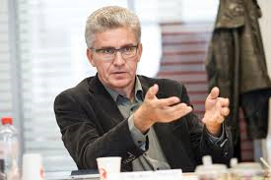


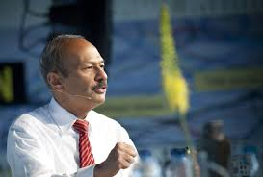

Thank you for your attention!
If you are interested to receive this presentation, please, be so kind to send me an email:
peter.oeij@tno.nl
[TNO, and Open University of the Netherlands]
Steven Dhondt / TNO [NL] and Catholoc University Leuven [Belgium]
Jeff Gaspersz / Neyenrode Business University, Breukelen [NL}

