Slide 1
Designing For Autonomy, Accountability, Appreciation & Agility: The Possibility of Positive Governance
Presented by Bernard J Mohr
(and Neil Samuels in absentia)
September 10, 2015. Leuven, Belgium
And Sponsored By
Global STSD Network

Slide 2
Today’s Topics
Why Govern?
Why is Governance Design important?
Our propositions
Positive Governance (PG) Defined
How is PG different from traditional Governance
How PG makes a difference
A Roadmap and Principles for Designing PG

Slide 3
But first...An Invitation to Co-Create
We (Bernard and Neil) want to share and discuss with you our ideas, frameworks etc. regarding the design of governance systems.
In exchange we ask for you to tell us
Which ideas are clear (and how could others be clearer)
Which ideas are valuable (and how could others be made more valuable)

Slide 4
Why Govern? - A Thought Experiment
What if……Governance were all about guiding an organization in ways that generate sustainable health and prosperity for itself, its members and the community of stakeholders in which it lives, within ethical and legal boundaries?
What if such governance was the direct outcome of an intentionally designed, highly integrated system of roles, practices, technologies and processes?
What if this system were intentionally designed to identify, magnify and connect individual and organizational strengths?
What if such governance occurred every day, in all corners of the system and not just in the rarified air of quarterly board meetings?
What if such governance directly reinforced coordination, learning and collaboration and destroyed siloes in the organization?
What if this intentional design emerged from a structured and highly participative process?
What if all this led to levels of staff engagement and operational excellence that enabled significantly faster responsiveness to threats and opportunities?

Slide 5
Why is Governance Design important?
“connecting with our audience matters”
A fad that died in the 80’s
A one size fits all “self-managing teams” solution.
Relevant mainly to manufacturing
Something dealing with information systems
Or…. “socio - what?”

Slide 6
Why is Governance Design important?
(“engagement” matters)
Visible “Iceberg”
70%
Dissatisfaction
“Below Water”
Frustration

Slide 7
Our Propositions
“Engagement” can equal QWL for all
More Accountability, Autonomy, Appreciation & Agility will increase QWL AND business success
In expanding what we mean by Governance, we open up new opportunities to increase Accountability, Autonomy, Appreciation & Agility
Structure, Roles, Practices and Processes are the elements of this expanded view of Governance and their design is our core work as STS-D practitioners

Slide 8
Positive Governance Defined
Positive Governance is an integrated system of structures, roles, practices, and processes, which through STS Design, takes organizational strategy and delivers:
Fully engaged staff
Ethical and Legal Behavior supportive of the long-term interests of shareholders and other stakeholders …while preventing the opposite;
Operational excellence;
Rapid Response to threats and opportunity; and,
Positive business, human and societal results;
Through a highly participative and iterative design process that ensures each element of the system:
1. Continually magnifies and connects individual and organizational strengths;
2. Builds and maintains collaborative relationships;
3. Supports highly coordinated action and learning; and,
4. Contains a minimal amount of control (control for exception rather than the rule)

Slide 9
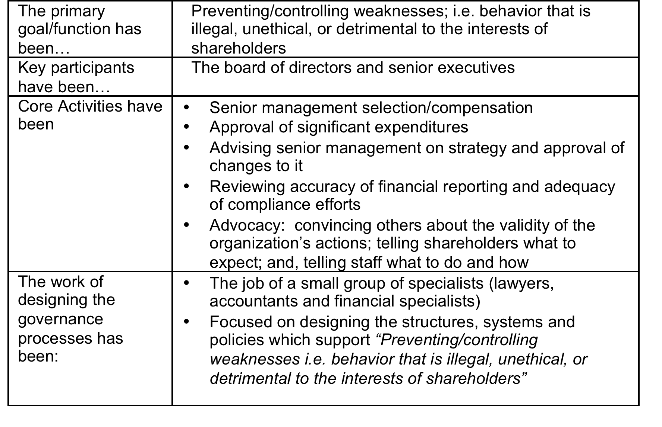
Old Thinking on Governance

Slide 10
How is PG different from “Old” Governance?
Refer to Handout called
Emerging Thinking About Governance Leuven, 2015 © Bernard J Mohr & Neil Samuels

Slide 11
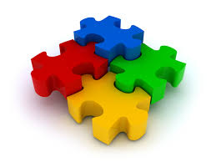
Appreciation = Designing For Strengths
Appreciation
Autonomy
Accountability
Agility

Slide 12
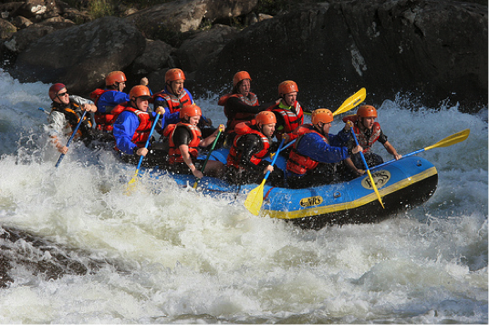
Strengths Defined
Gallup: “the ability to consistently provide near-perfect performance in a specific activity. The key to building a strength is to identify your dominant talents, then complement them by acquiring knowledge and skills pertinent to the activity.” A combination of talent, knowledge and skills
Peterson and Seligman: “positive individual core character traits that make a good life possible.”
Mohr and Samuels: “Connecting people’s talents, knowledge and skills to the best of who they are at their very core”
Notes:
Coming back to our definition of strengths, that would manifest first in people’s character and passions as a raft full of those who love the thrill of running rapids supported by a land-based logistics team who are energized more by planning and organizing than by paddling. Then it shows up in experience and expertise as to who paddles and who serves as helmsman. Finally, it comes down to skills and talents so that people sit on the side of the raft that best fits their body and arm strength. How much easier is the journey? That is what a focus on strengths in governance systems can bring to your organization.
Can also talk about Coordinated action learning and collaborative relationships from this slide. See the chapter in our book for details.
Of all the Gallop survey items, one item correlates best with performance and business results. That is: “I have the opportunity to do what I do best every day at work”
As Barbara Frederickson’s work has shown, such a state increases your intellectual resources improving your problem-solving skills and your ability to learn new information. It improves your physical resources with better coordination, strength, and cardiovascular health. It increases your psychological resources developing more optimism and resilience as well as deepening your sense of self and goal orientation. And finally, it improves your social resources by improving your ability to make new bonds and solidify existing ones (Fredrickson, 1998). Think back to your raft on the wild river. Wouldn’t you like to have the above describe all ten of your rowers? It would go a long way to ensuring that each rower can be the best he or she can possibly be.
Of all the Gallop survey items, one item correlates best with performance and business results. That is: “I have the opportunity to do what I do best every day at work” (Buckingham, 2007). What does it take for me to be able to answer “strongly agree” to this statement? Certainly factors like organizational culture, infrastructure and systems, pay and benefits matter, for they can distract people from being at their best. But even if everyone believes these are perfect, there is something more important. We assert that it is necessary that employees, their teammates, and their managers know their strengths. For it is only when people play to their strengths that they can deliver their best work every day.

Slide 13
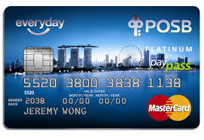
Autonomy/Accountability: Designing for minimal control
Must ensure fiduciary and regulatory requirements are met
Mobilize behavior that is legal, ethical, and supportive of the long-term interests of shareholders and other stakeholders
Design for the exception rather than the rule
Notes:
The organization MUST satisfy fiduciary and regulatory requirements. That does not change. But rather than focus on Preventing weaknesses i.e. behavior that is illegal, unethical, or detrimental to the interests of shareholders, design PG that mobilises positive behavior and builds in local checks and balances. The highly participative design process can help accomplish this by having the people doing the work figure out ways to “control” the work with the help of “experts” rather than having only the “experts” involved.
Note that this requires a system of accountability with real consequences for both desired AND undesired behaviors.
Credit card companies do not require advance notice for every purchase but have systems that alert unusual transactions. Amoco, back in the 90’s, designed their T&E system similarly. Employees filed their expense statements electronically and sent hard copy receipts to the accounting department. No supervisor signatures were required. Exceptions were handled when they arose. Trust and verify.
Why have a vacation policy for knowledge workers. People are accountable for results not time in the office.
UNLIMITED VACATION
From Richard Brandon’s Virgin Group and MGM Resorts International, which both last year created an unlimited vacation policies, to the pioneer in this area, Netflix, a growing number of employees don’t have vacation days at all. Instead, employees can take an unlimited amount of time off on an honor system. This idea is becoming more common, especially at startups and other Silicon Valley type companies, but is not the norm yet: Unlimited vacation or paid time-off is still only offered by fewer than 2% of firms, according to the report.
MANDATED VACATION
This is pretty much the opposite of unlimited vacation, and it gets people out the door without the guilt.
Hubspot, a software company in Cambridge, MA, created a mandatory two-week vacation policy (in addition to unlimited vacation) in a smart way that didn’t pile on extra work leading to the time off: It allowed employees to reduce their monthly sales quotas twice a year to make it easier to get away.
About 12% of companies close between Christmas and New Year’s according to the report, but others do this at other times. As Co.Exist wrote about last year, the non-profit TED shuts down for two weeks every summer so employees can all get away at once. "The impact on morale, productivity, and overall happiness is stunning," TED Media executive producer June Cohen said. http://www.fastcoexist.com/3043269/vacation-policies-youll-envy-from-companies-you-dont-work-for

Slide 14
How PG Makes a Difference
Socio-Economic
Environment
Positive Governance:
An Integrated system of roles, practices, technologies and processes created through a highly participative design process that ensures each element :
Continually Magnifies and Connects Strengths
Builds and Maintains Mutually Accountable Collaborative Relationships
Supports Highly Coordinated Action & Learning
Contains only a minimal amount of control
Services
and/or
Products
Valued By Customers
And
World
Rapid Response
to
Threats and Opportunities
Ethical and Legal
Behavior
Operational Excellence
✚
Fully Engaged Staff
Strategy
✚
Enterprise
and
Societal Results

Slide 15
Roadmap and Principles for Designing PG
1) Connect and Explore-- Discovery through appreciative curiosity
2) Imagine and Design-- Positive Image and Personal Choice
3) Mobilize and Test-- Experimental Mindset and Rapid Prototyping
4) Deliver and Evolve-- Implement through Learning

Slide 16
Elevating this work
Which ideas are clear (and how could others be clearer)
Which ideas are valuable (and how could others be made more valuable)

Slide 17
Thank You
Contact Information
Bernard J Mohr
+1-207-807-4974 bjmohr@InnovationPartners.com
Neil Samuels
+1- 630-605-4610
neil@profoundconversations.com

