Slide 1
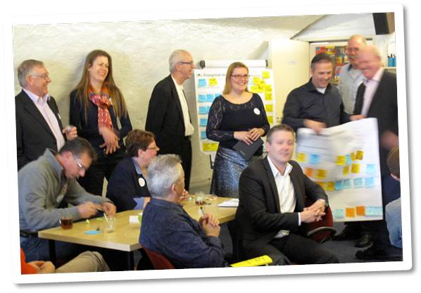
Voluntary innovation teams of public professionals
Wouter van der Torre & Peter Oeij, TNO

Slide 2
presentation
Results & lessons learned of a pilot with innovation teams of professionals, to stimulate bottom-up innovation in the public sector
Discuss how we can improve the method

Slide 3
Content
Introduction
Do-Tanks & teams
Results & lessons learned
Discussion

Slide 4
Smart Working Network
Goal: Stimulate bottom-up innovation: use and strengthen the innovative capacity of public professionals across organisational boundaries.
By developing an infrastructure which facilitates and stimulates public professionals to appoint challenges, develop innovative solutions and experiment with these solutions…
Do-tanks as important vehicle

Slide 5
Do-Tanks
Multidisciplinary teams
3 – 10 professionals from different organisations
Addressing a smart working issue or problem of own choice
Voluntary & without budget
Largely autonomous, innovation coach, ‘supporter’

Slide 6
Do-Tanks vs ‘regular’ teams
 | Do-Tank | ‘Regular’ organisational team
Goals | Problem or general idea | Specific goal
Notes:
Goals: weak task / goal interdependencies
'virtual', not bounded to a location / office / workplace
Temporary teams, with people which do not know each other

Slide 7
Do-Tanks vs ‘regular’ teams
 | Do-Tank | ‘Regular’ organisational team
Goals | Problem or general idea | Specific goal
Ownership / responsibility | Unclear / shared | Clear responsibilities
Notes:
Goals: weak task / goal interdependencies
'virtual', not bounded to a location / office / workplace
Temporary teams, with people which do not know each other

Slide 8
Do-Tanks vs ‘regular’ teams
 | Do-Tank | ‘Regular’ organisational team
Goals | Problem or general idea | Specific goal
Ownership / responsibility | Unclear / shared | Clear responsibilities
Decision-making power | “No man’s land” | Embedded in organisational context
Notes:
Goals: weak task / goal interdependencies
'virtual', not bounded to a location / office / workplace
Temporary teams, with people which do not know each other

Slide 9
Do-Tanks vs ‘regular’ teams
 | Do-Tank | ‘Regular’ organisational team
Goals | Problem or general idea | Specific goal
Ownership / responsibility | Unclear / shared | Clear responsibilities
Decision-making power | “No man’s land” | Embedded in organisational context
Means | ‘Own’ time / no budget | Work time / budget
Notes:
Goals: weak task / goal interdependencies
'virtual', not bounded to a location / office / workplace
Temporary teams, with people which do not know each other

Slide 10
Do-Tank dealing with challenges
 | Do-Tank | Solution
Goals | Problem or general idea | Find problem for solution. Involve problem owner. Define problem within circle of influence.

Slide 11
Do-Tank dealing with challenges
 | Do-Tank | Solution
Goals | Problem or general idea | Find problem for solution. Involve problem owner. Define problem within circle of influence.
Ownership / responsibility | Unclear / shared | Involve stakeholders & problem owner & make commitments explicit.

Slide 12
Do-Tank dealing with challenges
 | Do-Tank | Solution
Goals | Problem or general idea | Find problem for solution. Involve problem owner. Define problem within circle of influence.
Ownership / responsibility | Unclear / shared | Involve stakeholders & problem owner & make commitments explicit.
Decision-making power | “No man’s land” | Involve manager which has an interest and wants to experiment in his organisation.

Slide 13
Do-Tank dealing with challenges
 | Do-Tank | Solution
Goals | Problem or general idea | Find problem for solution. Involve problem owner. Define problem within circle of influence.
Ownership / responsibility | Unclear / shared | Involve stakeholders & problem owner & make commitments explicit.
Decision-making power | “No man’s land” | Involve manager who wants to experiment in his organisation.
Means | ‘Own’ time / no budget | Involve persons for which the Do-Tank is extension of regular work Co-operate with other initiatives.

Slide 14
Do-Tanks Results
 | Solution | Results
Goals | Find problem for solution. Involve problem owner. Define problem within circle of influence. | Assumed problems did not exist. Many Do-Tanks ended after problem analysis.

Slide 15
Do-Tanks Results
 | Solution | Results
Goals | Find problem for solution. Involve problem owner. Define problem within circle of influence. | Assumed problems did not exist. Many Do-Tanks ended after problem analysis.
Ownership / responsibility | Involve stakeholders & problem owner & make commitments explicit. | Small core which was committed surrounded with ‘advisors’ with fresh perspectives.

Slide 16
Do-Tanks Results
 | Solution | Results
Goals | Find problem for solution. Involve problem owner. Define problem within circle of influence. | Assumed problems did not exist. Many Do-Tanks ended after problem analysis.
Ownership / responsibility | Involve stakeholders & problem owner & make commitments explicit. | Small core which was committed surrounded with ‘advisors’ with fresh perspectives.
Decision-making power | Involve manager who wants to experiment in its organisation. | Involved manager was not the ‘real’ decision maker.

Slide 17
Do-Tanks Results
 | Solution | Results
Goals | Find problem for solution. Involve problem owner. Define problem within circle of influence. | Assumed problems did not exist. Many Do-Tanks ended after problem analysis.
Ownership / responsibility | Involve stakeholders & problem owner & make commitments explicit. | Small core which was committed surrounded with ‘advisors’ with fresh perspectives.
Decision-making power | Involve manager who wants to experiment in its organisation. | Involved manager was not real decision maker.
Means | Involve persons for which the Do-Tank is extension of regular work. Co-operate with other initiatives. | More time and means available, less autonomy.

Slide 18
Overall results
Many interested and participating professionals
Connecting professionals & exchanging knowledge was appreciated
Do-Tank-members were positive
Problem analysis and development of possible solutions went well….

Slide 19
Overall results
However…
  Only 7 out of 30 Do-Tanks successful
  Many stopped early in the process
  Experimenting in an organisation was a bridge too far for many Do-Tanks…
But, when experiments were realised, the innovation process continued.

Slide 20
Do-Tanks & Teams
Advantages Do-Tanks…
  Problems and issues from the professionals on the agenda and solutions developed
  Enthusiastic professionals experiencing (autonomous) innovation processes
  Knowledge sharing & networking across organisational boundaries
Disadvantages Do-Tanks
  Lack of time and means
  Lack of ownership and decision-making power

Slide 21
Questions & Discussion
Questions?
Questions for you:
  Is the concept of Do-Tanks useful in other contexts?
  How can we improve the method? E.g. regarding the lack of ownership and decision-making power…

Slide 22
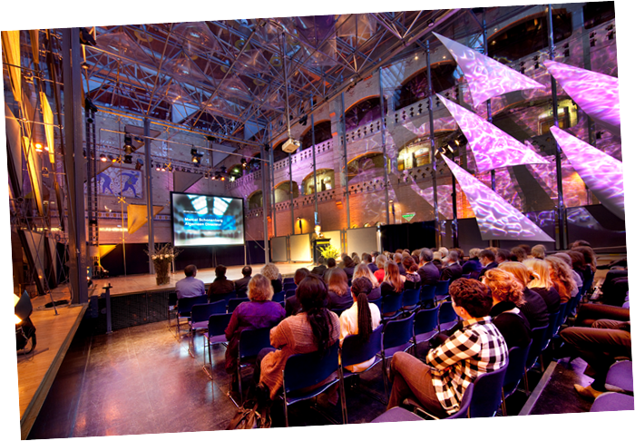
Thank you for your attention

