Slide 1


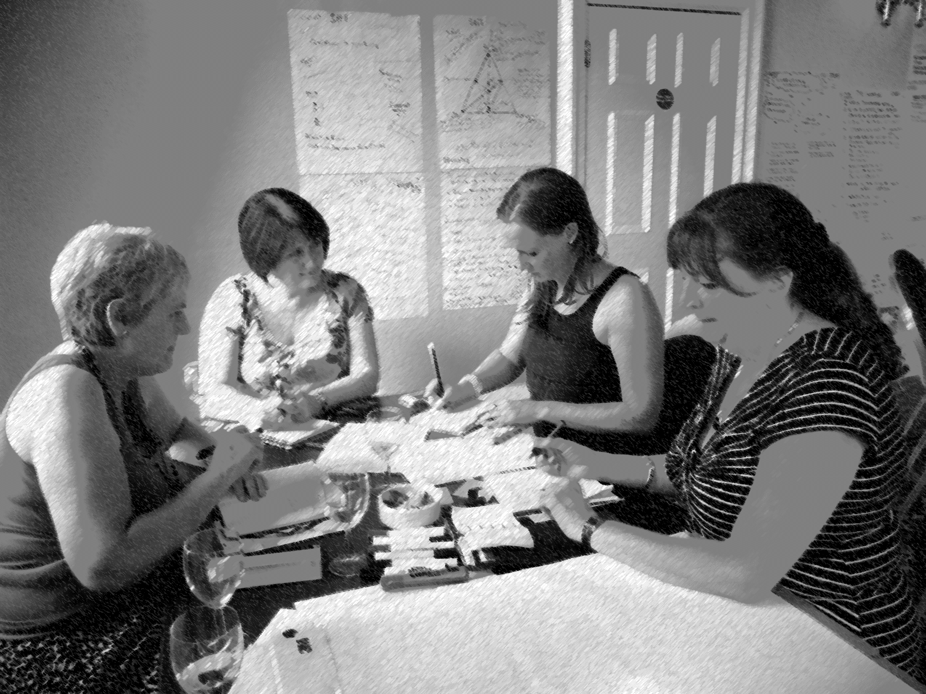

Giving Birth to Multi Disciplinary Team Working
ROSEMARY EXTON
PATRICIA GILLEN
PETER TOTTERDILL

Slide 2
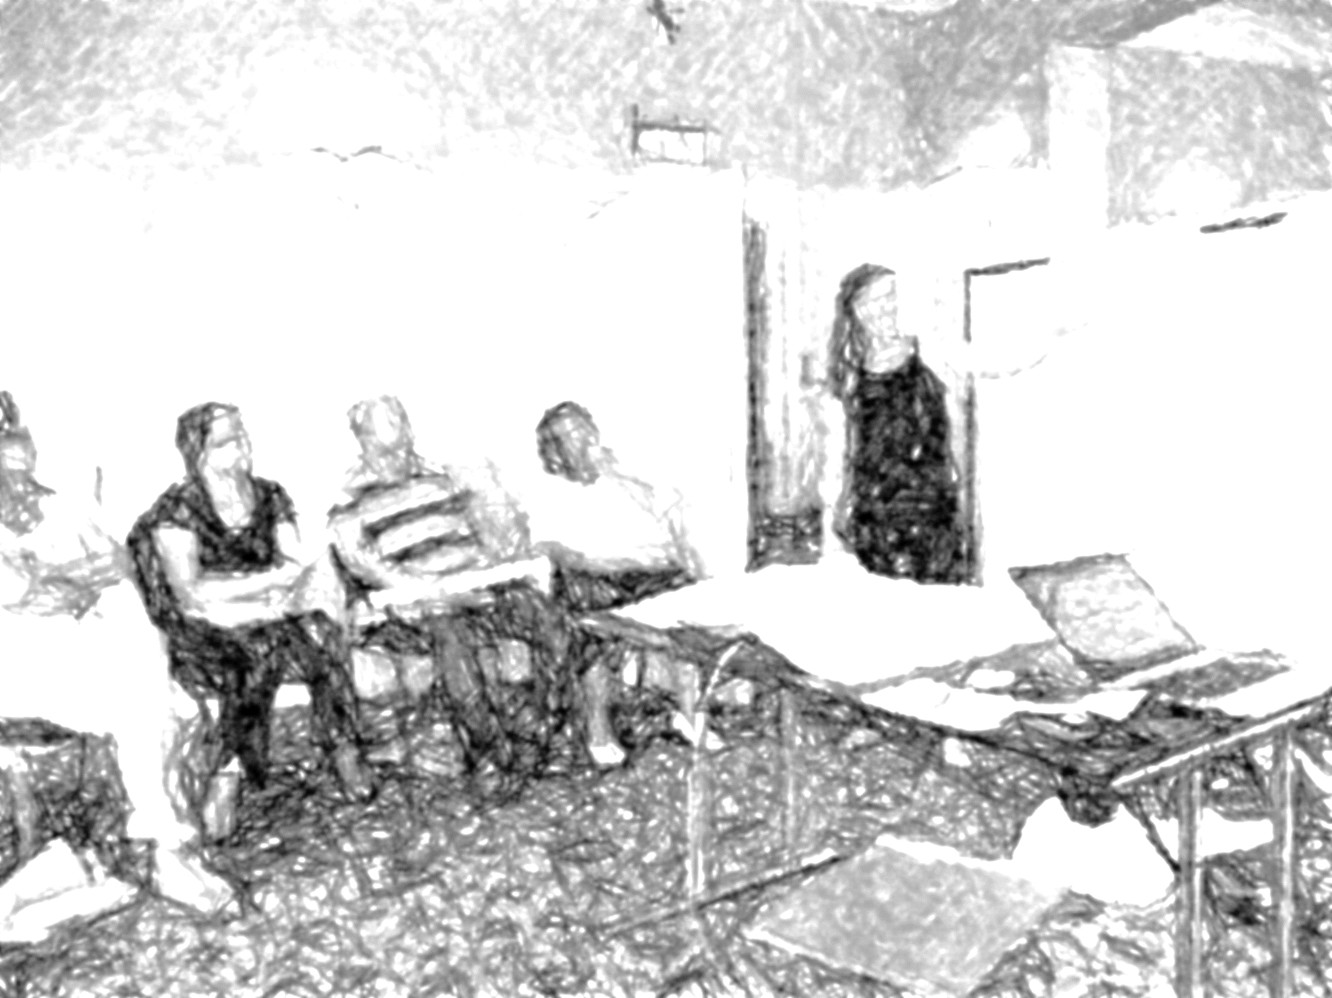
Retaining and engaging older workers through non-age related interventions to enhance quality of working life

Slide 3
Retaining and engaging older workers through non-age related interventions to enhance quality of working life . . . and performance

Slide 4
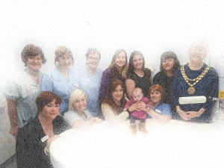
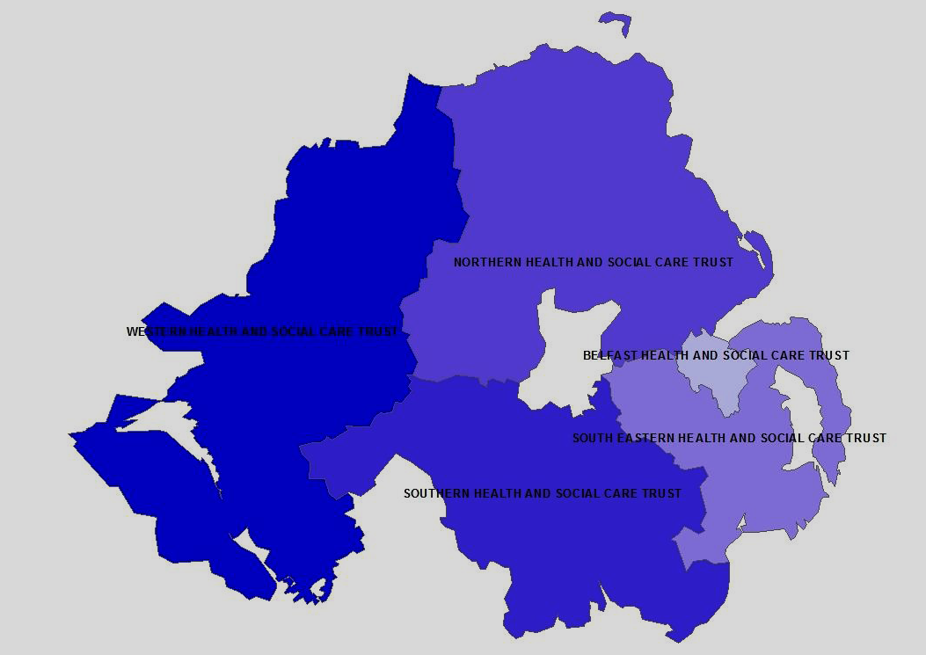
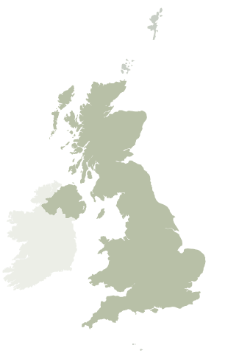

Slide 5
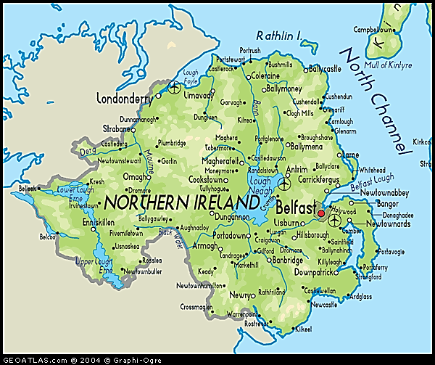

Two hospital sites
24 miles apart
Craigavon
Daisy Hill
Notes:
ST serves overall population of 366,000; mostly rural community
Recognised as one of the top 40 acute hospital Trusts in the UK at the prestigious CHKS awards in London in 2015: recognise and rewards 40 of the best performing acute Trusts across the UK, the CHKS 40 Top Awards are based on the evaluation of 23 indicators of clinical effectiveness, health outcomes, efficiency, patient experience and quality of care.
CHKS is a leading provider of healthcare intelligence and quality improvement services
The Trust provides Health and Social Care Services to the Council Areas: Armagh, Banbridge, Craigavon, Dungannon and South Tyrone and Newry and Mourne
NI has 26,000 births per annum;
SHSCT : 6,000+ (2011/12)
CAH: 4194 ; DHH:1904
Recently opening MLU in DHH; First AMU in NI opened in 2001 in ST
Head Count: 355 ( 277.76 WTE) Midwives & Support staff- Pay Bands 2-8a

Slide 6
The Intervention Team | The Multi Disciplinary Team
 | Midwives
 | Obstetric consultants & doctors
 | Senior management
 | Midwifery support workers
 | Healthcare assistants
 | Domestic staff
 | Admin and clerical
Notes:
ST serves overall population of 366,000; mostly rural community
Recognised as one of the top 40 acute hospital Trusts in the UK at the prestigious CHKS awards in London in 2015: recognise and rewards 40 of the best performing acute Trusts across the UK, the CHKS 40 Top Awards are based on the evaluation of 23 indicators of clinical effectiveness, health outcomes, efficiency, patient experience and quality of care.
CHKS is a leading provider of healthcare intelligence and quality improvement services
The Trust provides Health and Social Care Services to the Council Areas: Armagh, Banbridge, Craigavon, Dungannon and South Tyrone and Newry and Mourne
NI has 26,000 births per annum;
SHSCT : 6,000+ (2011/12)
CAH: 4194 ; DHH:1904
Recently opening MLU in DHH; First AMU in NI opened in 2001 in ST
Head Count: 355 ( 277.76 WTE) Midwives & Support staff- Pay Bands 2-8a

Slide 7
The Intervention Team | The Multi Disciplinary Team
WORKPLACE INNOVATION | Midwives
Rosemary Exton Peter Totterdill | Obstetric consultants & doctors
SOUTHERN TRUST | Senior management
Patricia Gillen Jeni Beckett | Midwifery support workers
 | Healthcare assistants
 | Domestic staff
 | Admin and clerical
Notes:
ST serves overall population of 366,000; mostly rural community
Recognised as one of the top 40 acute hospital Trusts in the UK at the prestigious CHKS awards in London in 2015: recognise and rewards 40 of the best performing acute Trusts across the UK, the CHKS 40 Top Awards are based on the evaluation of 23 indicators of clinical effectiveness, health outcomes, efficiency, patient experience and quality of care.
CHKS is a leading provider of healthcare intelligence and quality improvement services
The Trust provides Health and Social Care Services to the Council Areas: Armagh, Banbridge, Craigavon, Dungannon and South Tyrone and Newry and Mourne
NI has 26,000 births per annum;
SHSCT : 6,000+ (2011/12)
CAH: 4194 ; DHH:1904
Recently opening MLU in DHH; First AMU in NI opened in 2001 in ST
Head Count: 355 ( 277.76 WTE) Midwives & Support staff- Pay Bands 2-8a

Slide 8

Multi Disciplinary Team Working improves mortality, morbidity and working life
Integrating bodies of professional knowledge.
Consistency of communication with patients.
A more seamless pathway.
Professional diversity stimulates employee-driven innovation and improvement.
Shared learning enhances and extends CPD.
Mutual recognition of the knowledge and contribution of each profession.
Improved communication, problem-solving and conflict reduction.

Slide 9
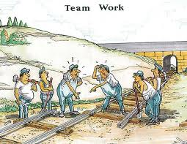
Multi Disciplinary Team Working improves mortality, morbidity and working life

Slide 10
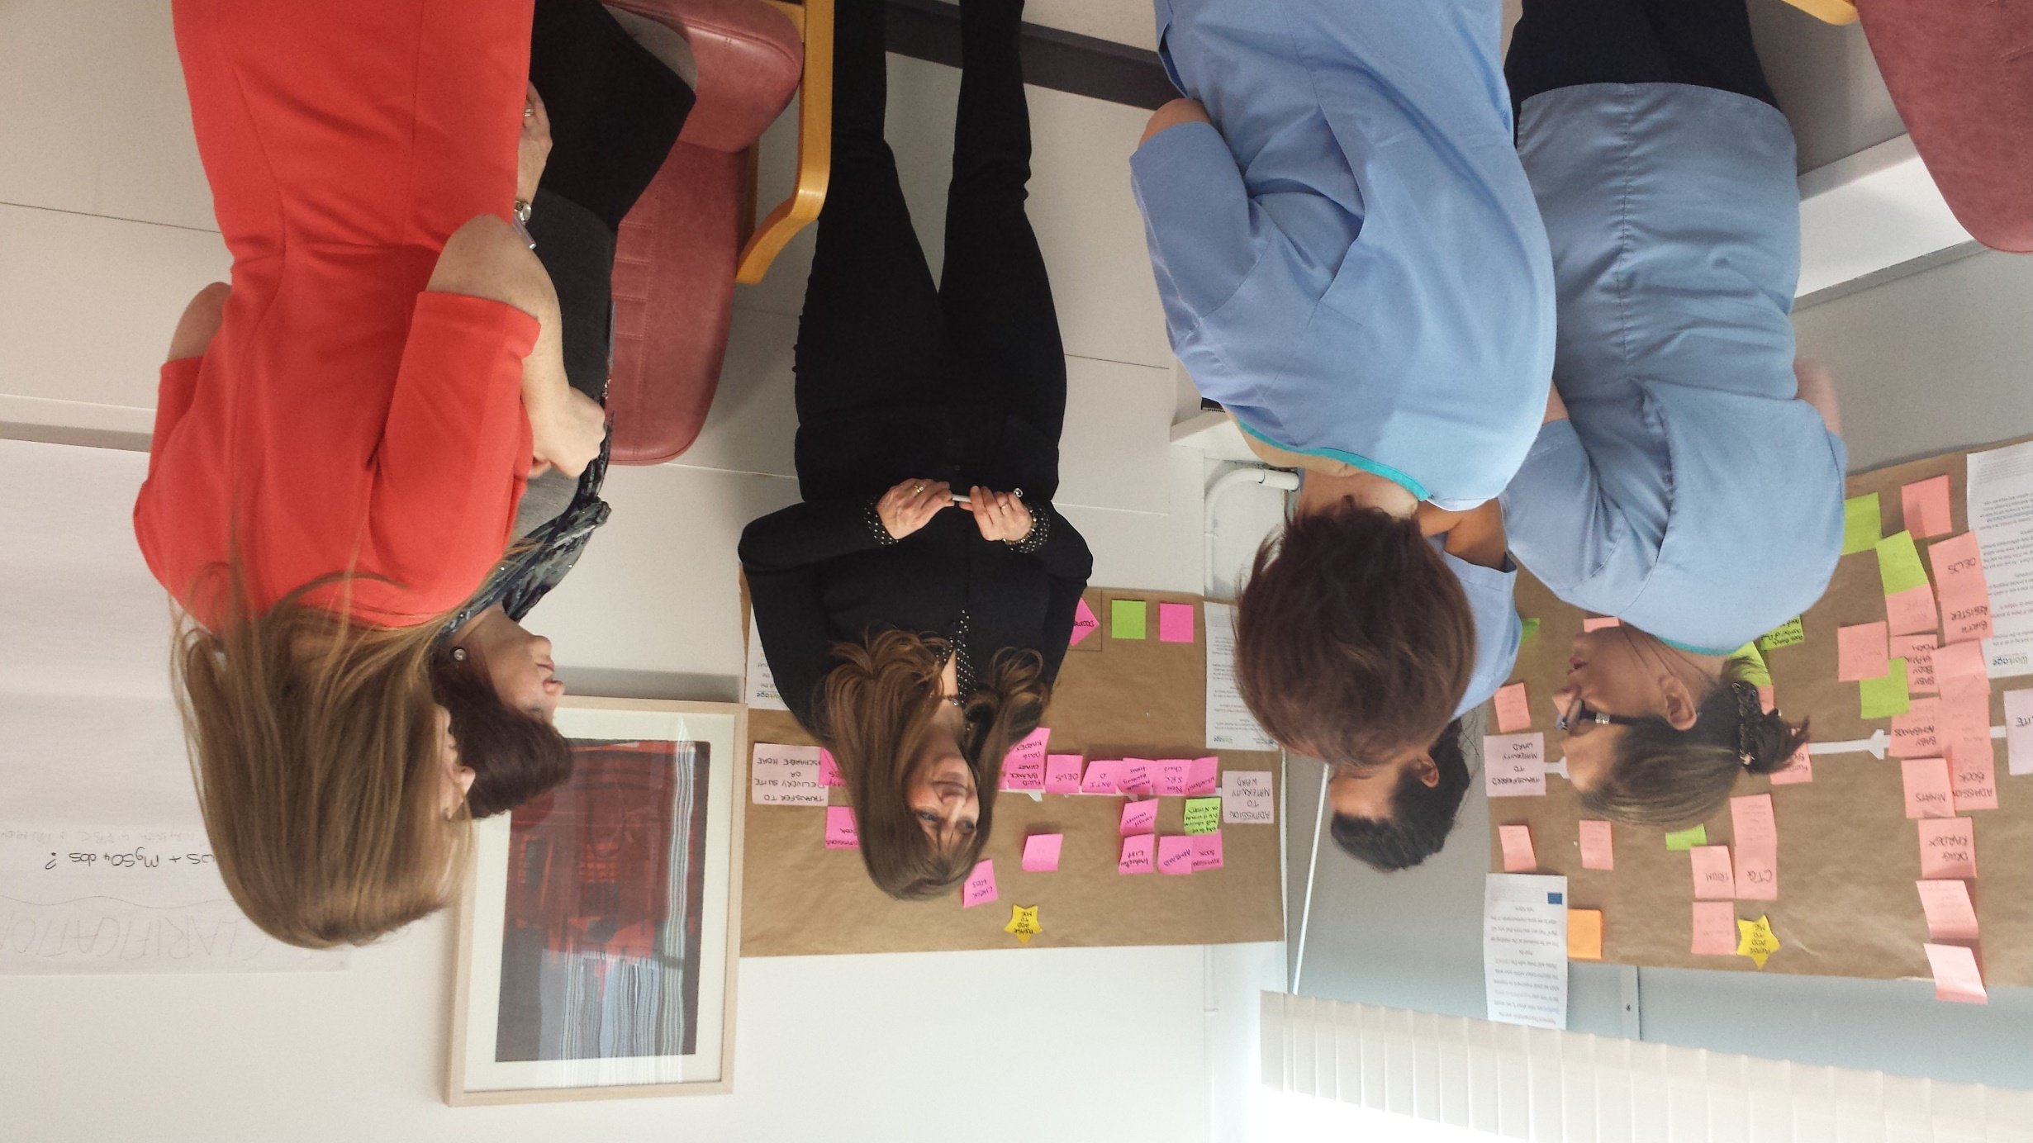
The intervention approach
Experience
Dialogue
Action

Slide 11
The intervention approach
Experience
Dialogue
Action
Feedback
Analysis
Refinement
Formative and summative evaluation

Slide 12
The intervention approach
Experience
Dialogue
Action

Slide 13
What staff experienced
Experience
Dialogue
Action
Patchy picture of interdisciplinary relations
Medical dominance = aversion to change
Inefficient processes – not reviewed collectively
Reluctance to challenge senior doctors & managers
Uneven leadership ability and skills in midwifery
Lack of team culture at the frontline
Senior management transactional and remote
Elephants in the room!

Slide 14
The intervention approach
Experience
Dialogue
Action

Slide 15
Priorities through dialogue
Experience
Dialogue
Action
Streamlining processes
Transparency and fairness
IMPROVING INTER-DISCIPLINARY WORKING

Slide 16
The intervention approach
Experience
Dialogue
Action

Slide 17

Making change happen
Overcoming denial
Building blocks
Leading effective midwife teams
MDT Task Groups

Slide 18
What does Multi Disciplinary Team Working looks like in a maternity unit?
Staff Voice: inclusive representation in strategic decision-making.
Embedded opportunities for shared learning, reflection & improvement.
Regular multidisciplinary meetings to discuss individual patients and for day-to-day planning and problem solving.
Coaching culture and co-operative working practices to support physical capability, skill mix and taking breaks.

Slide 19
What does Multi Disciplinary Team Working looks like in a maternity unit?
MULTI DISCIPLINARY TEAM WORKING
Staff Voice
Risk
Reporting
Feedback
Shared Learning, Reflection & Improvement
Quality improvement
Cost effectiveness
Staff engagement
Multi Disciplinary Meetings
Quality
Managing risk
Problem solving
Coaching Culture
& Co-operative Working Quality
Safety
Working life

Slide 20
What does Multi Disciplinary Team Working looks like in a maternity unit?
Staff Voice
Shared Learning, Reflection & Improvement
FEAR
MOBILISATION OF BIAS
DENIAL OF OPPORTUNITY
DISENGAGEMENT
Multi Disciplinary Meetings
Coaching Culture
& Co-operative Working

Slide 21
What does Multi Disciplinary Team Working looks like in a maternity unit?
MULTI DISCIPLINARY TEAM WORKING
Staff Voice
Risk
Reporting
Feedback
Shared Learning, Reflection & Improvement
Quality improvement
Cost effectiveness
Staff engagement
Multi Disciplinary Meetings
Quality
Managing risk
Problem solving
Coaching Culture
& Co-operative Working Quality
Safety
Working life

Slide 22
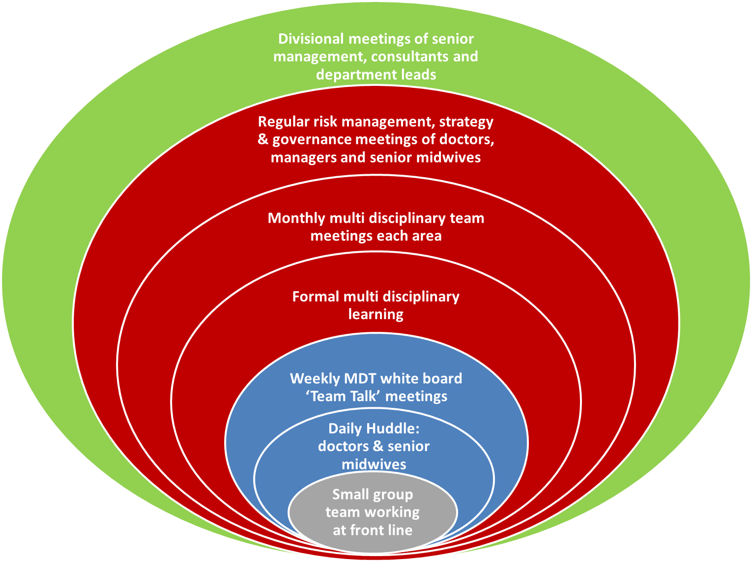

MULTI-DISCIPLINARY TEAMWORK PRINCIPLES IN PRACTICE

Slide 23
Challenges
Internal ownership of change
Engaging managers and doctors
Sustainability

Slide 24
rosemary.exton@ukwon.net
patricia.gillen@southerntrust.hscni.net
peter.totterdill@ukwon.net

