Slide 1

IWOT
A review to organize bottom-up organizational change in nursing homes
Anneke Offereins (PhD student)
Utrecht University of Applied Sciences
Notes:
Let me introduce myself: my name is Anneke Offereins, and I work at the Utrecht University of Applied Science.
I will introduce my paper that I’ve written about a literature review on empirical research about bottom-up organizational change in nursing homes.

Slide 2

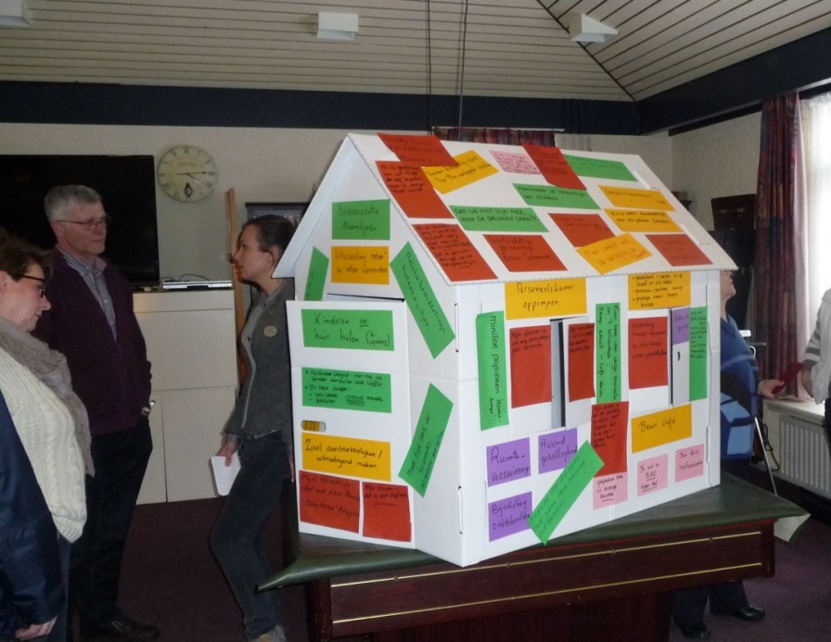
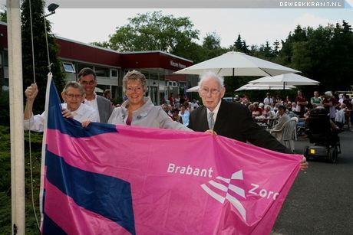
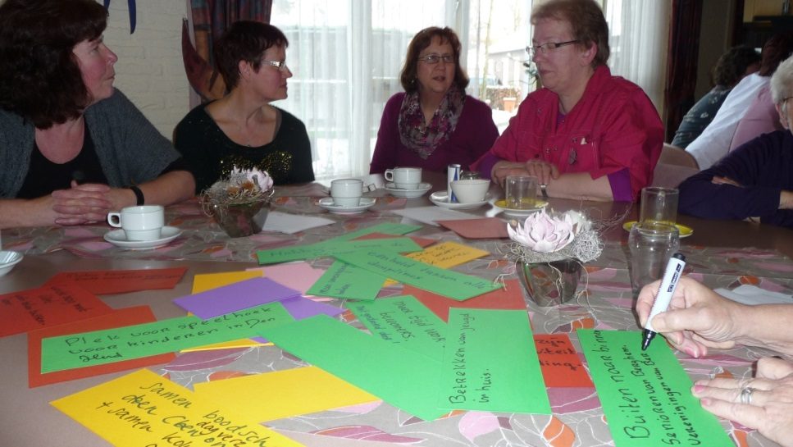

Slide 3
Definition of bottom-up change
The extent to which changes are either imposed by the top of the organization or made subject to discussion and approval by those at lower levels (Thompson & Sanders, 1997, p.138)
  The development of the organization’s human’s capability to implement strategy and to learn from actions taken and the effectiveness of changes made. Its focus is on the development of a high commitment culture. Change is emergent, less planned and programmatic (Theory O, as defined by Beer & Nohria, 2000, p. 3)

Slide 4
Research question
Streetlevel services centres around direct cliënt contact
Bottom-up change important means for transition
What interventions facilitate or hinder bottom-up organizational changes in nursing homes and what are enabling or hindering conditions?

Slide 5
Research method
Systematic literature review
Criteria:
    Empirical research related to nursing homes
    2004 – 2014
    English language
    Europe, USA, Canada, Australia
Search terms: ‘empowerment nursing homes’
280 hits
    10 relevant articles
    3 from previous research
Total: 13 relevant articles

Slide 6
Research model
Interventions
Bottom-up change
Quality of care
Quality of labour
Efficiency
Empowerment
Conditions

Slide 7
Definition empowerment
Empowerment can be divided into structural empowerment, which describes conditions in the working environment (e.g. shared decision-making and autonomy); and
psychological empowerment, which concerns individuals’ reactions to structural empowerment (Spreitzer, 2006).

Slide 8
What interventions are used for bottom-up change?
According to the articles frontline workers should be empowered by:
Intervening in the (organization of) work to create organizational conditions :
      Decentralized decision-making (e.g. introduction of self managing teams)
      Participation in change activities
      Breaking through routines
AND intervening by means of learning & development to create a learning culture:
      Participation families of residents
      Workplace learning

Slide 9
What are important conditions for bottom-up change?
HR climate:
  Staffing & turnover
  Leadership style
  Working pressure
Work characteristics
  Routines
Organization of work:
  Organization structure
  Goals & objectives
  Shared decision-making and participation
Learning climate:
  Shared values and inspiring goals
  Training, communication
Conditions that can both enable and hinder bottom-up change

Slide 10
What are important effects?
Positive relationship between empowerment and job satisfaction
  self esteem, more responsibilities, task division: individual preferences
Positive relationship empowerment and perceived quality of care by families of residents
Negative effect: too many meetings
Empowerment of residents and families

Slide 11
Conclusions
Empowerment seems a precondition to strengthen the change capacity of frontline workers
Combination of two factors:
    Organization of work: to become an effective team
    Developing professional and personal skills: decision-making, consultation, communication, reflection etc.
Only then frontline workers are able to initiate and realize change themselves

Slide 12
Findings related to the research model
Interventions
Bottom-up change
Change capacity
Frontline workers
Quality of care
Quality of labour
Efficiency
Empowerment
Conditions

Slide 13
Discussion
Any feedback is welcome
  Anneke.offereins@hu.nl
Thank you!

Slide 14
Extra slides

Slide 15
Overview articles

Slide 16
Enablers and barriers at team level
Factors at team level
Factor | Enabler | Barrier | Authors
Staffing | Stabile staffing of teams | High turnover High working pressure | Scalzi et al. 2006 Chuang et al.2011; Chaudhuri et al.2013; Parmelee et al.2009
Leadership | Manager who supports the team | Manager who: Refrains from providing feedback Does not provide sufficient information and communication Steers and controls | Chuang et al.2011; Koren, 2010; Chaudhuri, et al.2013; Scalzi et al.2006; Yeatts et al. 2004; Suominen et al.2008; Parmelee et al.2009 Kim et al.2014; Yeatts & Cready, 2007; Rahmann & Schnelle, 2008
Decision-making and participation | Shared decision-making and participation in the execution of decisions Clear goals | Exclusion from decision-making and communication | Chuang et al.2011; Chaudhuri et al.2013; Koren, 2010; Haggström et al.2009; Hamann, 2014; Yeatts & Cready, 2007
Teamwork |  | Lack of teamwork | Parmelee et al.2009
Routines |  | Daily routines | Chaudhuri et al.2013; Haggström et al.2009; Wadensten et al.2009
Training and education |  | Lack of training and education | Kim et al.2014
Respect of resident’s family and colleagues |  | Lack of respect from resident’s family and colleagues | Parmelee et al.2009

Slide 17
Enablers and barriers at organizational level
Factors at organizational level
Factor | Enabler | Barrier | Authors
Values and goals | Shared values and goals that inspire | Unclear or conflicting goals | Haggström et al. 2009; Scalzi et al. 2006
Organization structure | Organic organization structure: Decentralization of decision-making Limited formalization | Mechanistic organization structure: Centralization of decision-making Strong emphasis on procedures and compliance with rules | Kim et al. 2014
HR-activities | Support by HR activities: Training and education Communication Capacity | Lack of HR activities: Training and education Communication | Kim et al. 2014; Chuang et al. 2011
Resources | Sufficient financial resources and capacity | Limited financial resources | Chuang et al. 2011
Measuring methods |  | Lack of effective measuring instruments to improve the quality of care | Rahmann & Schnelle, 2008; Koren 2010

Slide 18
Change interventions
Factors |  | Authors
Enablers: | Interventions aimed at team organization and working methods
 | Introduction of self-managing teams | Yeatts et al. 2004
 | Decentralization of decision-making and increase of autonomy | Koren, 2010;
 | involving families with decision-making | Hamann, 2014
 | Breaking through routines | Wadensten et al. 2009; Haggström et al. 2009
 | Clear goals | Haggström et al. 2009
 | Rotating team coordinator | Yeatts et al. 2004
 | Participation by frontline workers | Scalzi et al. 2006
 | Participation by families of residents | Scalzi et al. 2006
 | Leadership style that stimulates innovative and problem-solving behavior | Koren, 2010; Scalzi et al. 2006
 | Investments in physical surroundings in order to prevent a clinical atmosphere | Koren, 2010
 | Interventions aimed at learning and development
 | Creating a learning culture | Chuang et al. 2011; Haggström et al. 2009
 | Workplace learning: observation of situations in practice, discussions, reflection and learning | Wadensten et al.2009; Rahmann & Schnelle, 2008
 | Developing listening skills and increase mutual understanding | Haggström et al. 2009
 | Monitoring of resident’s choices and determining how they can be stimulated to make their own choices | Rahmann & Schnelle, 2008
 | Training and education for frontline workers | Wadensten et al. 2009; Chuang et al. 2011; Kim et al 2014; Rahmann & Schnelle, 2008; Yeatt et al. 2004
 | Training and education for managers | Yeatts et al. 2004; Yeatts & Cready, 2007; Chuang et al. 2011; Wadensten et al. 2009; Suominen et al. 2009
Barriers: | Methods in which information is shared in a unidirectional way, or assignments that require frontline workers to write a lot | Wadensten et al. 2009
 | Facilitator who is too dominant or too absent | Yeatts et al. 2004
 | Exclusion of frontline workers from (culture) change activities | Scalzi et al. 2006
 | Change initiatives without training or a proper preparation. | Kim et al. 2014

