Slide 1
Designing Cooperative Organizations for a Sustainable Future – The PDW Approach
STS Roundtable Webinar Presentation
Peter Aughton, AMERIN MD
Thursday, 10 September
3:00pm-5:00pm Pacific Time /
Friday, 11 September
8:00am – 10:00am AEST

Slide 2
Organizations as open systems
Extended social field Environment
Highly uncertain environment: -
Discontinuous change
Industry 4.0
Climate change
COVID-19
Global recession
Geo-political tensions
Inequality
Discrimination
Other
Learn
In this environment organizations: -
Continuously adapt
Motivated employees
Customer centric
Learn and Innovate
Adopt leading-edge tech
Lean and Agile
Competitive
Productive
Requires System-wide Cooperation
Industry Environment
Organizations as an Open System
Plan
This presentation will outline why the DESIGN PRINCIPLE 2 organizational structure is a prerequisite for creating Cooperative Workplaces that continuously adapt and innovate

Slide 3
The STS RT webinar ‘Designing Cooperative Organizations for a Sustainable Future – the PDW Approach’
This aim of this webinar presentation is to introduce you to:
The organizational design principles
The Participative Design Workshop (PDW) – a participative STS method for changing organizational design principles
How the design principles affect intrinsic motivation, cooperation and productivity
Performance improvement examples from changing organizational design principles
Planning and preparation steps to change organizational design principles

Slide 4
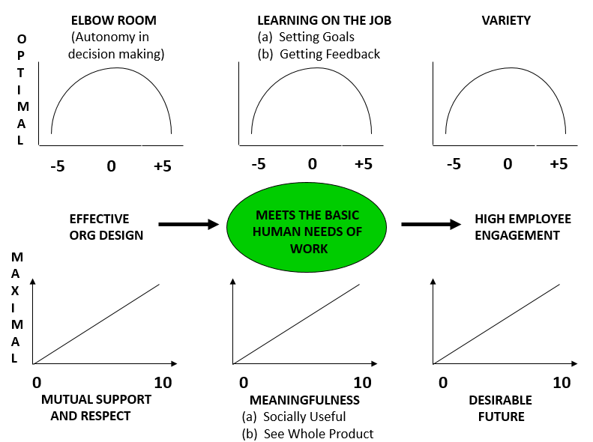
Intrinsic Motivators The 6 basic human needs of work

Slide 5
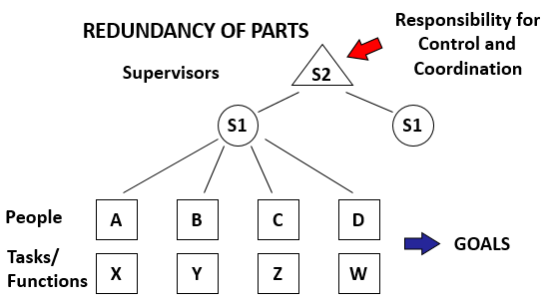
Design Principle 1 (DP1) The bureaucratic structure

Slide 6
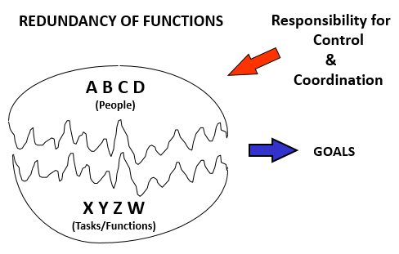
Design Principle 2 (DP2) The team-based structure

Slide 7
Participative Design Workshop (PDW) For organizational redesign
Analysis
Redesign
Practicalities
Briefing 1
DP1 & Consequences
Senior manager spells out strategic goals and challenges
Intrinsic motivators
Skills Matrix
High level process mapping
Briefing 2
DP2 & Consequences
Draw existing DP1 Structure (identify all employees using initials)
Redesign new DP2 Structure (best possible jobs for all)
Briefing 3
Team goals
Training Requirements
Career Paths
Employment T&Cs
Mechanisms of coordination
Other – make sure works
Improvement in Intrinsic Motivators

Slide 8
Organizational Redesign Examples
Manufacturing
Telecommunications
Disability care

Slide 9
Manufacturing Example
To compete with low-cost imports from China, Queensland-based manufacturer of detonators redesigned its organizational structure from DP1 to DP2.

Slide 10
Detonator Manufacturer Design Principle 1-Traditional Structure
Plant Manager
Silos
Admin Assistant
Quality Loss
Controller
Operations
Supervisor
Site
Engineer
Distribution
Supervisor
Leading Hands
(D/S, A/S, N/S)
Electrical
Engineer
QA Admin
Distribution
Operators
QA Tech
Day Shift
Operators
Maintenance
Engineer
Aft. Shift
Operators
Supply
Operator/RM
Fitters
Night Shift
Operators

Slide 11
Detonator Manufacturer Design Principle 2 –Team Structure
Planning horizon 1
Planning horizon 2
Management Team
Planning horizon 3
Plant priorities and
Goals
Maintenance
Team
Materials
Distribution
Team
G
G
Production Teams
Night
Day
Aft.
G
Peter Aughton AMERIN 2020
Production Teams

Slide 12
Telecommunications Example
Australian Telco established a virtual DP2 Managed Network Services company to dramatically improve customer experience.
Within 18 months MNS won the preferred supplier award by a global airline customer

Slide 13
Telco virtual transformation concept
Planning horizon 1
Planning horizon 2
Planning horizon 3
TELE
SERVICE
Strategy Team
Design Principle 1
Traditional Structure Silos
SALES
SDN
Operations Support Team
ISDN
WAN
Operations teams
Peter Aughton AMERIN 2020

Slide 14
Telco MNS Design Principle 2 - Customer Care Team Structure
Global Airline Management Team
(GMT)
Planning horizon 1
G
Planning horizon 2
Planning horizon 3
Teleservice
SDN
ISDN
GDN
WAN
Response Team
Internal Support
Team with Customer
GCSC
G
Co-located specialist skills
This structure was replicated for other major customers e.g. banking

Slide 15
Disability Care Provider Example
A national DCP’s silo-based culture was producing increased costs and low cooperation making it difficult to remain viable in a new customer centred funding model.
A HR / OD led transformation project changed the organizational structure from DP1 to DP2, eliminating duplication and unproductive supervisory roles.

Slide 16
Disability Care Design Principle 1- Traditional Structure
SL
S3
TAS
S3
VIC
S2
S2
S2
S2
S2
S2
S2
X 4
X 28
X 15
X 11
S1
X 40
S1
CP
CP
CP
CP
Accommodation, Day & Remote IS Carers
Remote IS Carers
Peter Aughton AMERIN 2020

Slide 17
Disability Care Design Principle 2- Integrated Team Structure
Planning horizon 1
SL
TAS & VIC
G
Planning horizon 2
Planning horizon 3
SS
CPs
CPs
CPs
CPs
CPs
G
G
G
G
G
G
Hobart & Melbourne Specialist Support
X 10
Melbourne North East Individual Support
X 15
Melbourne South West Individual Support
X 21
TAS NW Accom and Individual Support
X 14
Hobart Accom and Individual Support
X 22
Tasmanian Day program
X 26
Accommodation, Individual Support & Day Carers – remote and in-person staff

Slide 18
Disability Care National DP2 Structure High Level View of the Integrated DP2 Hierarchy of Function Structure
Panning horizons
Strategy and Future Direction Team
Planning Horizon 1
2-5 years
Planning & Resource Teams
Planning Horizon 2
12-18 months
Front Line Service Delivery
Teams
Front Line Delivery Support
Teams
Head Office Service Delivery Teams
Head Office Delivery Support Teams
Planning Horizon 3
Business as usual (BAU)
Customers

Slide 19
Planning & preparation steps for transitioning to DP2
Key players understand the design principles and their consequences for intrinsic motivation, mental health, innovation and productivity
Commitment from CEO, senior management and the board
Organizational health assessment
CEO communication to all employees – strategic goals and rationale for change
Establish an online employee communication channel
Involve and seek feedback from ecosystem members – customers, supply chain partners, unions, regulators, others
Establish and train a PDW transformation team

Slide 20
Planning & preparation steps for transitioning to DP2 (cont’d)
In the current environment, the transformation team will need to:
Design work for hybrid workers – remote and/or in-person
Suggest innovative opportunities to eliminate / mitigate errors identified during process mapping using smart technology
Know how to scale agile teams
Design a bottom-up PDW project plan for entire organization
Establish a T&Cs project group to:
Develop DP2 terms & conditions of employment
Use PDW data to establish a skills-based career path and remuneration program
Develop an employee redundancy policy
Seek support from your national workplace relations (IR) tribunal to help build cooperative and productive workplaces

Slide 21
Thankyou
For further information contact:
Peter Aughton
M: 61 3 (0) 409 415 956
E: peter.aughton@amerin.com.au

