Slide 1
Gamification of care teams: modifying a manufacturing game for use in a health care setting
Ezra Dessers, Sam Pless, Leen De Kort, Geert Van Hootegem

Slide 2
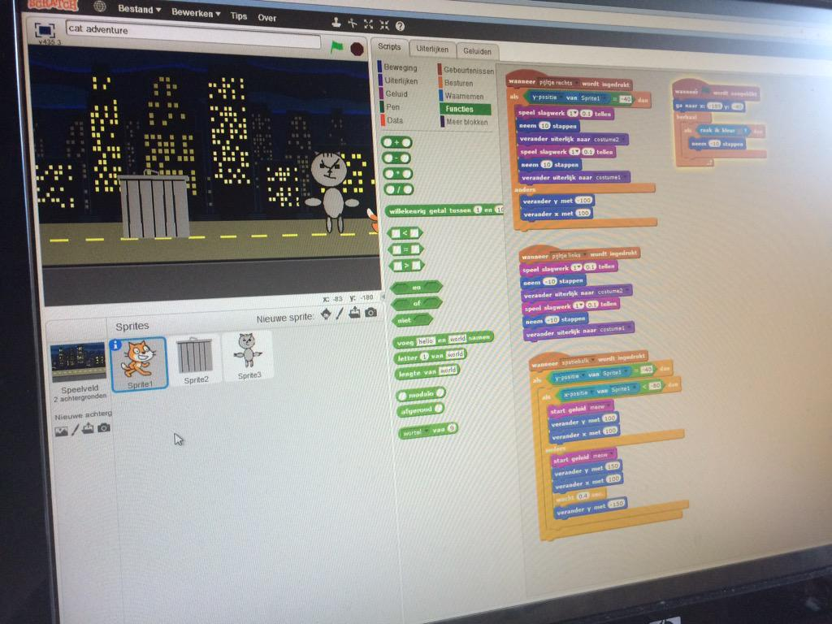
https://scratch.mit.edu/

Slide 3
Gamification of care teams: modifying a manufacturing game for use in a health care setting
Ezra Dessers, Sam Pless, Leen De Kort, Geert Van Hootegem

Slide 4
Acknowledgements This research is part of CORTEXS, a multidisciplinary research project studying integrated care in Flanders, Belgium (www.cortexs.be), and KIO, an interuniversity consortium studying innovations in elderly care in Flanders. CORTEXS and KIO are financed by the Flemish Agency for Innovation by Science and Technology (IWT).
The CORTEXS consortium consists of Geert Van Hootegem, Ezra Dessers & Sam Pless (Centre for Sociological Research - KU Leuven), Herman Nys & Ellen Vanermen (KU Leuven - Centre for Biomedical Ethics and Law), Koen Hermans & Anke Mutsaerts (KU Leuven - LUCAS - Centre for Care Research and Consultancy), Steven Dhondt, Denise van der Klauw & de Weerd Marjolein (TNO - Innovation Area Work & Employment), Johan Hellings, Dominique Vandijck & Sonja Vertriest (UHasselt - Research Group Patient Safety and Health Economics), Patrick Kenis, Bart Cambré & Steven Van den Oord (Antwerp Management School), Lieven Annemans & Nick verhaeghe (UGent - Health Economics Unit).
The KIO consortium consists of Mark Leys & Lien Pots (OPIH-VUB), Ellen Gorus & Charlotte Brys (GERO-VUB), Ezra Dessers, Geert Van Hootegem & Leen De Kort (CeSO-KU Leuven), Marc Jegers & Lukas Versteele (iCher), Patricia De Vriendt (GERO-VUB, Arteveldehogeschool) & Juul Lemey (Arteveldehogeschool), Bart Jansen (ETRO-VUB), Bart Mistiaen & Bart Grimonprez (HOWEST).

Slide 5
Why a game?
Gamification is the use of game thinking in non-game contexts. The resulting ‘serious games’ are simulations of real-world events. Although a serious game can be entertaining, its main purpose is to educate its players.
Other purposes:
Policy preparation
Decision making
Evaluation
Experimenting
Presenting results
Behavioral change (e.g. health: doing exercises)

Slide 6
Teamwork and workplace innovation
Educating people about these concepts and their application
Raising awareness about alternatives and their implications
Apart from books, classes, courses, lectures, …
Games let you experience what these concepts mean!

Slide 7
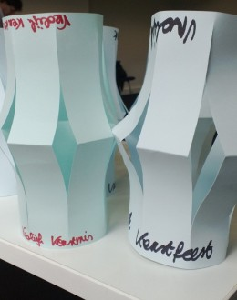
Paper Lantern Factory game
Production of lanterns
Measuring, folding, cutting, stapling and decorating
Two situations are played successively by the whole group:
Functional departments
All orders pass through all departments
Multifunctional teams
Each order is completed by one of the team
http://www.preparedmind.eu/blog/de-lampionnenfabriek-een-experiment-met-zelfsturende-teams/

Slide 8
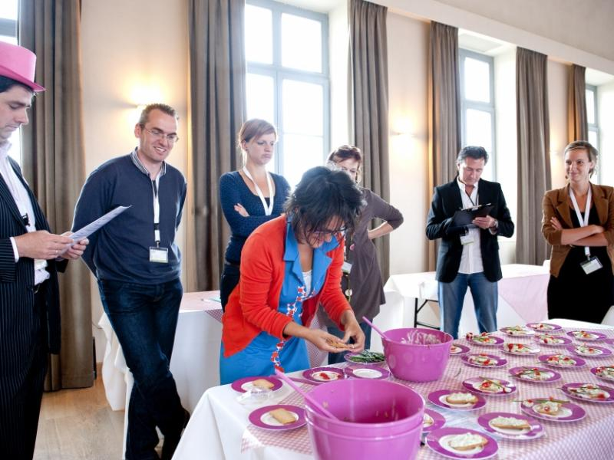
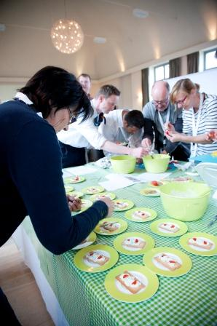
Tzatziki game
Participants are divided in four groups, who are differently organised to make tzatziki. The jobs in the four groups reprensent the 4 quadrants of the Job Demand / Control Model of Karasek.
http://www.flanderssynergy.be/projectwerking/zorgvernieuwers/tools/tzatziki

Slide 9
Challenge: develop a game for care professionals
Paper Lantern & Tzatziki
Well tested, consistent results
Played with students, academics, managers, employees from different levels and economic sectors…
Why a new game?
Paper Lantern & Tzatziki simulate manufacturing processes → can care professionals translate game experiences to their own field of work?
The versatility is limited because of duration (2+ hours)
→ We started developing concepts for game designs (see: abstract)

Slide 10
Game for Care Living Labs convention
Requirements
Care-related setting
Explain relevant concepts
Playable in 30 minutes max. (incl introduction and discussion)
For the Care Living Labs convention, preceding the Active Assisted Living Forum 2015 in Ghent, Belgium
http://www.aal-europe.eu/forum-2015/

Slide 11
“Care game” (working title…)
Participants (20 max) are divided into four groups.
Each group represents a residential care unit
Residents are represented by toy dolls
Task: get all residents properly dressed at the breakfast table in 6 minutes.

Slide 12
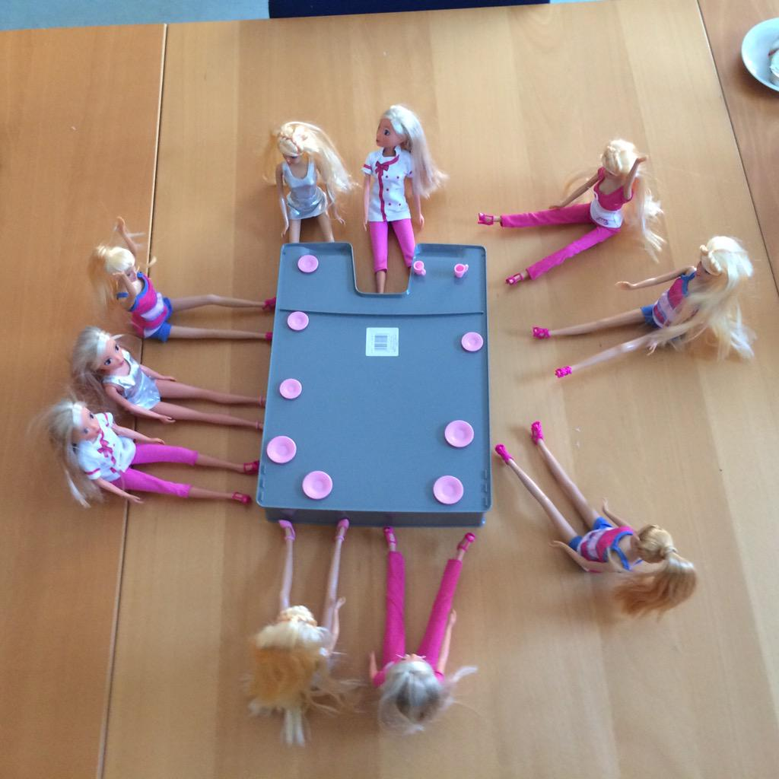

Slide 13
At each table, one of the job types identified by Karasek’s Job Demand / Control model is simulated
Learning possibilities Innovative behaviour
Low
Strain
Active
High
Job control
Low
Passive
High
strain
Risks for stress and physical illness
Low
High
Job demands
Notes:
Karasek’s model predicts that job quality results from the joint effects of workload (i.e. job demands) and autonomy (i.e. job control). Job quality depends on the balance between job demands (implying control needs) and control capacity.

Slide 15
Job Demands
Number of residents
Low: 2 residents per participant (total of 10 if 5 participants)
High: 5 residents per participant (total of 25 if 5 participants)

Slide 16
Job Control
Task division
Low: functional specialisation
Sorting, Trousers, Shirt, Shoes, Breakfast
High: multifunctional team
Each participants performs all the tasks per resident
They are allowed to help eachother
Clothing rules
Low: Choose from prescribed combinations
High: free combination of clothes
In case of missing clothes
Low: fill in a form
High: go get it yourself from the storage

Slide 17
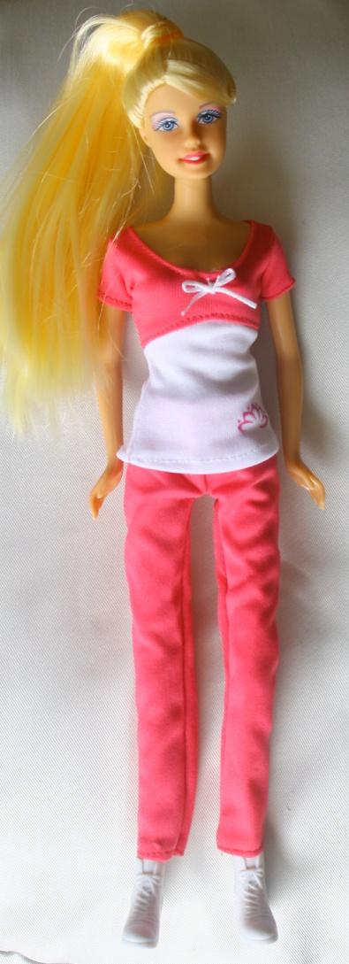
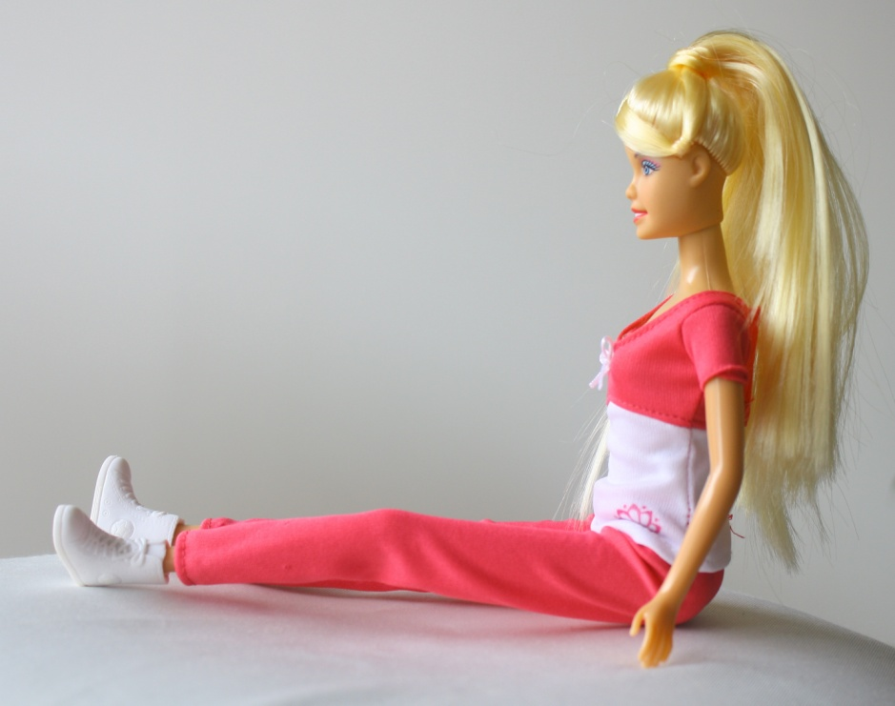
Pink pants, long
Pink and white shirt
White boots

Slide 18
Debriefing
Participants are asked after their experiences in terms of results, encountered problems, frustration, enjoyment, boredom etc.
By doing so, players reconstruct the model themselves which helps them to understand the underlying principles.
Notes:
Karasek’s Job Demand / Control model predicts the possible impact of job characteristics on job quality. People from practice, such as care professionals, tend to find this conceptual model rather abstract. Gamification may help to educate care professionals in the model by letting them experience jobs with differing characteristics in a game context.

Slide 19
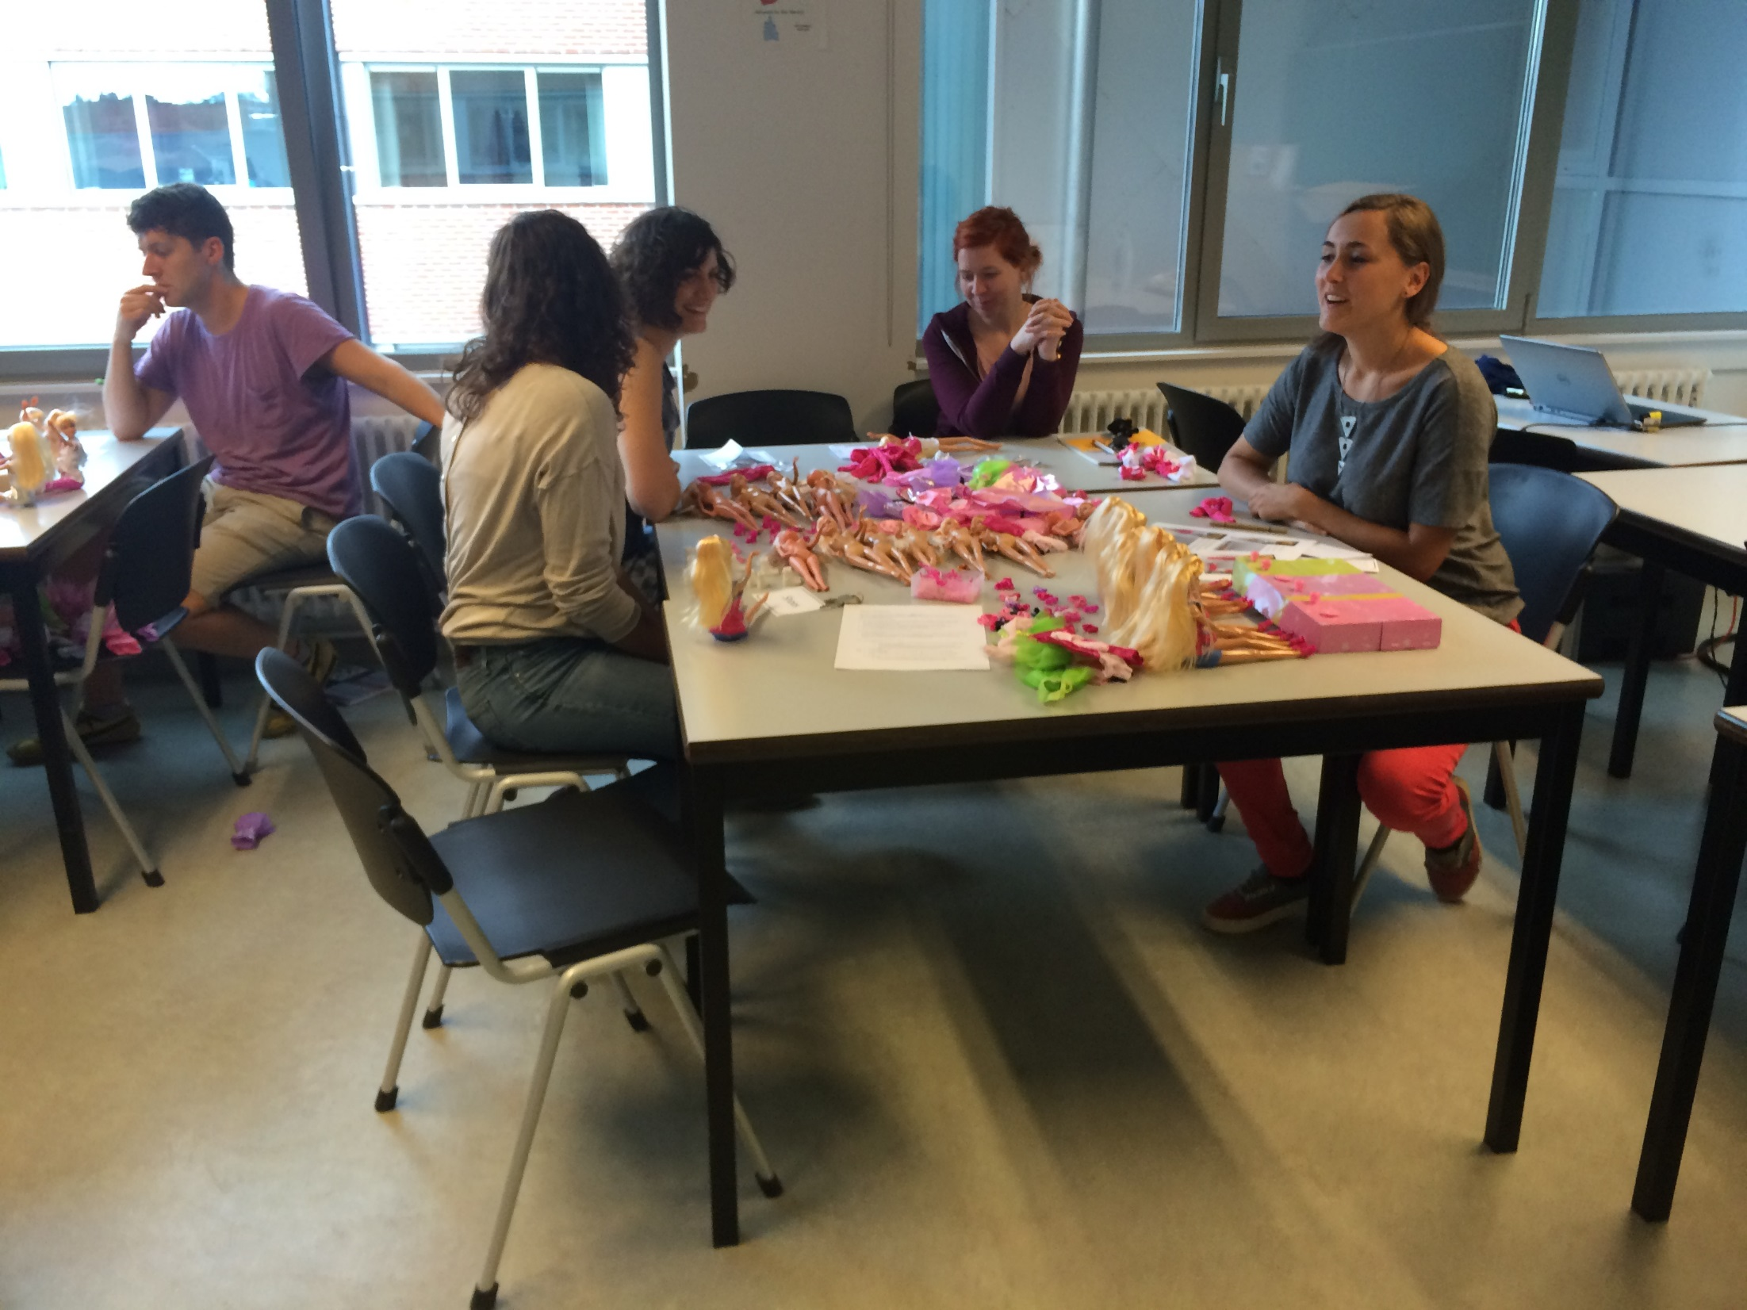

Slide 20
Conclusion
The game is appealing because of its simplicity
Offers starting points for further interventions in the organization of work.
The main purpose of the game is obviously not to simulate the average health care job as realistically as possible, but to let players experience differences between job characteristics in a setting that relates to their own field of work.
The game will be played during the Festival of Connecting on Wednesday afternoon
Notes:
The game will be played at the Active Assisted Living Forum (Ghent) and at the Festival of Connecting (Leuven) in September 2015.

