Slide 1
From a solo to an ensemble performance – the Family Medicine Clinic Collaboration experience
Yee Wei Lim
Saw Swee Hock School of Public Health
National University of Singapore

Slide 2
Today’s talk
Describe Singapore and its healthcare system
Explain the Family Medicine Clinic pilot
Describe the collaboration framework
Explain findings from our study
Share some observations and questions

Slide 3
Background: Singapore
Small island state of 5.5 million people
Healthcare financing and provision are hybrid in nature, involving public and private sectors and individual citizen’s contribution
Rapidly aging population and a large burden of chronic diseases

Slide 4
Singapore: a small country…..
Area: 707.1 sq km (6,489/km²)
Ethnically diverse:
Chinese: 75%
Malays: 14%
Indians: 9%
Others: 2%
Second most densely populated place in the world
Rapidly aging
High burden of chronic diseases

Slide 5
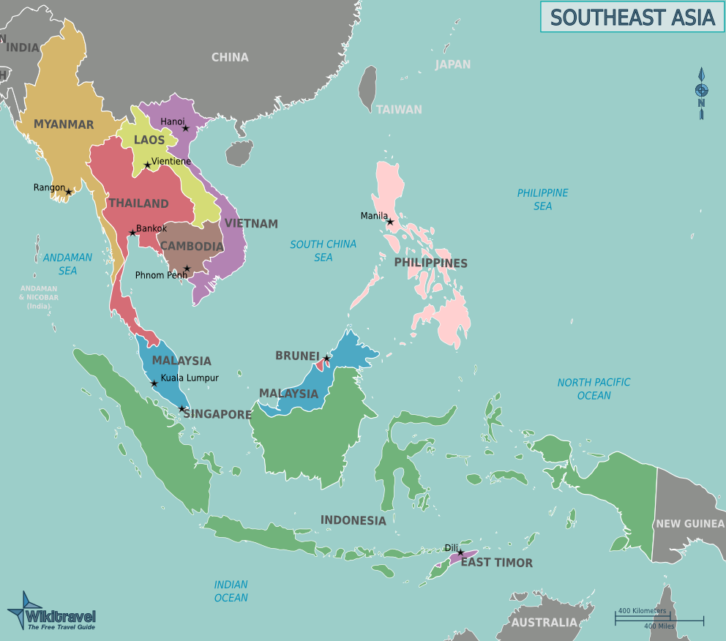

Slide 10
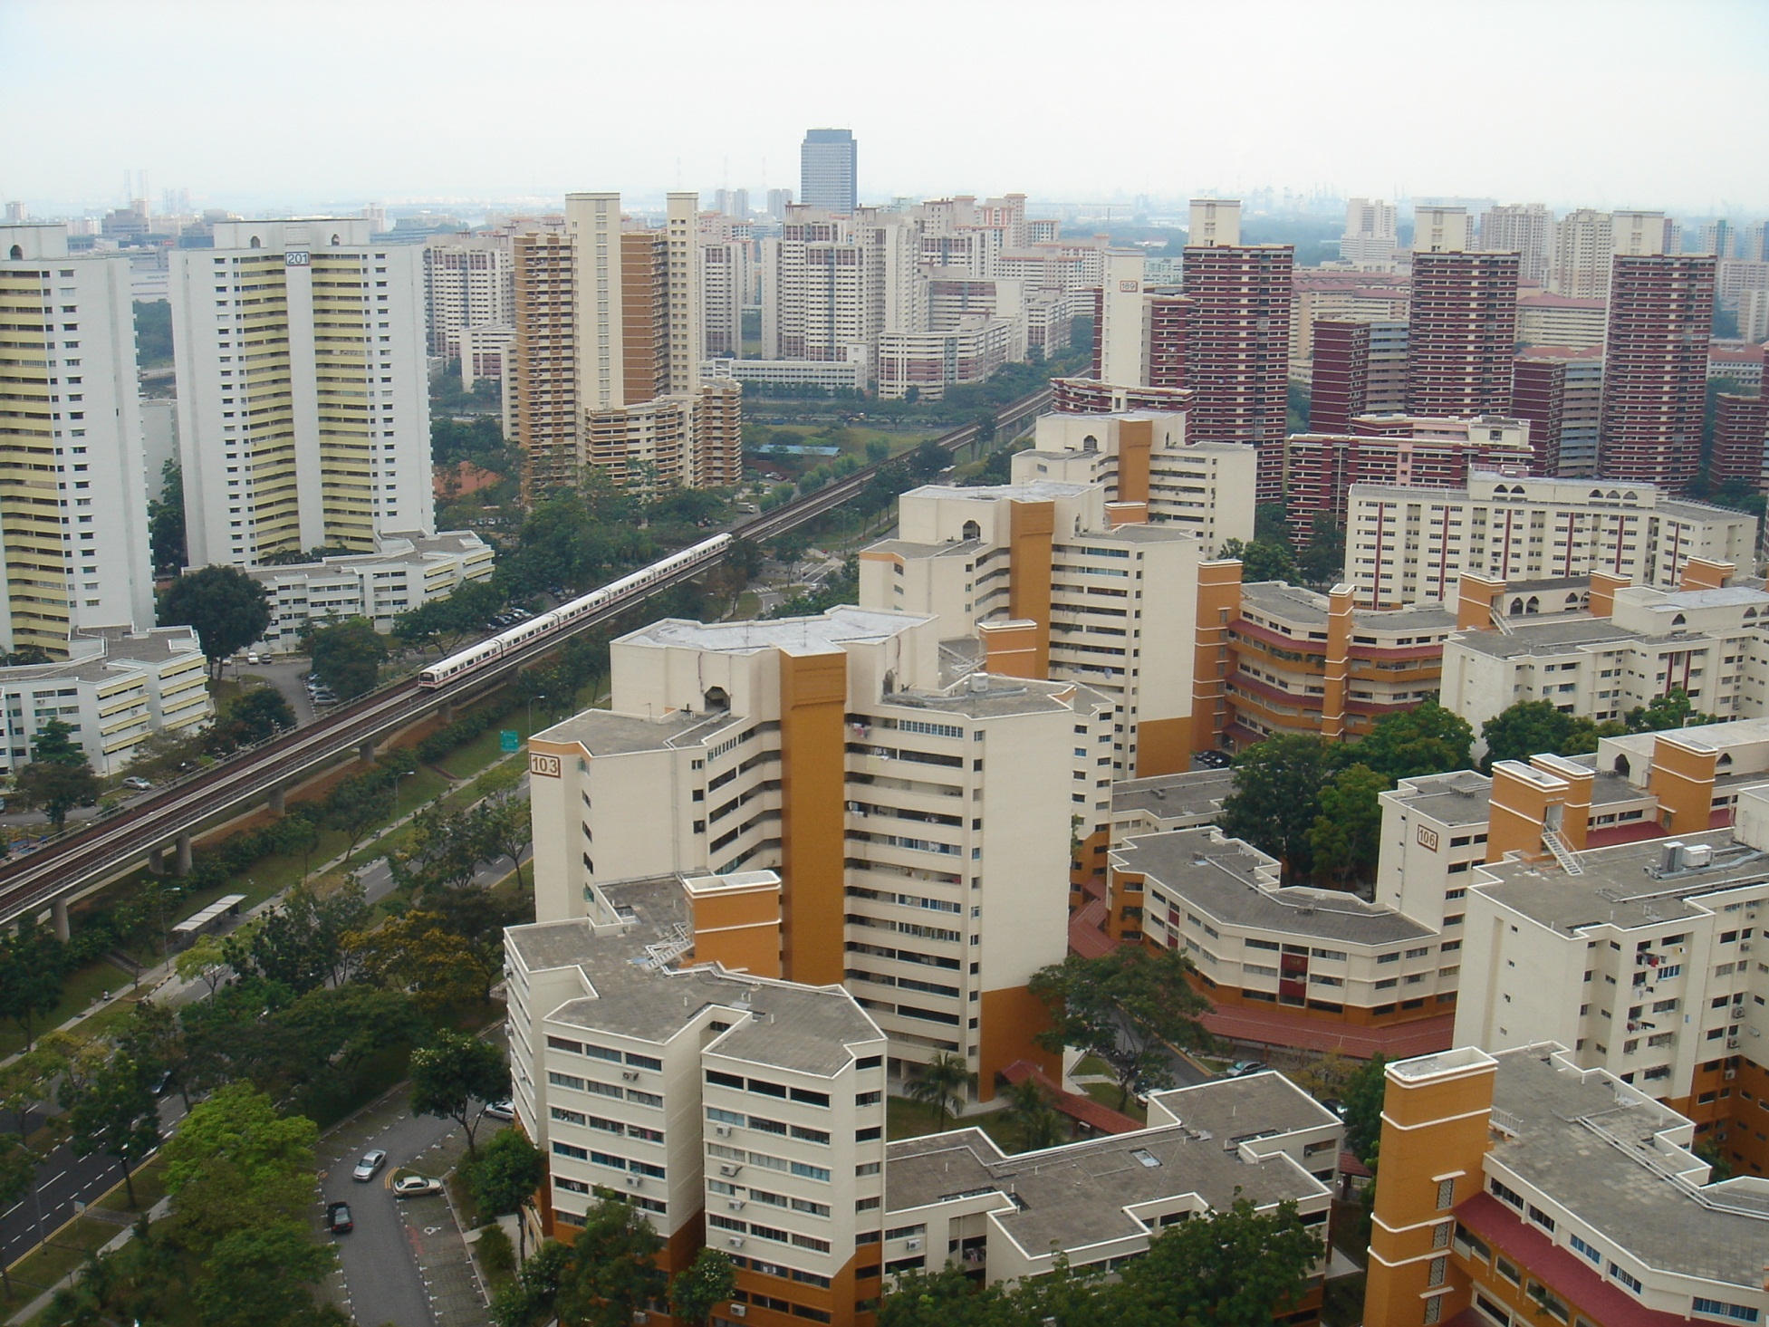

Slide 12
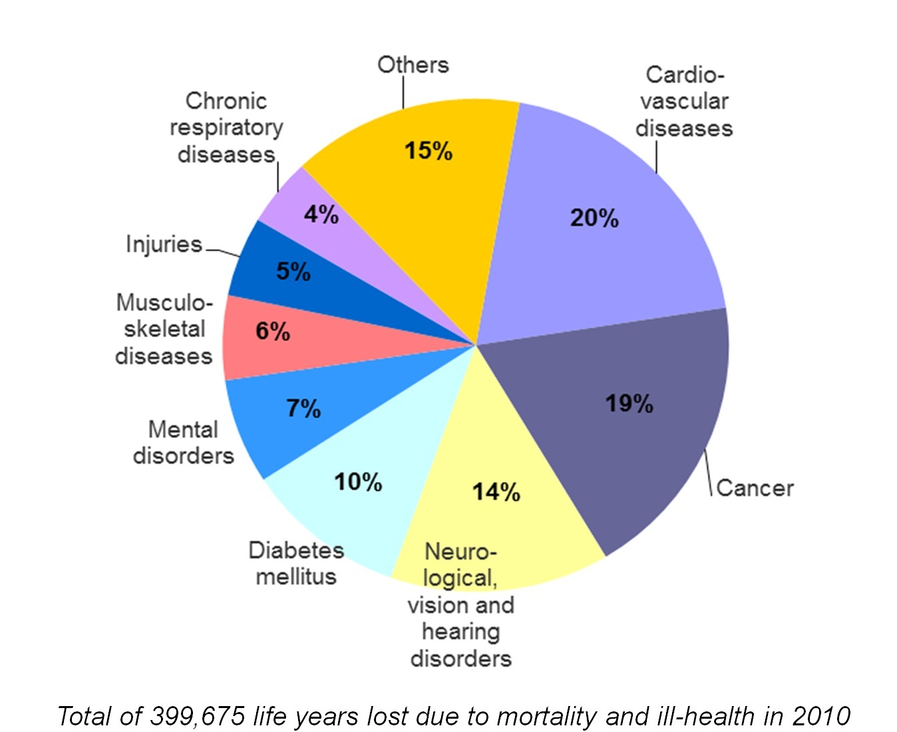
Chronic diseases: significant burden

Slide 14
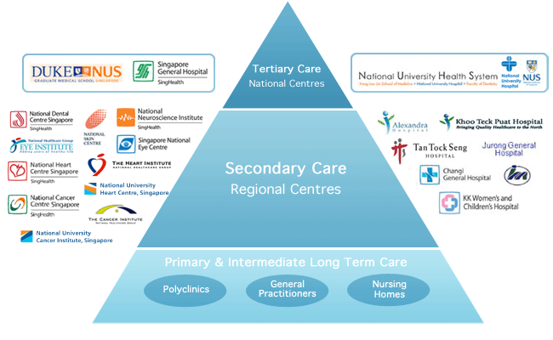
Healthcare is essentially public
14
Moving towards an integrated care system
20% of secondary and tertiary care provided by private sector
80% provided by the public sector in 14 hospitals and specialty centres
18 public polyclinics: 20% of population
GPs in approx. 2,000 private medical clinics: 80% of population
SOURCE: Ministry of Health Holdings, SIngapore

Slide 15
Moving forward: regional integrated health systems
In the face of the growing burden of diseases, an aging population, everyone sees a need to involve care beyond existing silos – i.e., hospital, primary care practice and long term care facility
Ministry of Health (MOH) sees the future moving to a more integrated healthcare system, to involve more providers and support groups
In 2011, announced the formation of Regional Health Systems (RHS)

Slide 16
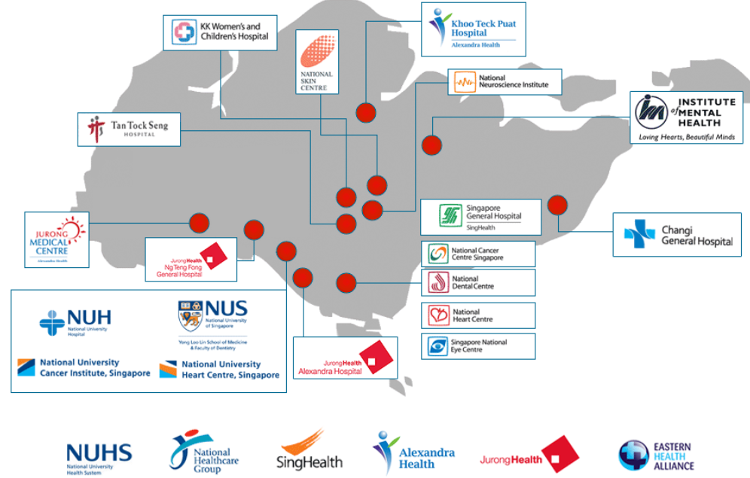
Six Regional Health Systems

Slide 17
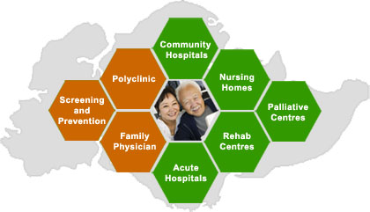
Components of an RHS

Slide 18
Now, to our story…
In 2012, for the first time in Singapore’s history, a large public hospital (National University Hospital or NUH) initiated a pilot with a small private primary care practice (Frontier Medical Group) to provide a new model of care where patients receive care that is more community-based, outside of the hospital
The pilot is the Family Medicine Clinic (FMC)

Slide 19
FMC’s objectives
First clinic outside of hospital to treat chronic diseases
To provide team-based care
Patients will be referred from NUH to FMC
Assigned a FMC-based primary care doctor
FMC is part of the larger RHS to provide integrated care
Sources: Straits Times news report, May 6 2013; MOH website on FMC; NUH media release, 2013

Slide 20
Key research questions
Using FMC as the platform, how are the two institutions working together (i.e., NUH and Frontier Medical Group)?
Can we see an emergent form of collaboration? A team?
Was team-based care provided to patients?

Slide 21
How to think about working together?
Working together can manifest on a spectrum of relationships, from a loose exchange between entities, to one that is closely-knit
Different levels of “working together” could exist together at the same time
See diagram on next slide

Slide 22
Levels of working together
collaborating
cooperating
Networking and coordinating
Do we see a workgroup or a team working together?
Is there a common understanding of goals and outcomes?
Additional sub-question: is there interprofessional collaboration

Slide 23
Some definitions
NETWORKING:
Exchanging information
requires low initial level of trust,
limited time availability
no sharing of turf
COORDINATING:
Exchanging information
altering program activities for mutual benefit
requires more organizational involvement
higher level of trust
some access to one’s turf

Slide 24
Some definitions (2)
COOPERATING:
Exchanging information
Altering activities
sharing resources
increased organizational commitment
requires substantial time commitment
high level of trust and significant sharing of turf

Slide 25
Some definitions (3)
COLLABORATING:
Exchanging information
altering activities
sharing resources
increased organizational commitment
Requires a substantial time commitment
high level of trust, and sharing turf
enhancing each other’s capacity
sharing risks, responsibilities and rewards

Slide 26
The study and findings

Slide 27
The study
Mixed method study of the FMC Pilot, 2013-2015
Data collected:
Organizational survey of staff, providers and leaders
In-depth interview of healthcare providers, administrator, senior leaders from NUH and Frontier
Patient survey
In-depth interview of patients with complex care needs

Slide 28
What do we see in the FMC pilot? Networking?
FMC
Secondment of NUH pharmacist, nurses and case managers
Provide access to NUH patient’s medical records system
NUH
Sharing human and infrastructural resources

Slide 29
Networking? (2)
Another example: medication and clinic items from NUH
NUH
FMC is considered one ‘section’ of NUH
Revenues from sales of medications & clinic items go to NUH
FMC
Ordering medications from NUH
Ordering clinic items from NUH
Yes, there is evidence of networking

Slide 30
Do we see coordination?
Example: “shared care” for stable patients
NUH specialists
Altered workflow and extra effort to refer patients
Shared EMR for information exchange
FMC physicians
Altered workflow: learn a new IT system so as to access NUH EMR
Use NUH medications
Care Coordinators
A team specially set up to coordinate patient movement between NUH and FMC
Yes, but not uniform. No care coordination of patients at the nurse or case manager level

Slide 31
Do we see cooperation/collaboration?
Example: “shared care” for complex patients
NUH specialists
Enhancing FMC physicians’ capacity by going to FMC to discuss complex patients
Shared EMR for information exchange
FMC Physicians
Initiate communication with specialists to gather info about patients
Coordinate patient care from several specialists
Attend specialist’s sessions to learn about disease management. E.g. liver cirrhosis
Maybe. Only among physicians. Non-physicians - no shared care of patients
Case Manager
NUH nurse working in FMC to identify and manage complex patients

Slide 32
Do we see cooperation/collaboration? (2)
Is there shared goals?
NUH and FMC staff do not have similar understanding of the goals of FMC:
NUH considers FMC as mean to reduce patient load at SOC and reducing hospital admissions
FMC considers the pilot as developing a new model of primary care
No strong evidence

Slide 33
Do we see cooperation/collaboration? (3)
Is there shared risks, responsibilities and rewards?
Risk: probably yes. If outcomes unsatisfactory to funder, FMC pilot will be ended
Responsibilities: not clear. After patients referred to FMC, NUH providers don’t have much continued co-management of patients with FMC providers
Rewards: maybe
Mixed evidence?

Slide 34
Do we see cooperation/collaboration? (4)
Is there shared capacity building?
Capacity building mostly one-directional:
FMC physicians learn about care at NUH, but NUH specialists don’t receive training on FMC-related care
FMC case manager rotate to chronic disease management programs in NUH
Individual effort to upgrade skills
No structured planned staff training before start of FMC pilot
No strong evidence

Slide 35
Collaboration within FMC?
Daily interactions
Constantly changing & evolving
Cross covering
Yes, there is some evidence
Shared targets: to develop FMC into new model of primary care
Family physicians
Case manager
Shared responsibilities: management & retention of patients
Care coordinator
Nurses
Shared risks: FMC pilot may be terminated if targets are not met
Clinic receptionists
Pharmacist
Shared rewards: pilot to be continued or scaled up if targets are met
Pharmacy technicians

Slide 36
Evidence of team-based care?
Within FMC:
Yes, there is some evidence members are working together as a team although patients only have contact with physicians
Big burden on case manager in reducing hospital readmission rate.
Increase pressure on pharmacist to perform new clinical services e.g. warfarin clinic, medication reconciliation.
Nurses have limited time to deliver patient counseling
Yes, there is some evidence physicians delegating tasks but patients don’t perceive team-care

Slide 37
Evidence of team-based care? (2)
Between NUH and FMC:
Only seen in a few specific physician-to-physician relationships
Lack of shared care between allied health providers between NUH and FMC
No planned development of a model of team-based care
Some evidence

Slide 38
Summary: NUH-FMC relationship
FMC as a platform for working together is lopsided – with NUH sharing much human and physical resources
A common IT system helped information sharing but is imperfect
There is some evidence of coordination
Less evidence of collaboration
Within FMC, staff worked as a team,
NUH-FMC little or no team-work
No clear evidence that team-based care was provided

Slide 39
Questions to consider
In a hospital-primary care practice like FMC, do we need to strive for collaboration? Is networking enough?
Is team-based care needed? Or simply coordinated care?
What needs to be done differently to develop team-based care?
What other lenses could we use to examine FMC as a form of working together?

Slide 40
Acknowledgement
Co-Investigators:
Prof Audrey Chia
Dr Zoe Lim
Research Associates:
Ms Farhana Hossain
Mr Tayef Quader

Slide 41
Thank you!

