Slide 1
How Cross-Functional Teams Improve Operating Room Performance
Justin Bitter, Caro van Haren, Pierre van Amelsvoort, Kristina Lauche
The 19th International Workshop on Teamworking (IWOT 19) in Leuven, 7-8 Sept. 2015

Slide 2
Introduction
Justin Bitter MSc.
Manager Operating Rooms, Bernhoven Hospital
PhD. candidate Radboud University Nijmegen, Netherlands, since January, 2012
Promoters: K. Lauche, P. Van Amelsvoort, H. Gooszen
Dissertation topic:
Managing and Reducing Uncertainty in the Operating Room Assessing collaboration between Professionals and its association with Operating Room Performance

Slide 3
Content
Purpose
Design/methodology/approach
Findings
Research limitations/Research implications
Practical implications
Originality/value

Slide 4
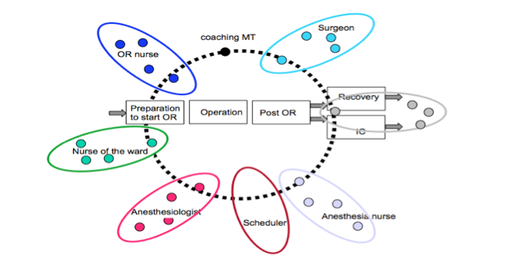
Purpose
Relational Coordination
Cross-Functional Team
Operating Room Performance
To show how implementing cross-functional teams improves coordination in the preoperative phase of operating room scheduling, which contributes to improving both efficiency and performance
Design based on socio-technical systems theory

Slide 5
Research Questions
RQ1. How do cross-functional teams in the pre-operative phase of operating room scheduling affect operating room performance compared to a control group?
RQ2. Which factors contribute to multidisciplinary teamwork in the pre-operative phase of operating room scheduling?

Slide 6
Design/methodology/approach
A longitudinal study conducted as a field experiment comparing a cross-functional team against a control group at the operating room department in a general hospital in the Netherlands.
Pre- and post-measures as well as qualitative methods were used to determine which factors contribute to an increased operating room performance

Slide 7
Design/methodology/approach
2x2 design to evaluate the impact of cross-functional team on operating room performance compared to a control group
dataset consisted of the years 2013 and 2014:
Bernhoven Hospital 3,006 operating room days with 25,590 surgical cases performed
Control Group 2,424 operating room days with 15,422 surgical cases performed

Slide 8
Design/methodology/approach
The performance indicator ‘raw utilization’ (%) was defined as the total time patients are present in the OR divided by the total amount of allocated operating room time per day, in a given block time (i.e. 8:00h until 17:00h) x 100%. This excluded turnover time and over-utilized operating room time.
An operating room day was defined as a combination of one operating room and one date on which at least one surgical case was performed

Slide 9
Design/methodology/approach
In addition, qualitative research was used to open the black box of coordination, and understand how introducing cross-functional teams affected the work processes and practices in the pre-operative planning
Triangulation:
The second author observed 14 one-hour meetings of a cross-functional
team as a non-participant observer.
One of the meetings was videotaped to enable the rest of the research team
to jointly develop a scheme for analyzing the collaboration
Ten in-depth, semi-structured interviews were conducted with the members
of the cross-functional team

Slide 10
Design/methodology/approach

Slide 11
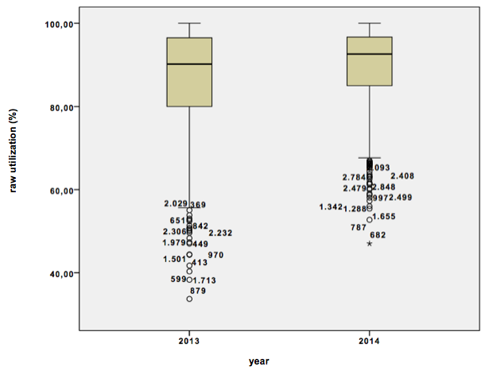
Findings Quantitative Research
Effect of the introduction of Cross-Functional Teams on Operating Room Performance in Bernhoven hospital expressed in box-and-whisker plots (SPSS 22) of raw utilization (%) per year

Slide 12
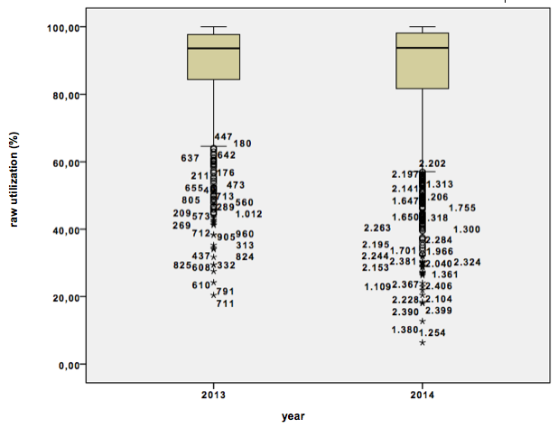
Findings Quantitative Research
Operating Room Performance of the control group without intervention during this period expressed in box-and-whisker plots (SPSS 22) of raw utilization (%) per year.

Slide 13
Findings Qualitative Research
Mutual relations and coordination (behavior) can mainly mean increasing organizational performance.
Due to the multidisciplinary approach and abandoning the bureaucratic silo structure, the cross-functional team was able to handle variety and interferences in the preoperative phase of OR scheduling

Slide 14
Research limitations/Research implications
Differences in organizational characteristics were excluded. For example case duration, casemix, and planning accuracy are topics for further exploration
Due to a decrease of the IQR in 2014 for Bernhoven hospital, it is not yet clear or a learning effect occurred. Because of the focus on optimizing operating room schedules, the team members were obvious paying attention to it.
It is not obvious whether cross-functional team leads to better quality outcomes, and a higher degree of patient safety because this was not measured in this current study. This could be a topic for further research.

Slide 15
Practical implications
Effect on operating room performance after implementation cross-functional team (organizational learning, feedback, single- and double loop learning)
Effect on group dynamics within a cross-functional team (cohesion, openness, mutual respect, shared goals)
Effects on uncertainty and interferences after implementation
The importancy of coordination (negotiation) in cross-functional teams

Slide 16
Originality/value
Implementing a cross-functional team can be an important step in the additional checks that occur in the perioperative chain of a patient until now (as prescribed by the Dutch Health Inspectorate)
Although there are several views (i.e. mathematical predictions, logaritms) on operating room performance, a holistic view through the lense of socio-technical systems theory was not used before to investigate operating room performance in the preoperative phase of operating room scheduling.

Slide 17
The 19th International Workshop on Teamworking (IWOT 19) in Leuven, 7-8 Sept. 2015

