Slide 1
STS Roundtable Conference – 2017
Creating Integrated Care for residents of Los Angeles County
Co-Generated Change
Eco-system Phase of Labor-Management partnership
September 14, 2017
Peter Lazes, Murphy Institute for Worker Education and Labor Studies, CUNY

Slide 2
Our Healthcare Crisis and
Situation of Unions
Healthcare Issues
- U.S. citizens pays 53% more for healthcare
- Over 11.9 % of American’s without health
insurance (1st Qtr. 2017)
- Bottom quartile in terms of quality of care
- 1.5% quality improvement over a 7 year period
Union Density Crisis
- 1950’s 35%
- 1980’s 20%
- 2017 > 10%
Notes:
Some significant facts that I am sure have been shared with you during this class… I just want to highlight issues of although we pay more for healthcare compared to other industrial countries…that we have more quality of care…and don’t provide services for 50 million Americans.
We do provide the right care… in terms of sophisticated care.

Slide 3
Our Values (Value Frame)
Patients are not getting access to quality care—what they deserve
Healthcare as a right, not a privilege
Supporting the public (“safety net”) health system
Helping to create Patient-Centered Care
Creating positive and sustainable returns to society
Notes:
A high functioning healthcare system is needed in our country.
Healthcare is a right, not a privilege and are committed to supporting the public (“safety net”) health system
Creative and committed union and management leaders are needed to achieve this goal.
Health systems that promote patient-centered care and fairness & dignity for healthcare professionals and patients generate positive and sustainable returns to civil society.

Slide 4
Eco-system definition
As system, or group of interconnected elements, formed by the intersection of community of organisms with their environment….any system or network of interconnecting and interfacing parts, as in a business.

Slide 5
Co-generated activities occurs when insiders and outsiders participate in as equal partners in decision-making activities. Participation must be full participation or a form of “codetermination” if it is to be empowering.
Max Elden- in Cogenerative Learning

Slide 6
“ Leading organizations can not be left solely to management.”
Des Geraghty
General Secretary
SIPTU

Slide 7
Strategic Alliance
A Labor Management agreement to work together in defined areas of shared interest, while understanding that each organization will at times work independently in other areas.

Slide 8
Evolution of Worker
Engagement
Unit- Based Teams (self-mgt)
Departmental Teams
Delivery system
& Union Building
Eco-system work

Slide 9
Phases of Labor-Management Transformation Process in LA
Phase I: 2000 - 2002 Established problem solving team- response to re-engineer
Phase II: 2009 - 2010 LAC-USC Environmental Service initiatives
Phase III: 2012 - 2015 Care Improvement Teams and PCMH development
Phase IV: 2015 - present Eco-system development

Slide 10
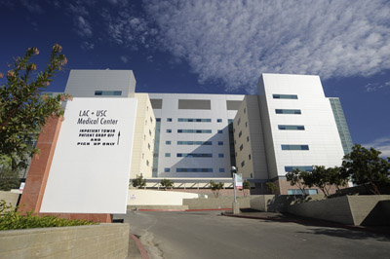
LA-DHS
Los Angeles Department of Health Services
2nd largest public health system
4 hospitals, 19 health centers, 1 rehabilitation facility, community-based clinics
1,671 beds
22,000 employees
Budget: $ 4.3 billion
Delivery system transformation, improving patient experience
Unions:
  AFSCME
  Committee for Interns and Residents (CIR)
  SEIU Local 721
  UAPD

Slide 11
Phase I:
Labor- Management Partnership Work in response to Re-Engineering
Labor-Management Committee in all 4 hospital to keep track of re- engineering project
Trained union and management leaders to guide the process
No loss of employment if a job was eliminated
Established a county workforce development institute (still exists) to provide training for all displaced workers

Slide 12
Phase II:
Environmental Services – Labor-Management Partnership Work
Created a common vision
Trained union and management leaders to guide the process
Established Action Teams in key areas of the hospital
Negotiated time off for teams to analyze, solve and implement changes
Staying within current jobs and responsibilities

Slide 13
Results
50% increase in patient satisfaction scores
Press Ganey scores from 46 to over 7 0 (increased cleanliness of rooms)
Purchasing of new equipment and supplies by workers
Shift to shift communications improved
Moved from ED to in-patient floors
Reduced absenteeism

Slide 14
Phase III: A New Journey
Retreat with key leaders
  Created a social contract-
    Principles of engagement
    Mission, responsibility of LMTC, groundrules for council and for engagement of frontline staff
    Structure: Care Improvement teams (modeled after Kaiser) –
    Budget and resources
Trained internal consultants ( Healthcare Transformation Advocates
Focus– access to care, improved coordination of services within DHS, and workforce retraining (including customer services)
Use of best practices– Patient-Centered Medical Homes ( PCMHs)

Slide 15
LA-DHS/SEIU Partnership Process
Labor-Management
Transformation Council
Patient Experience Workgroup
LMTC Operations Group
CIT
Workgroup
Quality & Safety Workgroup
LMC
Workgroup

Slide 16
We need to bargain and operate outside the NLRA box and Re-Engineer our union
Quality standards
Overtime
Budgets
Marketing
Wages
Seniority
Differentials
Service
Grievances
Business strategy

Slide 17
Levels of Involvement and Decision Making Between Labor and Management Strategic Partners
1
2
3
4
5
INFORMED
CONSULTED
On-going Communication about key activities
DEVELOPERS
INPUT IN DECISION-MAKING
Opportunity to influence through giving feedback on what is already designed.
FULL PARTNERS IN DECISIONS
Participate in developing solutions, changes, and proposals.
Opportunity to influence final decisions; participate in monitoring and taking corrective action.
Full partners in reaching final decisions, formulating plans, monitoring, and taking corrective action.

Slide 18

Best Sector Strategies

Slide 19
Creating a Patient-Centered Medical Home
Integrated Care
Coordinated Care:
Patient centered care involving collaboration among primary care physician, nurses, patient, family and community
Health Coach, Nurse Navigator:
Staff use of electronic portals and tracking tools to monitor progress of patients, especially those with chronic conditions
Feedback to Physicians and Healthcare Team
Measure clinical or service performance by physician/practice
Information Technology:
Electronic Medical Records/History, E-Prescriptions, Interactive Patient Web Portal
Tracking Outcome Tools:
Use data to identify issues of critical care
Reimbursement Reform:
Restructuring of the current system used to compensate physicians based on “fee for service” to one that is bundled/pre-paid, and quality outcome linked
Notes:
[Mention slide.]

Slide 20
From Fragmented to
Integrated Care Delivery Systems
Integrated Care
Fragmented Care
No care coordination among physician, staff, family and community
System reacts to needs
Fee for service reimbursement
Limited tools/processes for preventive care or patient progress
Patient centered coordinated care involving all parties in patients healthcare
Needs are anticipated
Bundled reimbursement centered on outcomes/quality
Electronic/staff tools to track patient progress and monitor chronic conditions

Slide 21

Transforming Outpatient Clinics to Patient Centered Medical Homes
  Enhanced focus on outpatient services
  Clinics are not “mini hospitals”
  Focus on continuity of care, care coordination, panel management
  Staff to fulfill a variety of roles and support physicians in efficiently seeing patients
  People working at the top of their licenses
Notes:
We need to transform our out-patient clinics into Patient Centered Medical Homes. Does anyone know what patient centered medical homes are?
[Audience participation]
A medical home provides care that is accessible, continuous, comprehensive and coordinated and delivered in the context of family and community. This will give our patients more coordinated care, which is especially important with our populations as they are complex patients with chronic diseases.
Here’s a quick video to walk you through how Patient Centered Medical Homes operate.
http://www.emmisolutions.com/medicalhome/pcpcc/index.html
Changing to Patient Centered Medical Homes will help us reduce our costs and enroll more newly insured patients. Plus, it gives our patients better, more coordinated care. Many other hospital systems have started the process of transforming their clinics into Patient Centered Medical Homes. We want to be known to lead on quality and patient care and be one of the first safety-net hospital that has accomplished transforming our outpatient services into Patient-Centered Medical Homes.

Slide 22
Aligning Sub-Systems
Informal
Organization
Input
(response to a specific problem or system)
Environment
Resources
History
Output /
Performance
System
Unit
Individual
Strategy
Work &
Technology
Formal
Organization
(Structure, Roles. Procedures)
Culture
Engagement of People,
Skills, & Accountability
Source: Nadler and Tushman
Notes:
NOTES

Slide 23
Results
Ending block appointments--- with reduced wait time
Increase access to primary care.
Empaneling close to 300,000 patients into Medical Homes
Install disease manage registry to track the interventions
patient need longitudinally
Helping to implement Electronic Medical Records System
An engaged union local (top to bottom involvement)
SEIU 721 engages other unions and suggest ways to
integrate DMH and DPH with DHS and develops the position
paper: A Pathway to Creating Integrated Care in LA County

Slide 24
Phase IV:
Going from coordination to Eco-System
Every institution has its unique set of irrational and difficult constraints, yet some make a leap while others facing the same environmental challenges do not. Greatness (high performing organizations) , it turns out, is largely a matter of conscious choice and discipline.”
Jim Collins, Good to Great and the Social Sector

Slide 25
Making the Transition
Population/
Global
Payment
Value
Payment
Methodologies
Shared
Savings
Achieved by Q1 2012
Individual/
Fee For Service
Volume
Encounter
Episodes
Lifetime
Care Delivery

Slide 26
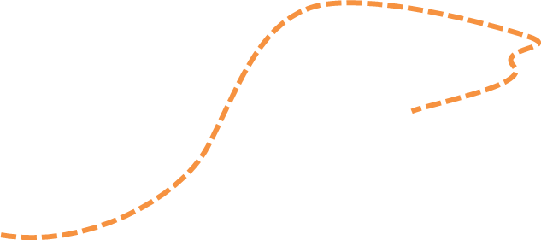

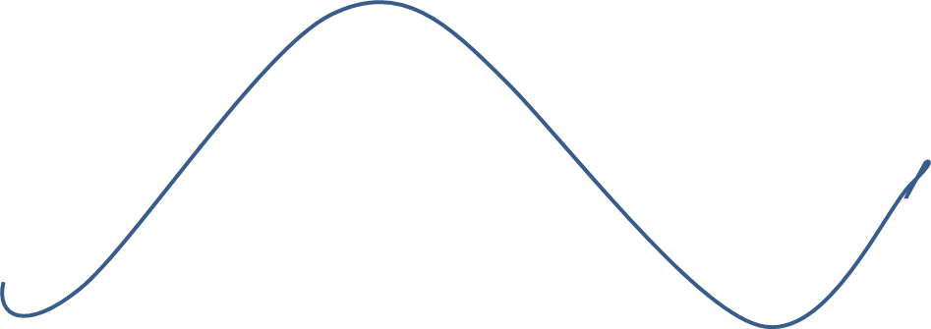
Moving to a New S Curve
Innovation Progress
Innovation Culture
Innovation Plateau
Newer Disruptive Processes, Systems, Thinking
Execution Culture
Newly Emerging Processes, Systems, Thinking
Innovation Culture
Maturing Processes,
Systems, Thinking
Disruptive Processes, Systems, Thinking
Time
Early Market
Mass Market
Adoption
Mature Market
Late Adopters
Most organizations become very good at incremental changes,--less radical. Successful s-curves are needed to replace older processes and continue to drive growth upwards.
SAPIENCE – SV
Notes:
Most organization become very good at incremental change, but less at “radical” change. Faster, broader transformation. Innovative companies will typically be working on new innovations that will eventually replace older ones. Successive s-curves will come along to replace older ones and continue to drive growth upwards.
Once returns to effort fall, it may be time to move to a new S curve…where are we now on this curve?
There is a recognition that the organizational capabilities, assets, structures, processes, best suited to exploiting this new s curve may not be the ones best suited to jumping to a new one.

Slide 28
LA-DHS : Future State of Patient Delivery
Restructuring Team
Restructuring Team
In-Patient
Ambulatory Care Clinics
Community
Physicians
Patient
Management
Quality Lab
HHC
Practitioners
Payers
Other Practitioners
Researchers
Unions
Consulting work focuses on Integrating LA-DHS components

Slide 29
Pathway to Creating Integrated Care in LA County
An Organizational Change Structure for Creating the new Health Agency
LA-DHS
LMC
LA-DPH
LMC
LA-DMH
LMC
Community Health Centers
LMC
Care Integration Task Force
Care Integration Work Group
Care Integration Work Group
Care Integration Work Group
Notes:
Agency LMTC – to meet initial for a 2 day retreat and then meet once a quarter
LMCs- to meet once a month

Slide 30
Lewin Change Model
Principle of Dynamic Tension
(Driving and Restraining Forces)
Unfreezing
Making
Changes
Continuous Change
Refreezing
Notes:
NOTES

Slide 31
Principles of Eco-Systems Transformation
Establish participation principles, governance structure, social contract, funds and resources
Getting everyone on the same page- securing organizational support
Leadership development – creating active union and management leaders
Operations driven process with union goals too
Education and training for frontline staff and management ( e.g. industry literacy)
Success in achieving high impact activities in strategic areas (either sector strategies or transformative changes)
Documentation and monitoring

Slide 32
You never change things by fighting the existing reality. To change something, build a new model that makes the existing model obsolete…
Buckminister Fuller

Slide 33
Key Factors for Creating a Successful Eco-System
Active union leaders
Co-generated development and implementation
New Roles (boundary spanning)
New Work Systems as a result of innovation and disruption
Creating and nurturing strategic partners
Networks---flexible teams
Managing the finances while going through major changes

Slide 34
Current status of activities
Radical expansion of 3 to 4 PCMHs to have more engagement with community groups and full engagement of behavior health and public health (improving population health)
Conducted educational programs on: Creating a Just Culture
Expanding the number of Healthcare Transformation Advocates
Extensive restructuring of SEIU local 721
Agreement on employment security
And contemplating deep community engagement strategies s

Slide 35
The problem is not that we can’t find solutions but we can’t get people to work together on them.
Charles Heckscher— from Understanding Trust and Community

